Slide 1
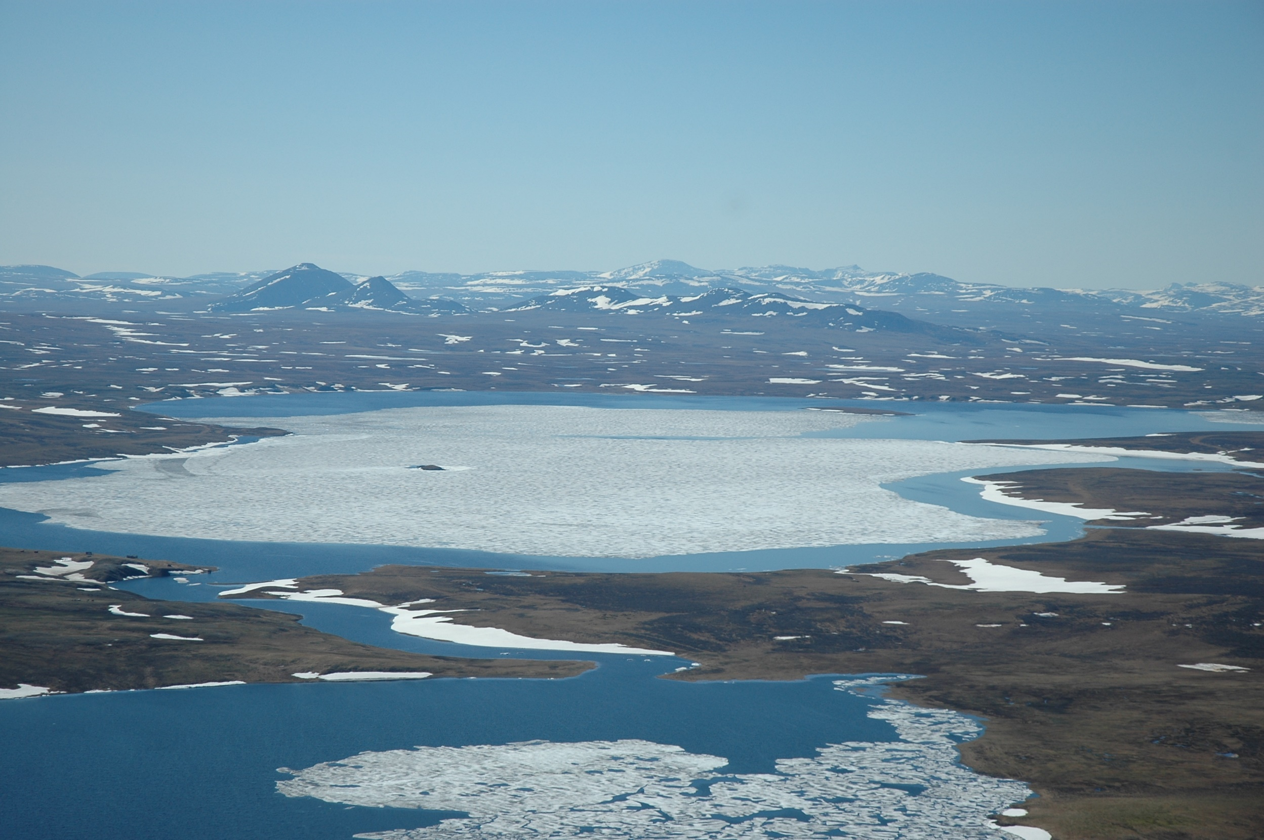
Methods of collective hunting for large ungulates among the population
of North Asia
in archeology and ethnography
Oleg Kardash
Surgut State University, Surgut, Russia
Ekaterina Girchenko
Institute of Archaeology and Ethnography SB RAS, Novosibirsk, Russia

Slide 2
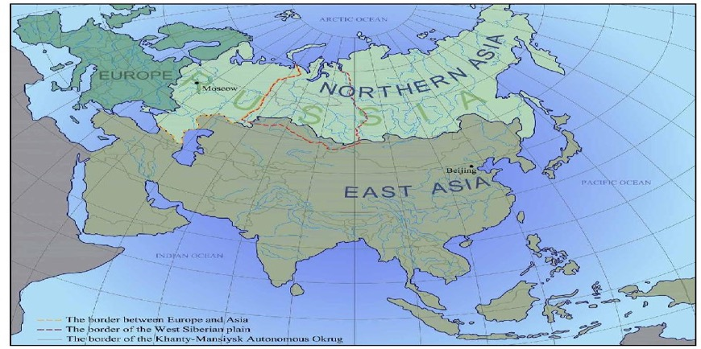
Durability and constancy of the indigenous peoples traditions of the north of Siberia allow us to reconstruct the traditional way of life at the rather wide chronological period - from the middle of the 7th-6th millennium BC and until the middle of the 20th century. This wide range can be explained by stability of natural conditions in the taiga region of Western Siberia, stable biocenosis and stable results of hunting.

Slide 3
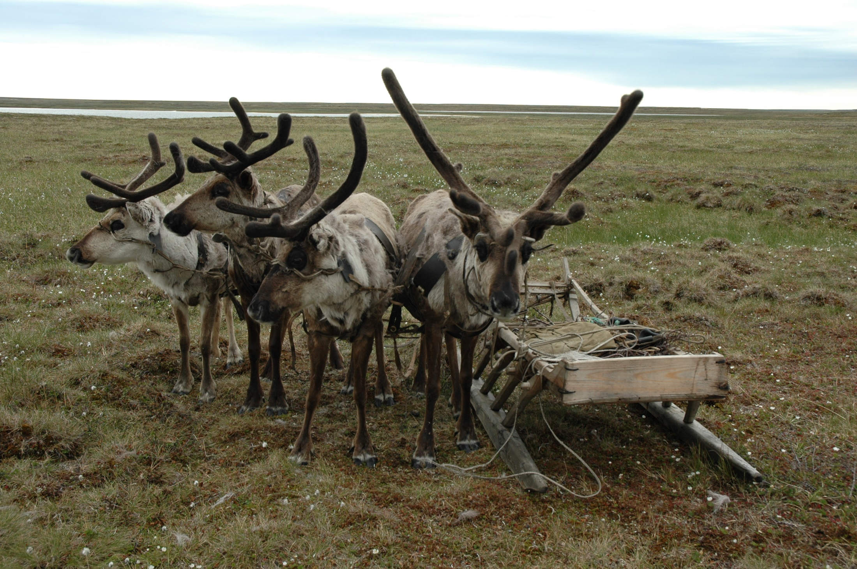
Domesticated reindeer were used only as transport, no more than 10-15 reindeer for one family. Stability of food species and their abundance provided food. The main food species, according to archeozoology, were large ungulates - reindeer and elk.
The North of Western Siberia. The Yamal Peninsula. The Nenets. Narten transport. Photo by Kardash O.

Slide 4
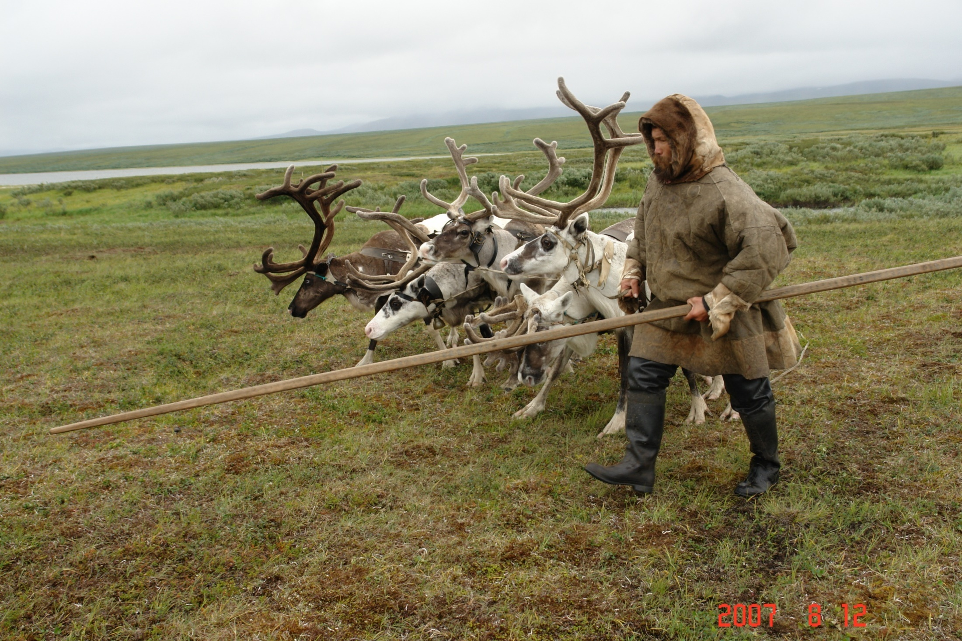
The most effective way to hunt for herd animals were passive hunting with the use of pitfall trap systems or corral hunting with leather net traps. Both ways of hunting are based on the natural seasonal migrations of animals. The food ration was also supplemented by fish. The hunting for other animal species had either ritual or trade purposes.
The North of Western Siberia. The Yamal Peninsula. The Nenets. Photo by Kardash O.

Slide 5
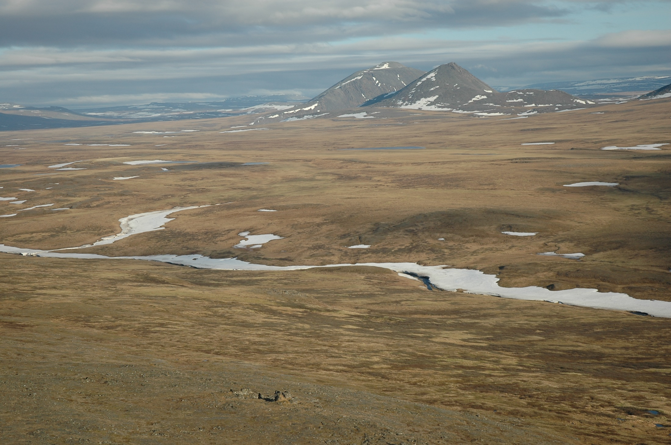
Collective hunting, when all members of the ancient community were somehow involved at the different stages, its features and basic methods are closely related to the landscape and the biocenosis. Collective hunting due to geographical conditions, it is not suitable for all territories, but in the Far North of Asia, on the West Siberian Plain the necessary conditions existed.
The North of Western Siberia. Tundra. Arctic desert. Photo by Kardash O.

Slide 6
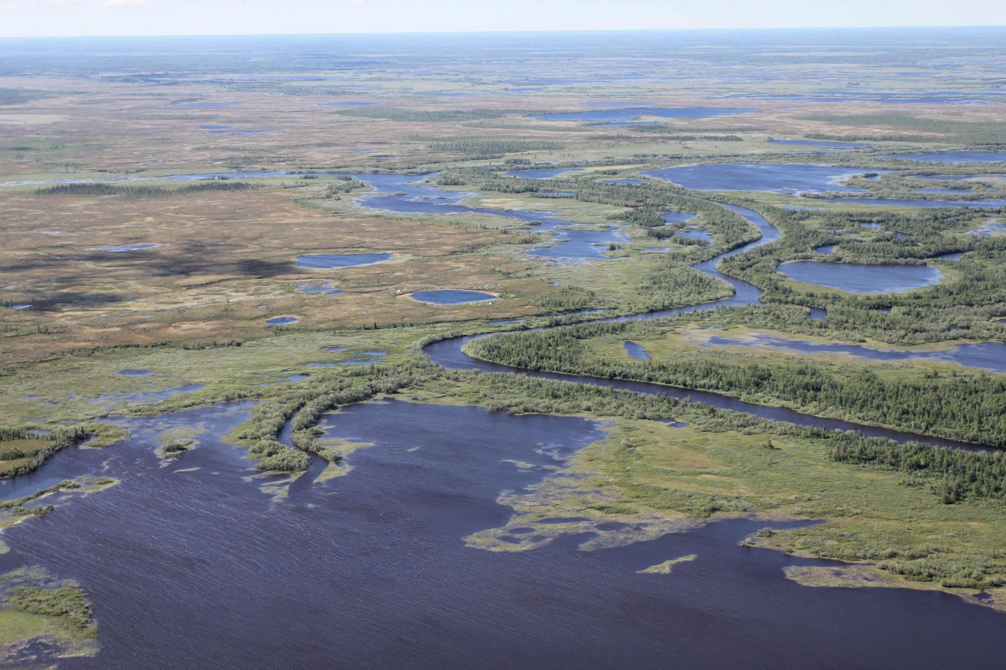
Annually thousands of herds of wild reindeer made meridional seasonal migrations. Collective hunting made it possible to obtain a large number of food resources for a long time and it meant stable survival.
The North of Western Siberia. Forest tundra. Northern taiga. Photo by Kardash O.

Slide 7
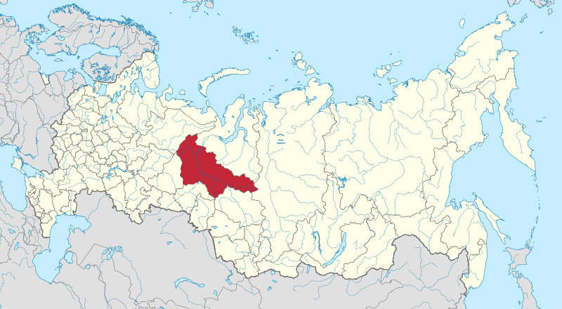
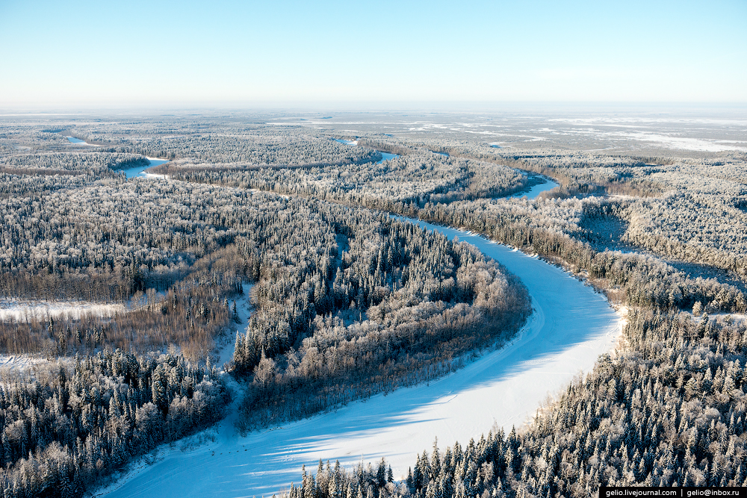
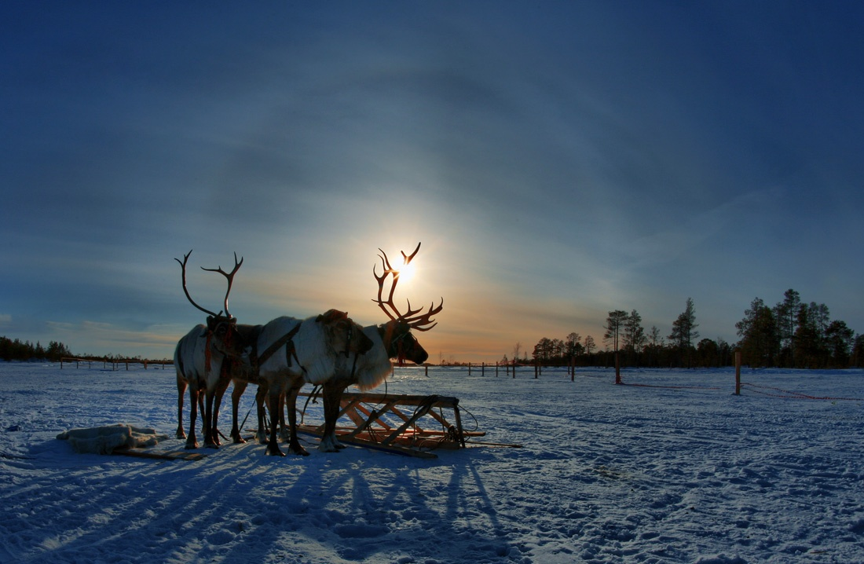
Is located in the central part of the West Siberian Plain, practically the entire territory is located within one natural zone - the middle taiga. 52% of the territory are forests. The Yugra is a homeland for such indigenous peoples as Khanty, Mansi, Komi, Nenets, etc. The archeology of this region has been studied unevenly. In Yugra, there are approximately 5,800 archaeological sites from the Upper Paleolithic to the late Middle Ages, about 900 (20%) of this list are groups of pitfall trap systems which are special interest for this study.
Khanty-Mansi Autonomous Okrug — Yugra

Slide 8
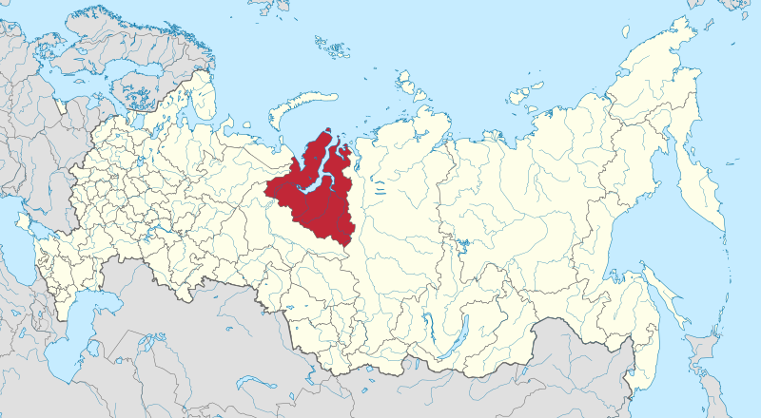
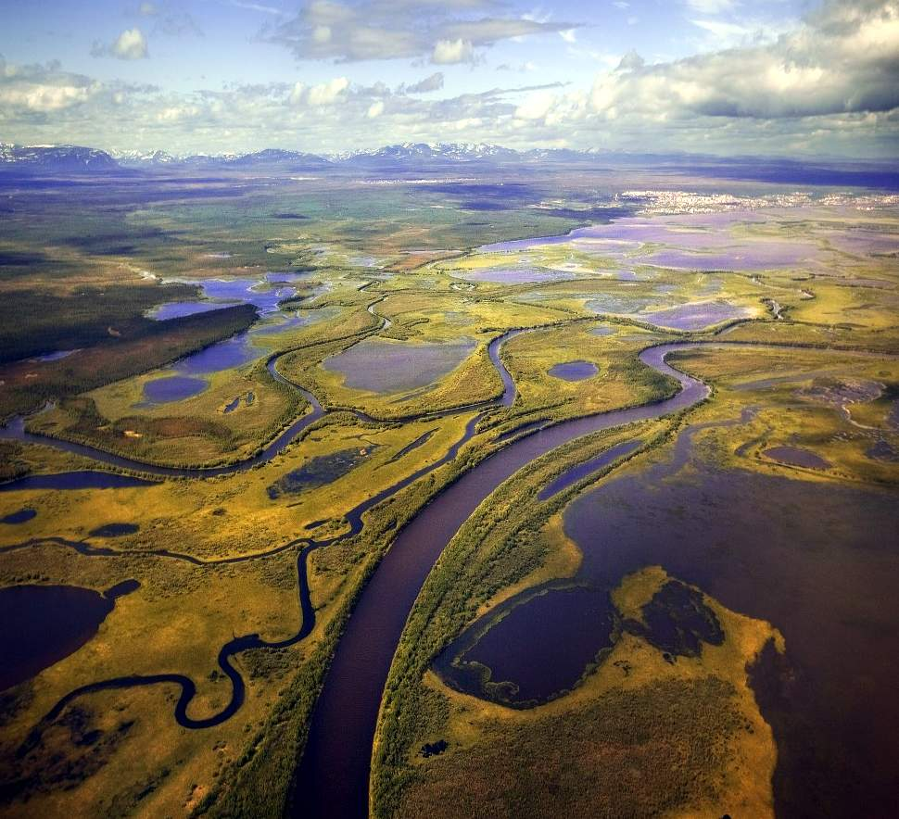
Is located in the north of the West Siberian Plain, it is the region of Far North and more than half of its territory is located beyond the Arctic Circle. This is the zone of taiga in the south, forest-tundra and tundra in the north with many lakes and marshes. Indigenous peoples are represented by the Nenets, Khanty, Komi, Selkups, etc. In the Yamal-Nenets Autonomous Okrug, about 550 archaeological sites have been found, about a 100 of them are classified as pitfall traps, they are mainly in the forest-tundra zone, mainly in the territories adjacent to the Yugra borders.
Yamal-Nenets Autonomous Okrug

Slide 9
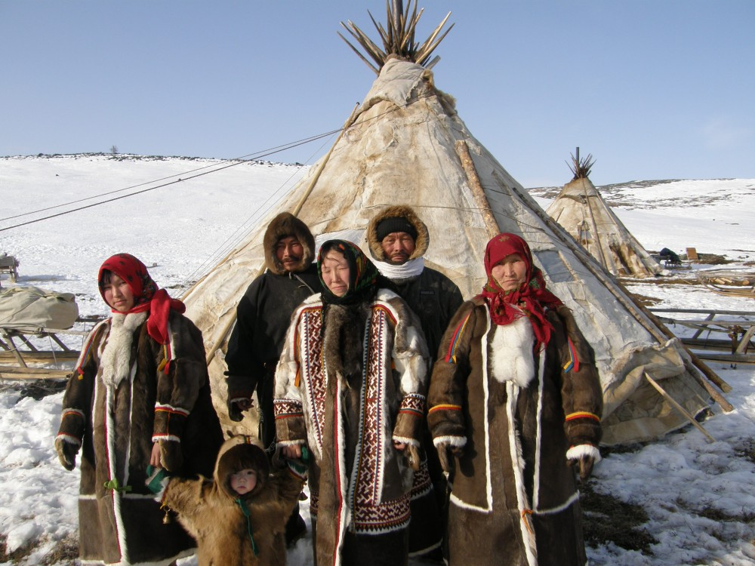
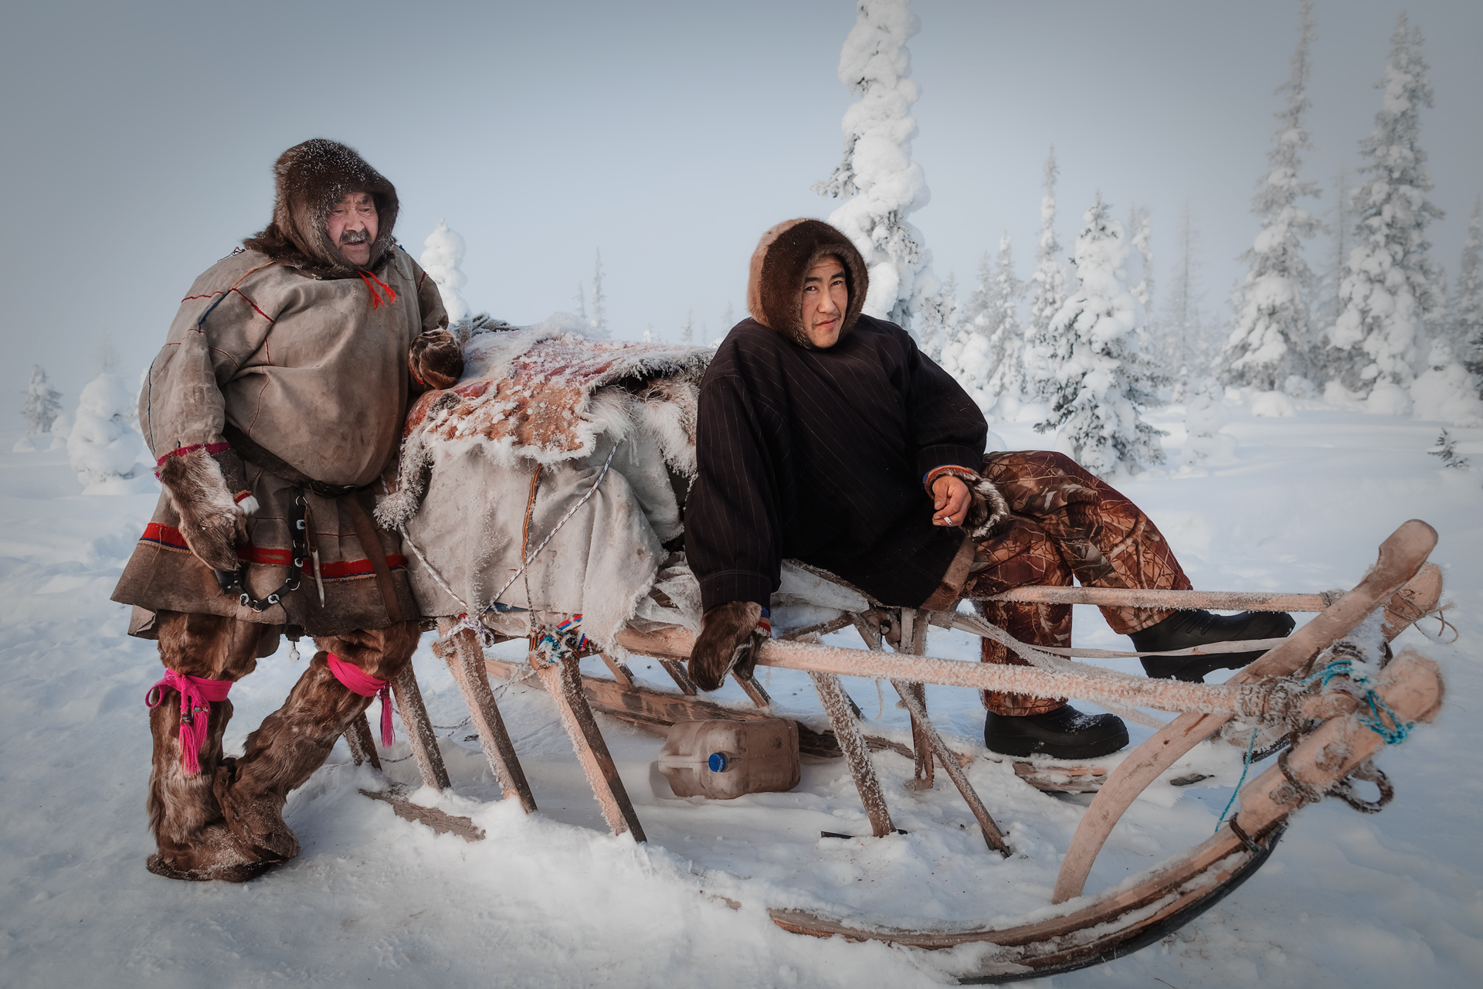
20% of archaeological sites of hunting economy in the zone of the northern taiga is a general indicator from the Upper Paleolithic to the Middle Ages. Most of the sites belong to the Neolithic - the middle of the first millennium AD.
But in the south, in the steppe, there are no this type of economy, in the Russian European north-east this type of sites is extremely rare, there are no publications or scientific excavations, which is incomparable with the massive number of this type of sites in Siberia.

Slide 10
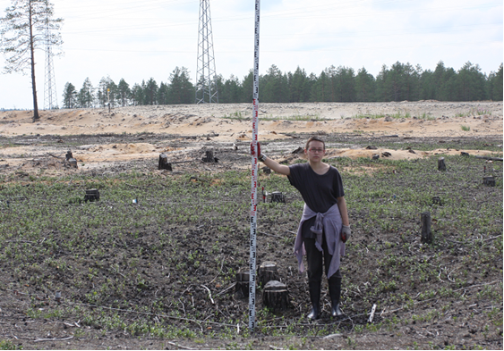
There are single hunting pits, there are systems of several of them of different stage of preservation, some of them are dug in chains, stretched in a line, some are located chaotically.
Pitfall traps on Balinskoe 63 site before excavation works,
Yugra, July 2016. Photo by Girchenko E.

Slide 11
A chain of pitfall traps on plan and
the stratigraphy of one of them on Kedrovaya 20 site
Photo by Rudkovskaya M.

Slide 12
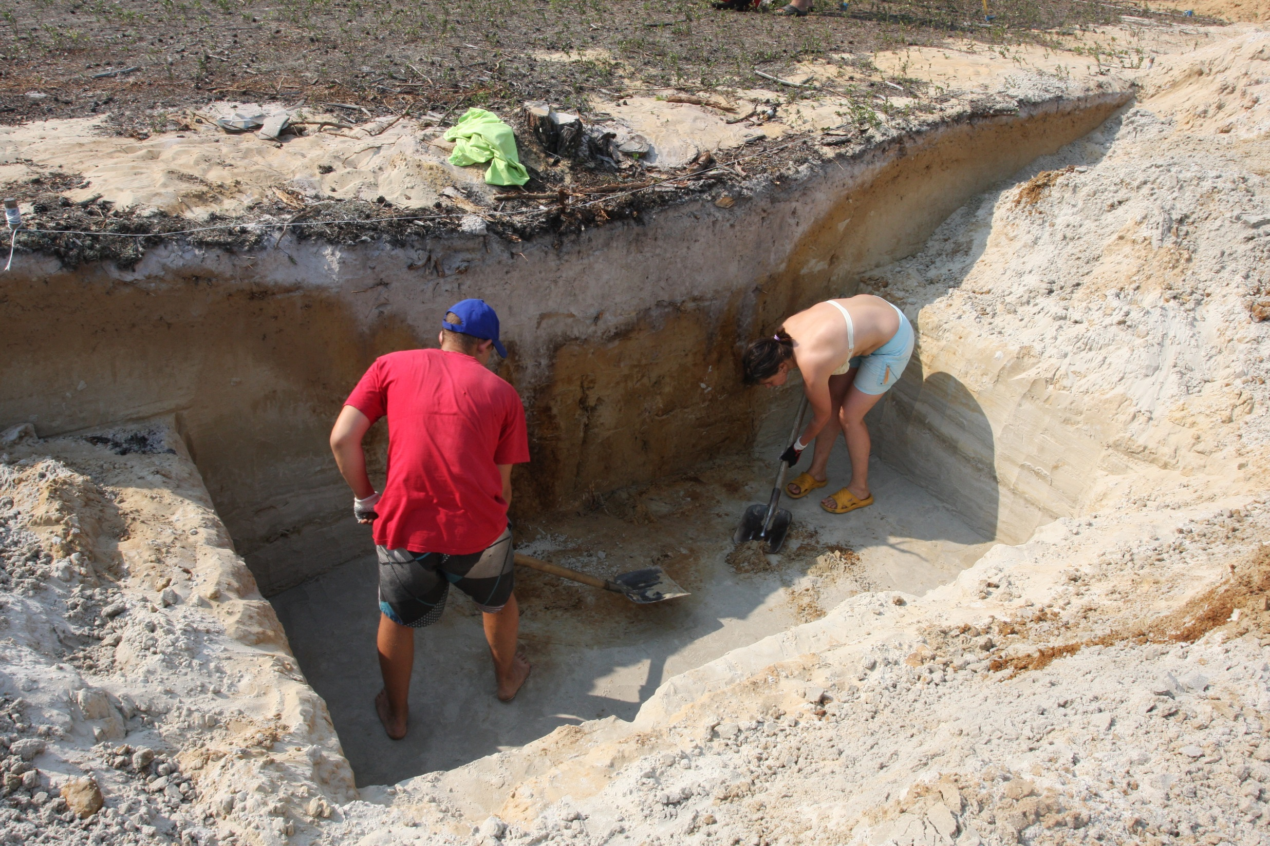
Some pits are square, cone-shaped or sub-rectangular in shape, sometimes up to 3 m deep. Average depth is 1, 5 m. The size depends on the hunting object, most of them are for reindeer, the main food resource for this territory from the Upper Paleolithic.
The excavation of pitfall traps of Balinskoe 63 site, Yugra, July 2016. Photo by Girchenko E.

Slide 13
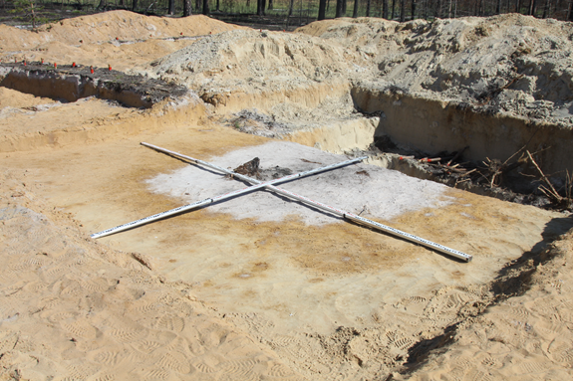
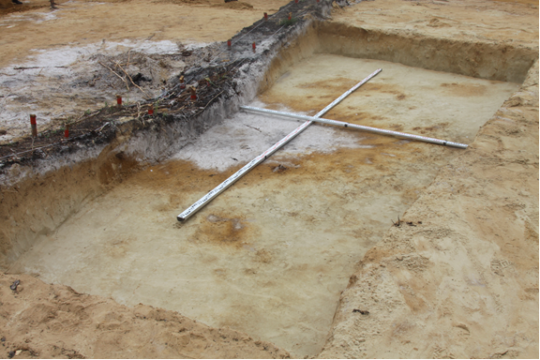
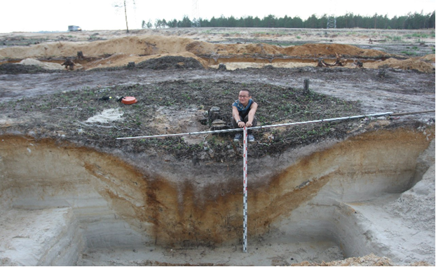
The excavation works of pitfall traps on Balinskoe 63, Yugra, July 2016. Photos by Girchenko E.

Slide 14
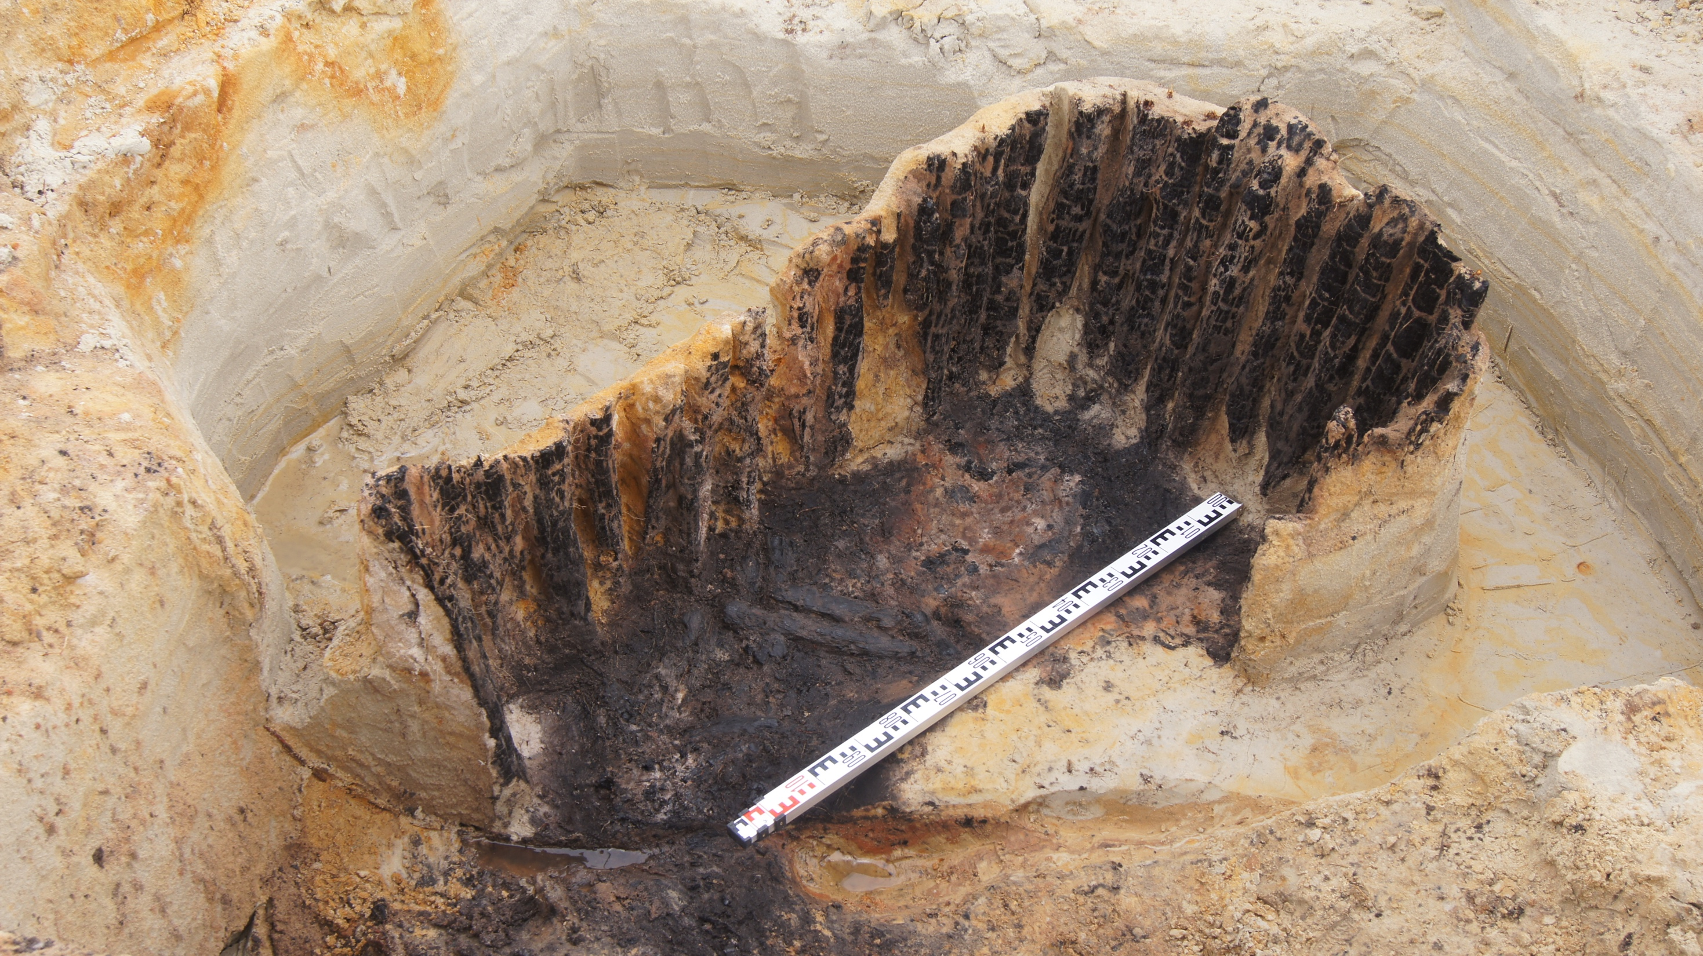
The wooden constructions of pitfall traps of Kedrovaya 20, Yugra, 2015. Photo by Rudkovskaya M.

Slide 15
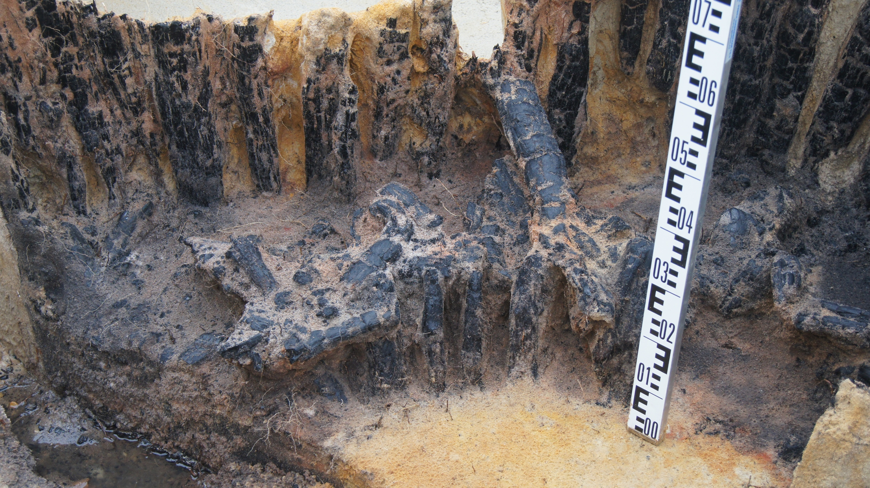
The wooden constructions of pitfall traps of Kedrovaya 20, Yugra, 2015

Slide 16
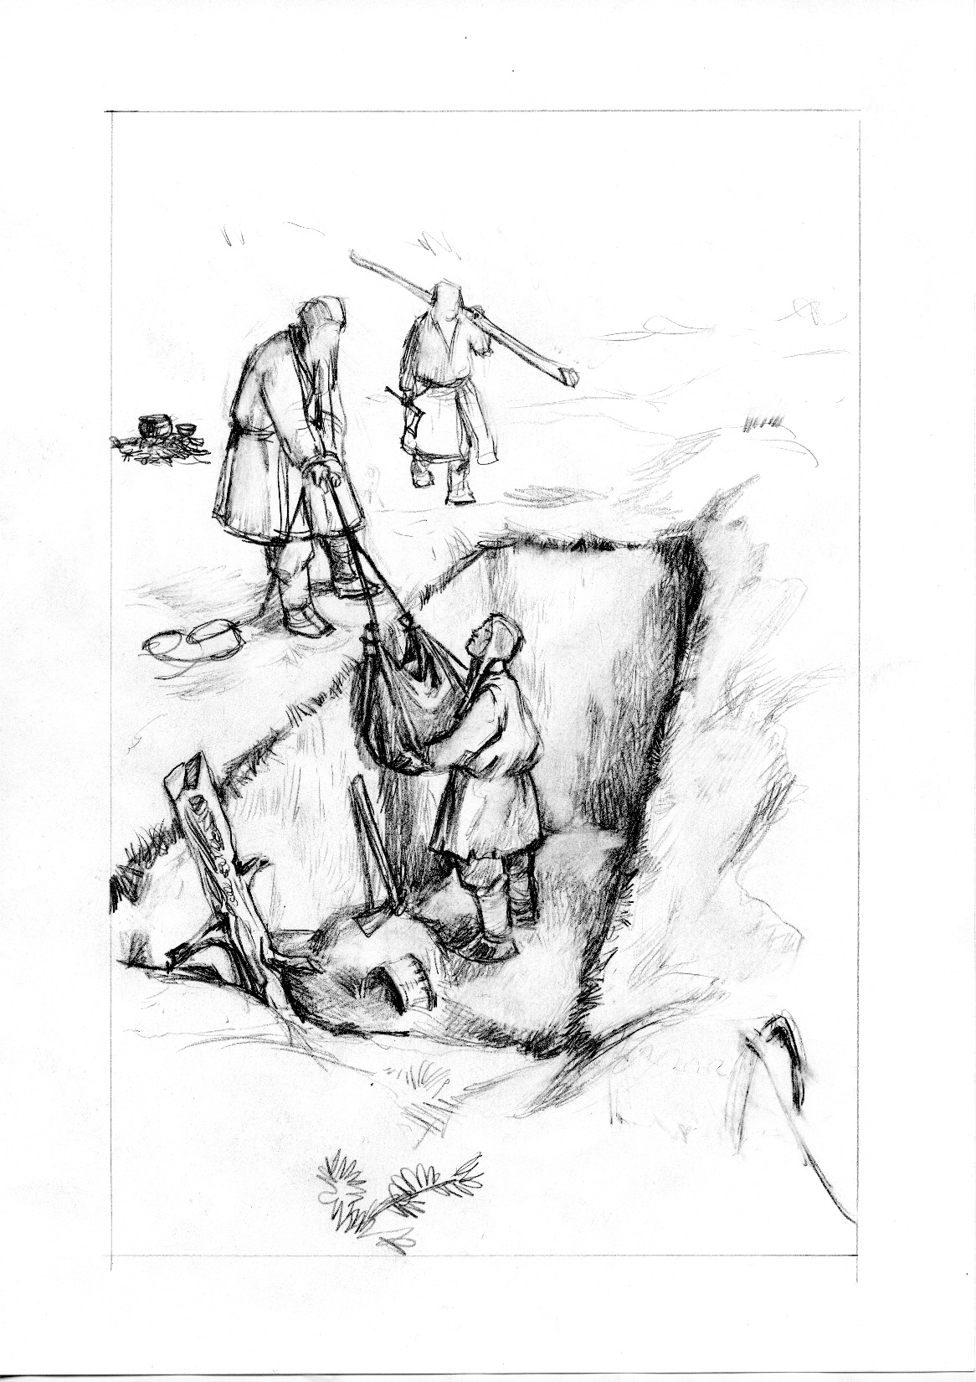
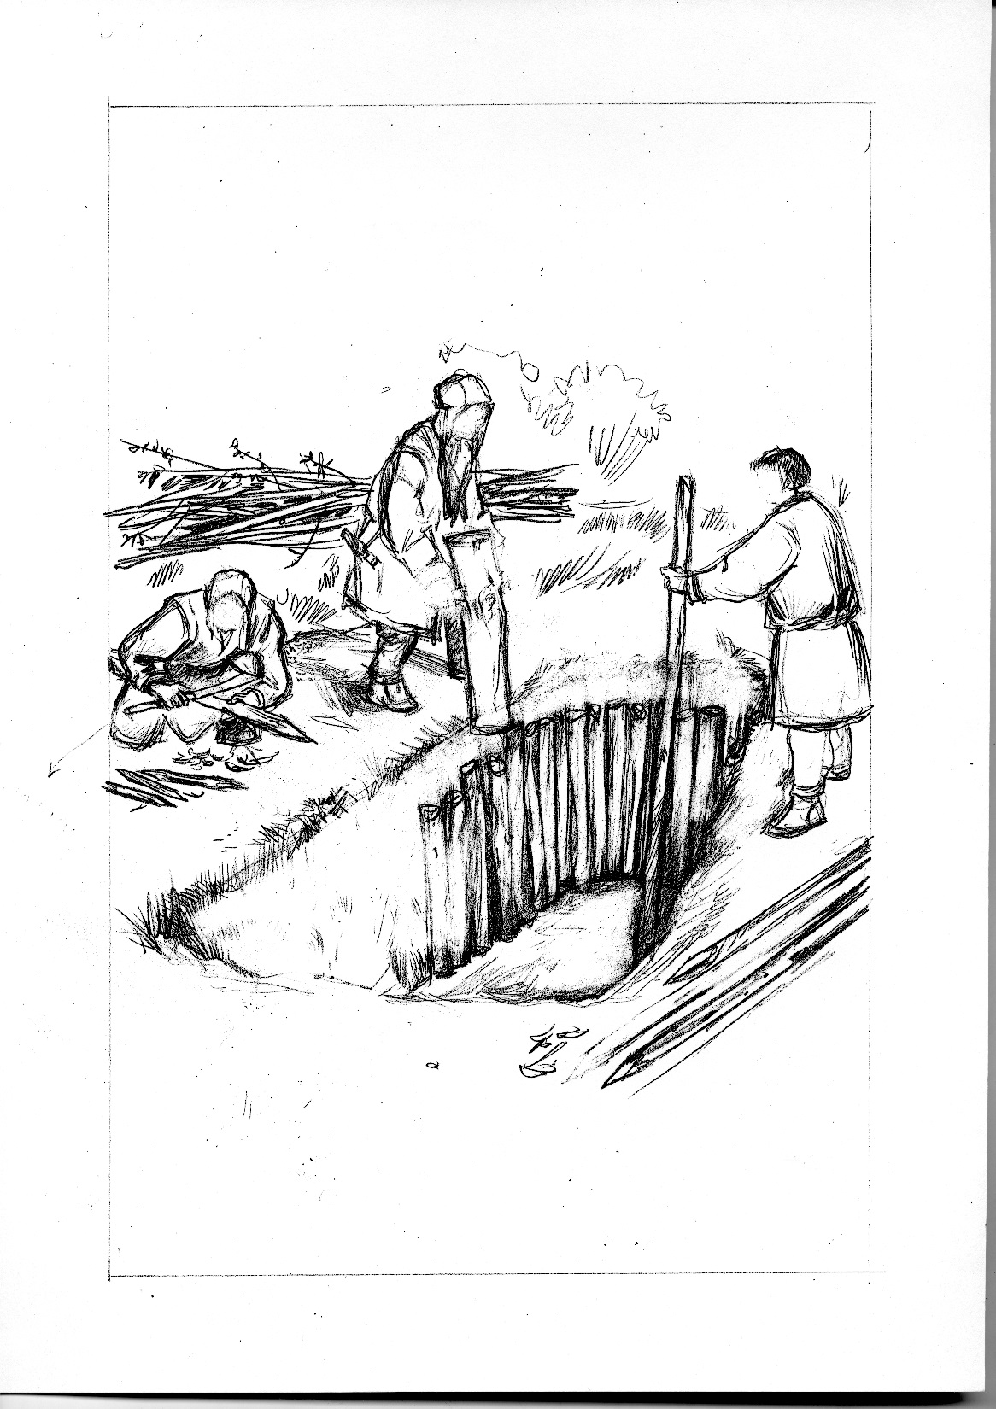
The reconstruction of making a pitfall trap, the drawings by Kuhterin A.

Slide 17
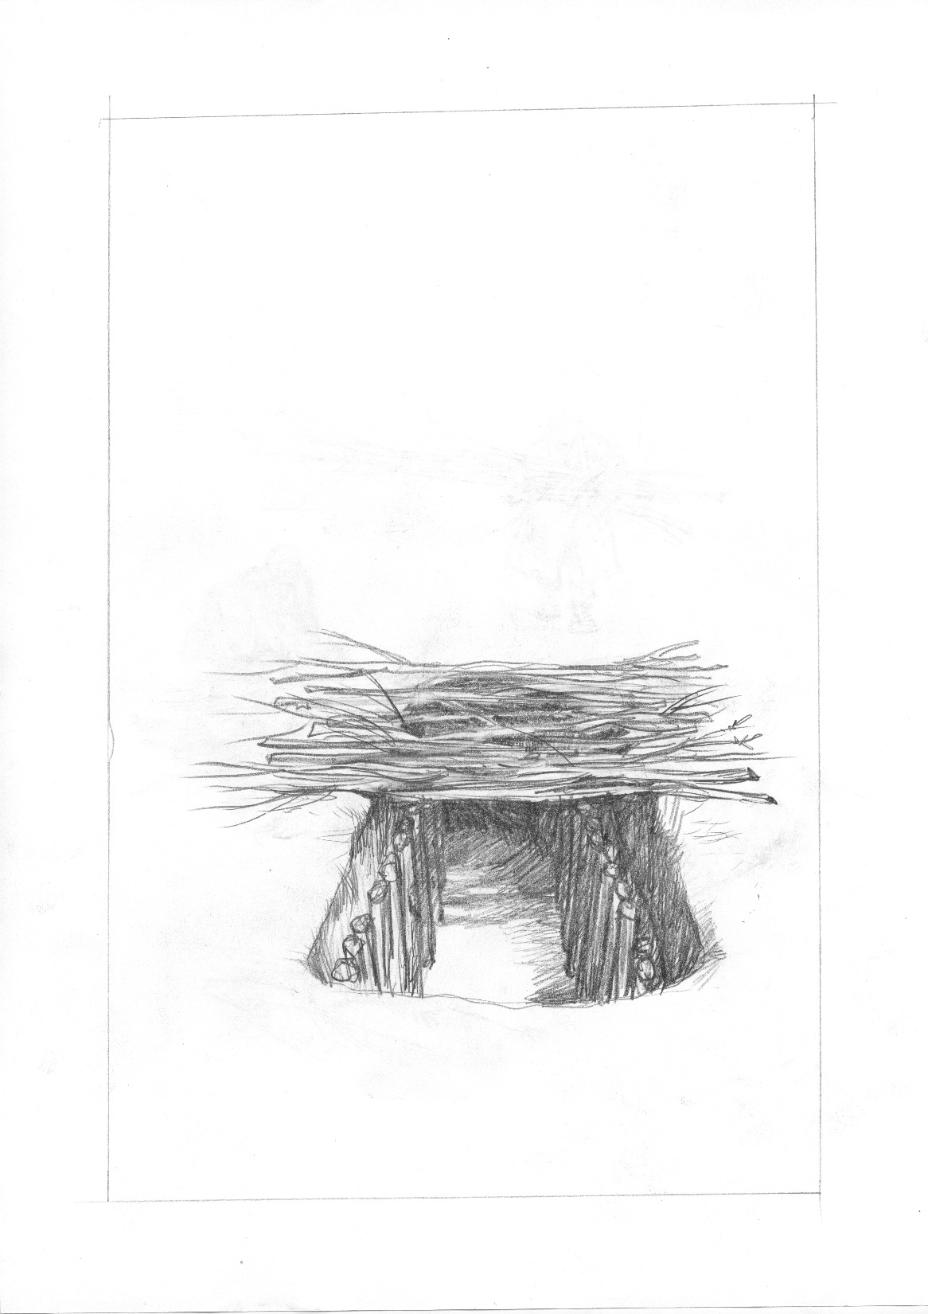
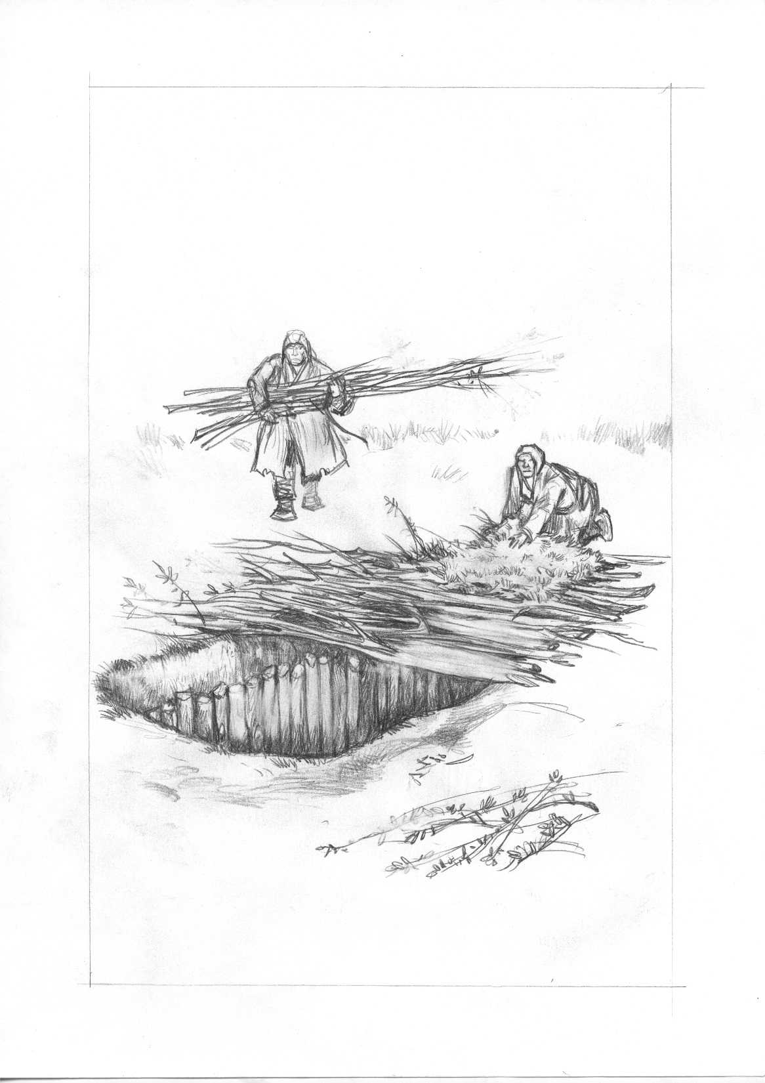
The reconstruction of making a pitfall trap, the drawings by Kuhterin A.

Slide 18
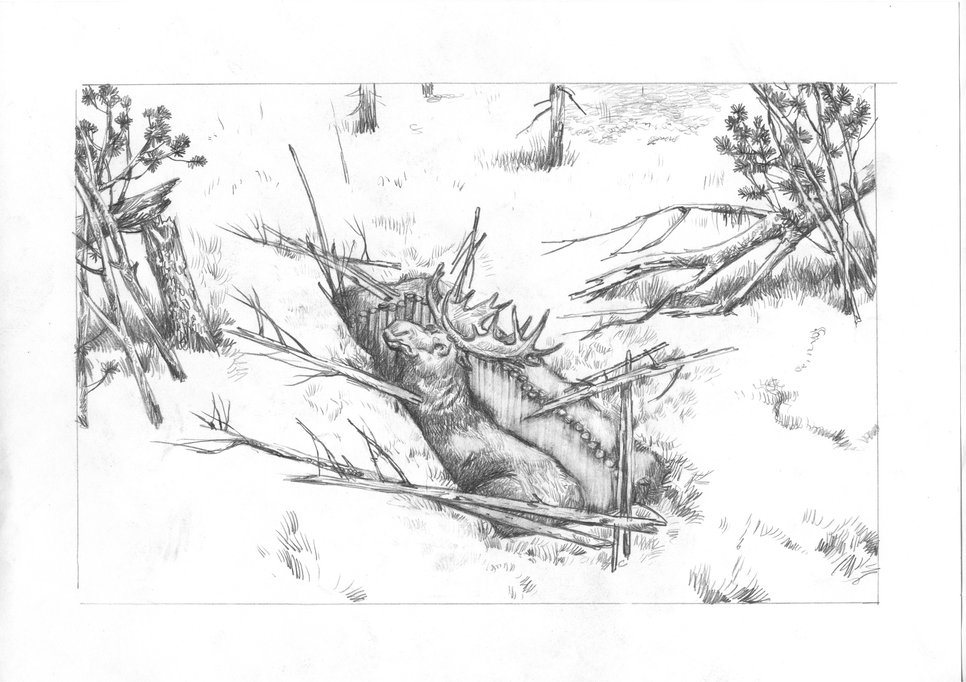
The reconstruction of a pitfall trap and a fence system, the drawings by Kuhterin A.

Slide 19
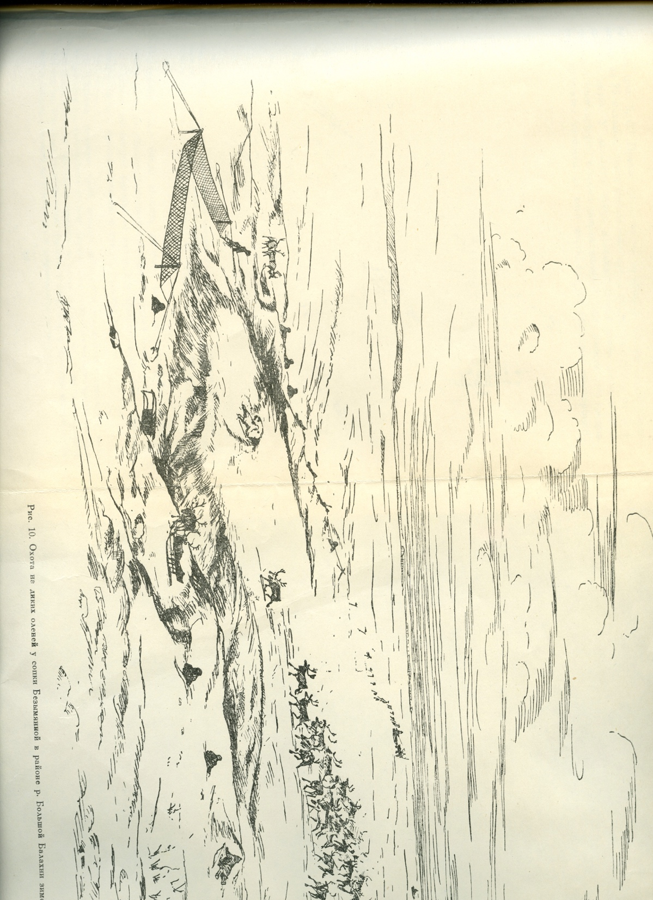
The corral hunting with nets on the reindeer natural migration routes, the drawing by Popov A.
The corral hunting with the help of stationary devices such as nets on the reindeer natural migration routes, the drawings by Kuhterin A.

Slide 20
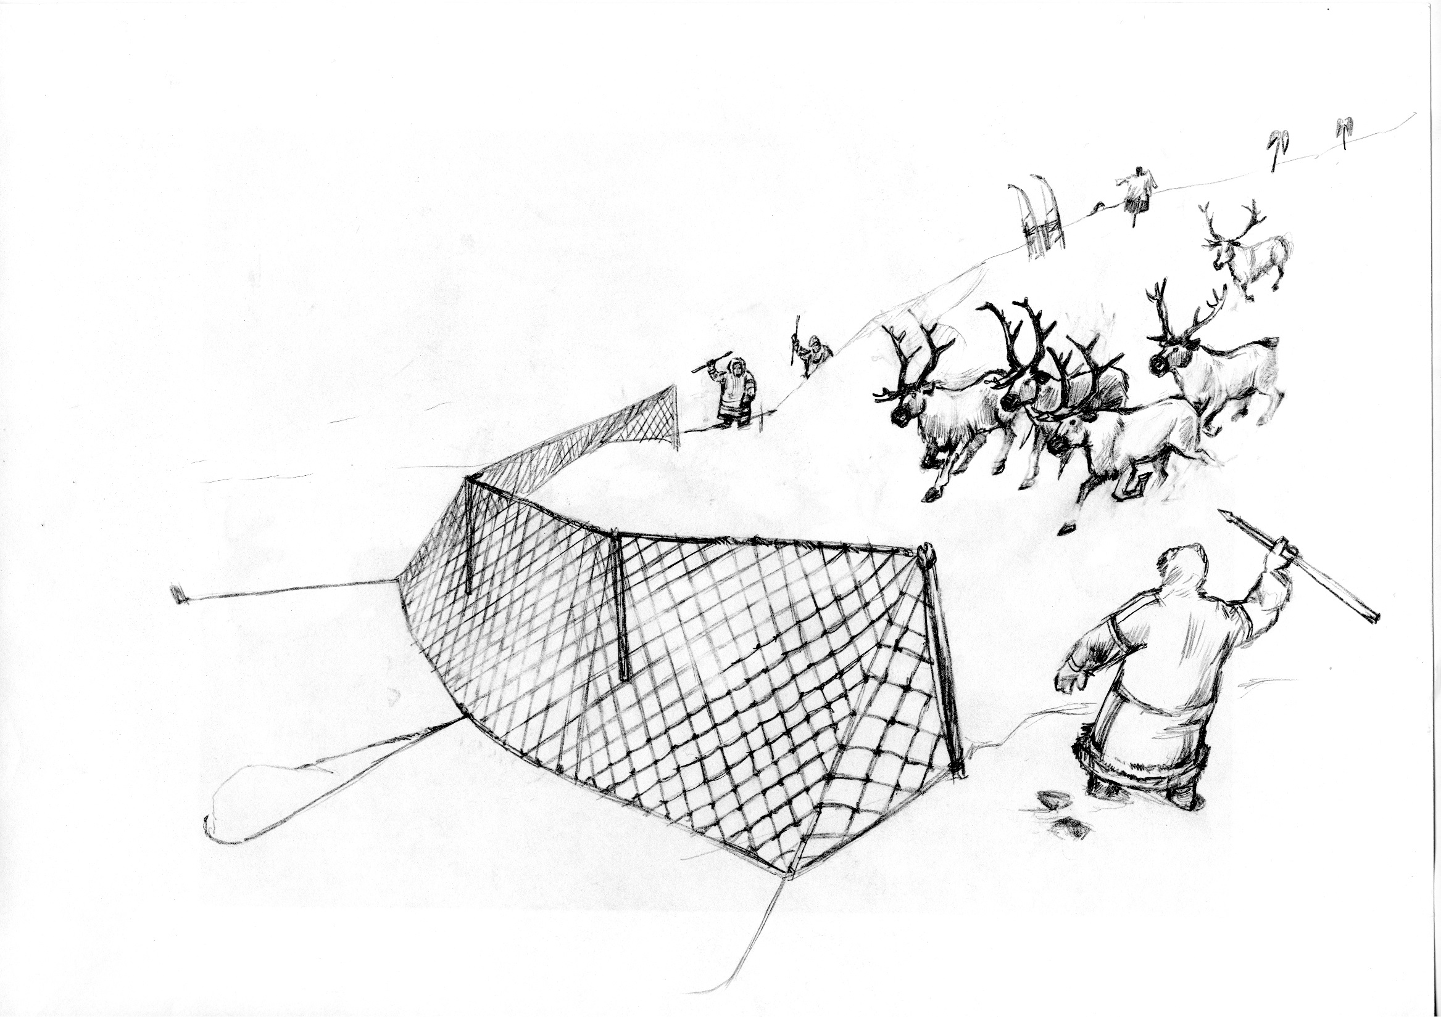
The corral hunting with the help of nets on the reindeer natural migration routes, the drawings by Kuhterin A.

Slide 21
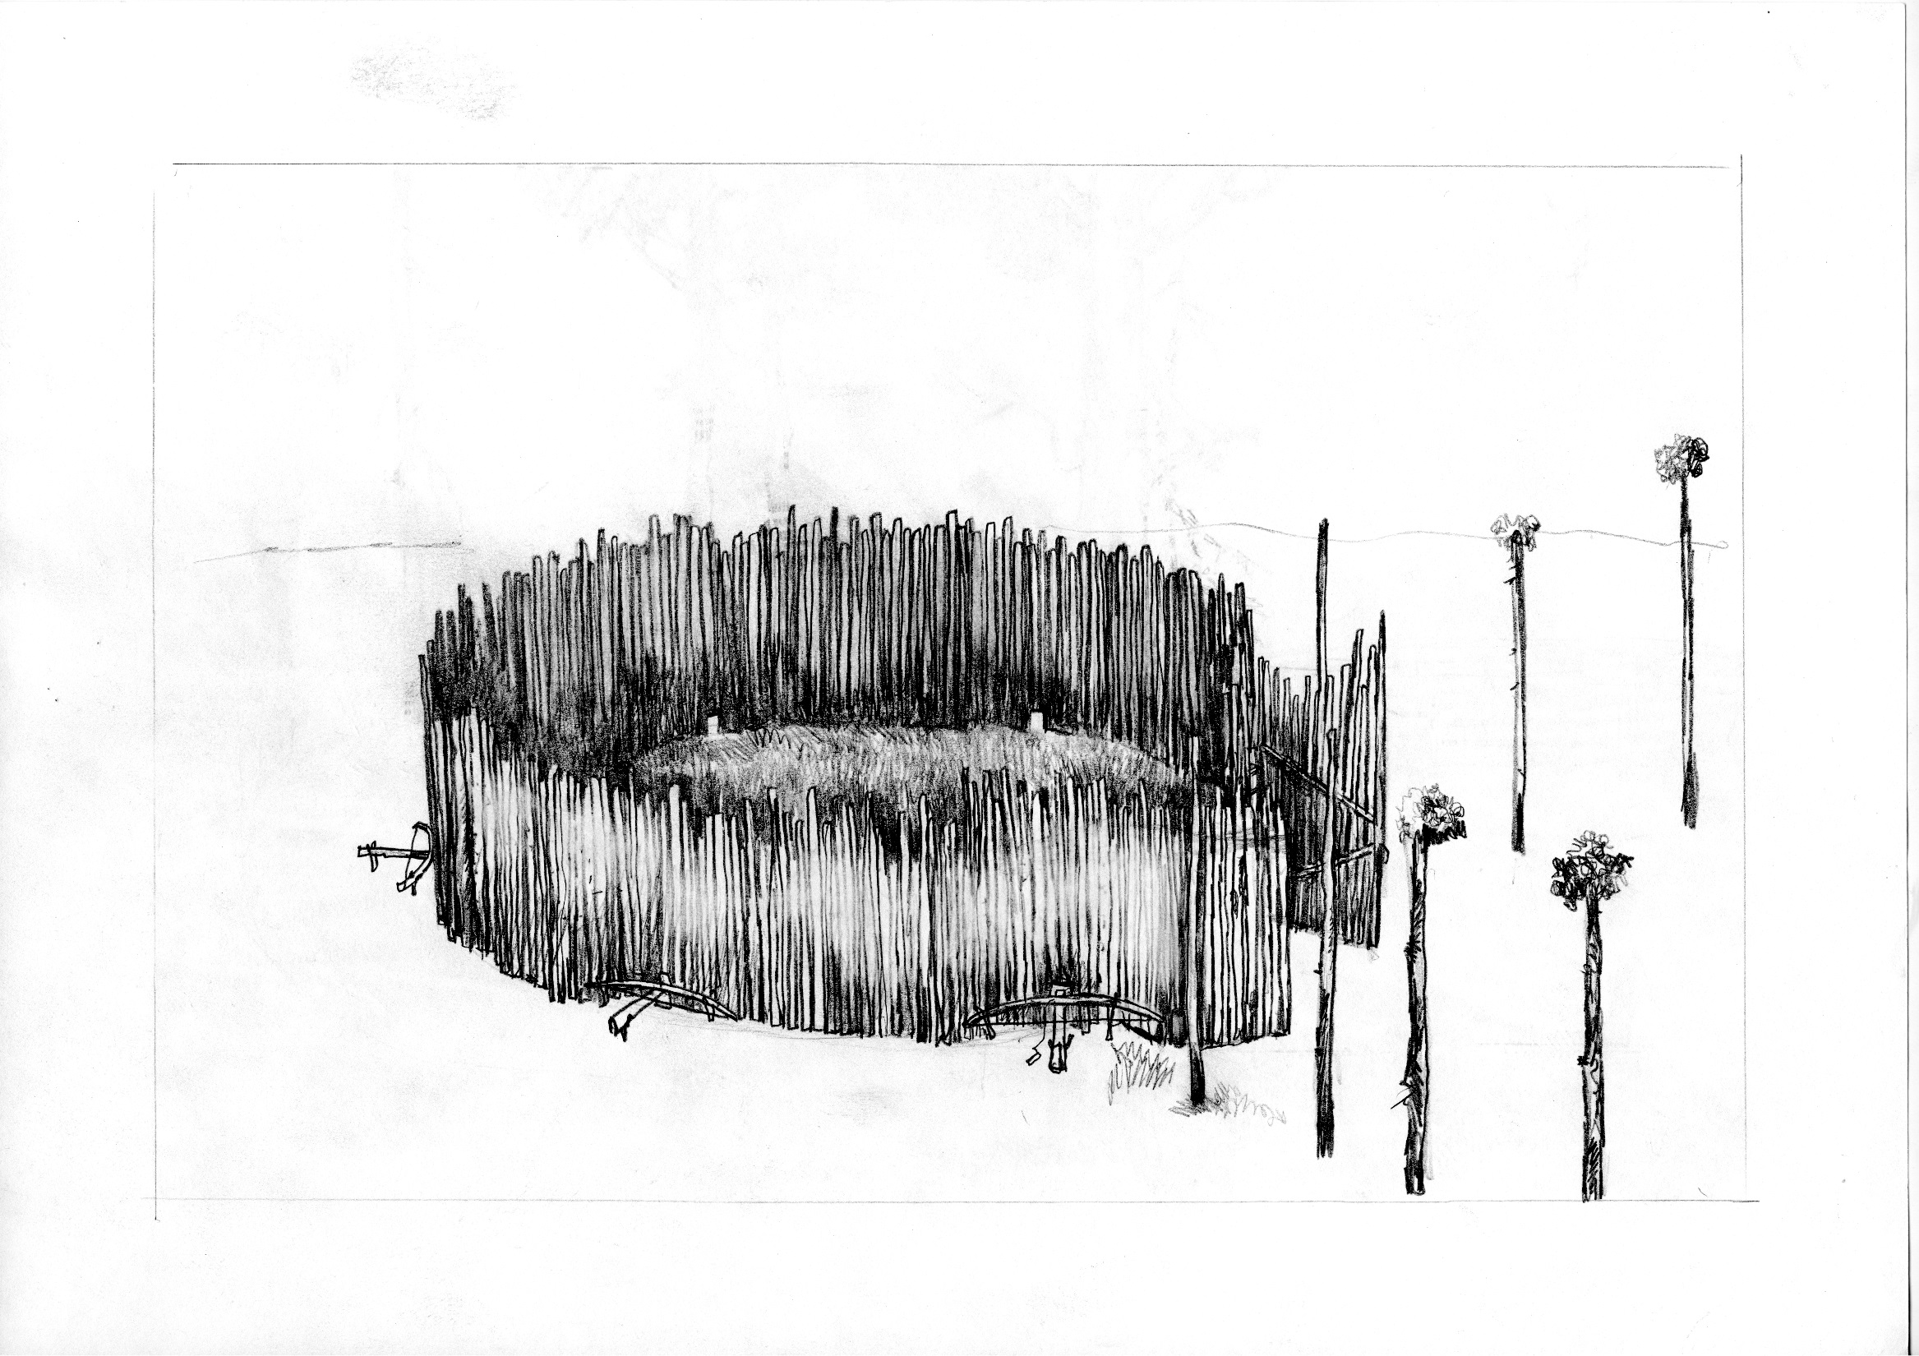
The corral hunting with crossbows on the reindeer natural migration routes, the drawings by Kuhterin A.

Slide 22
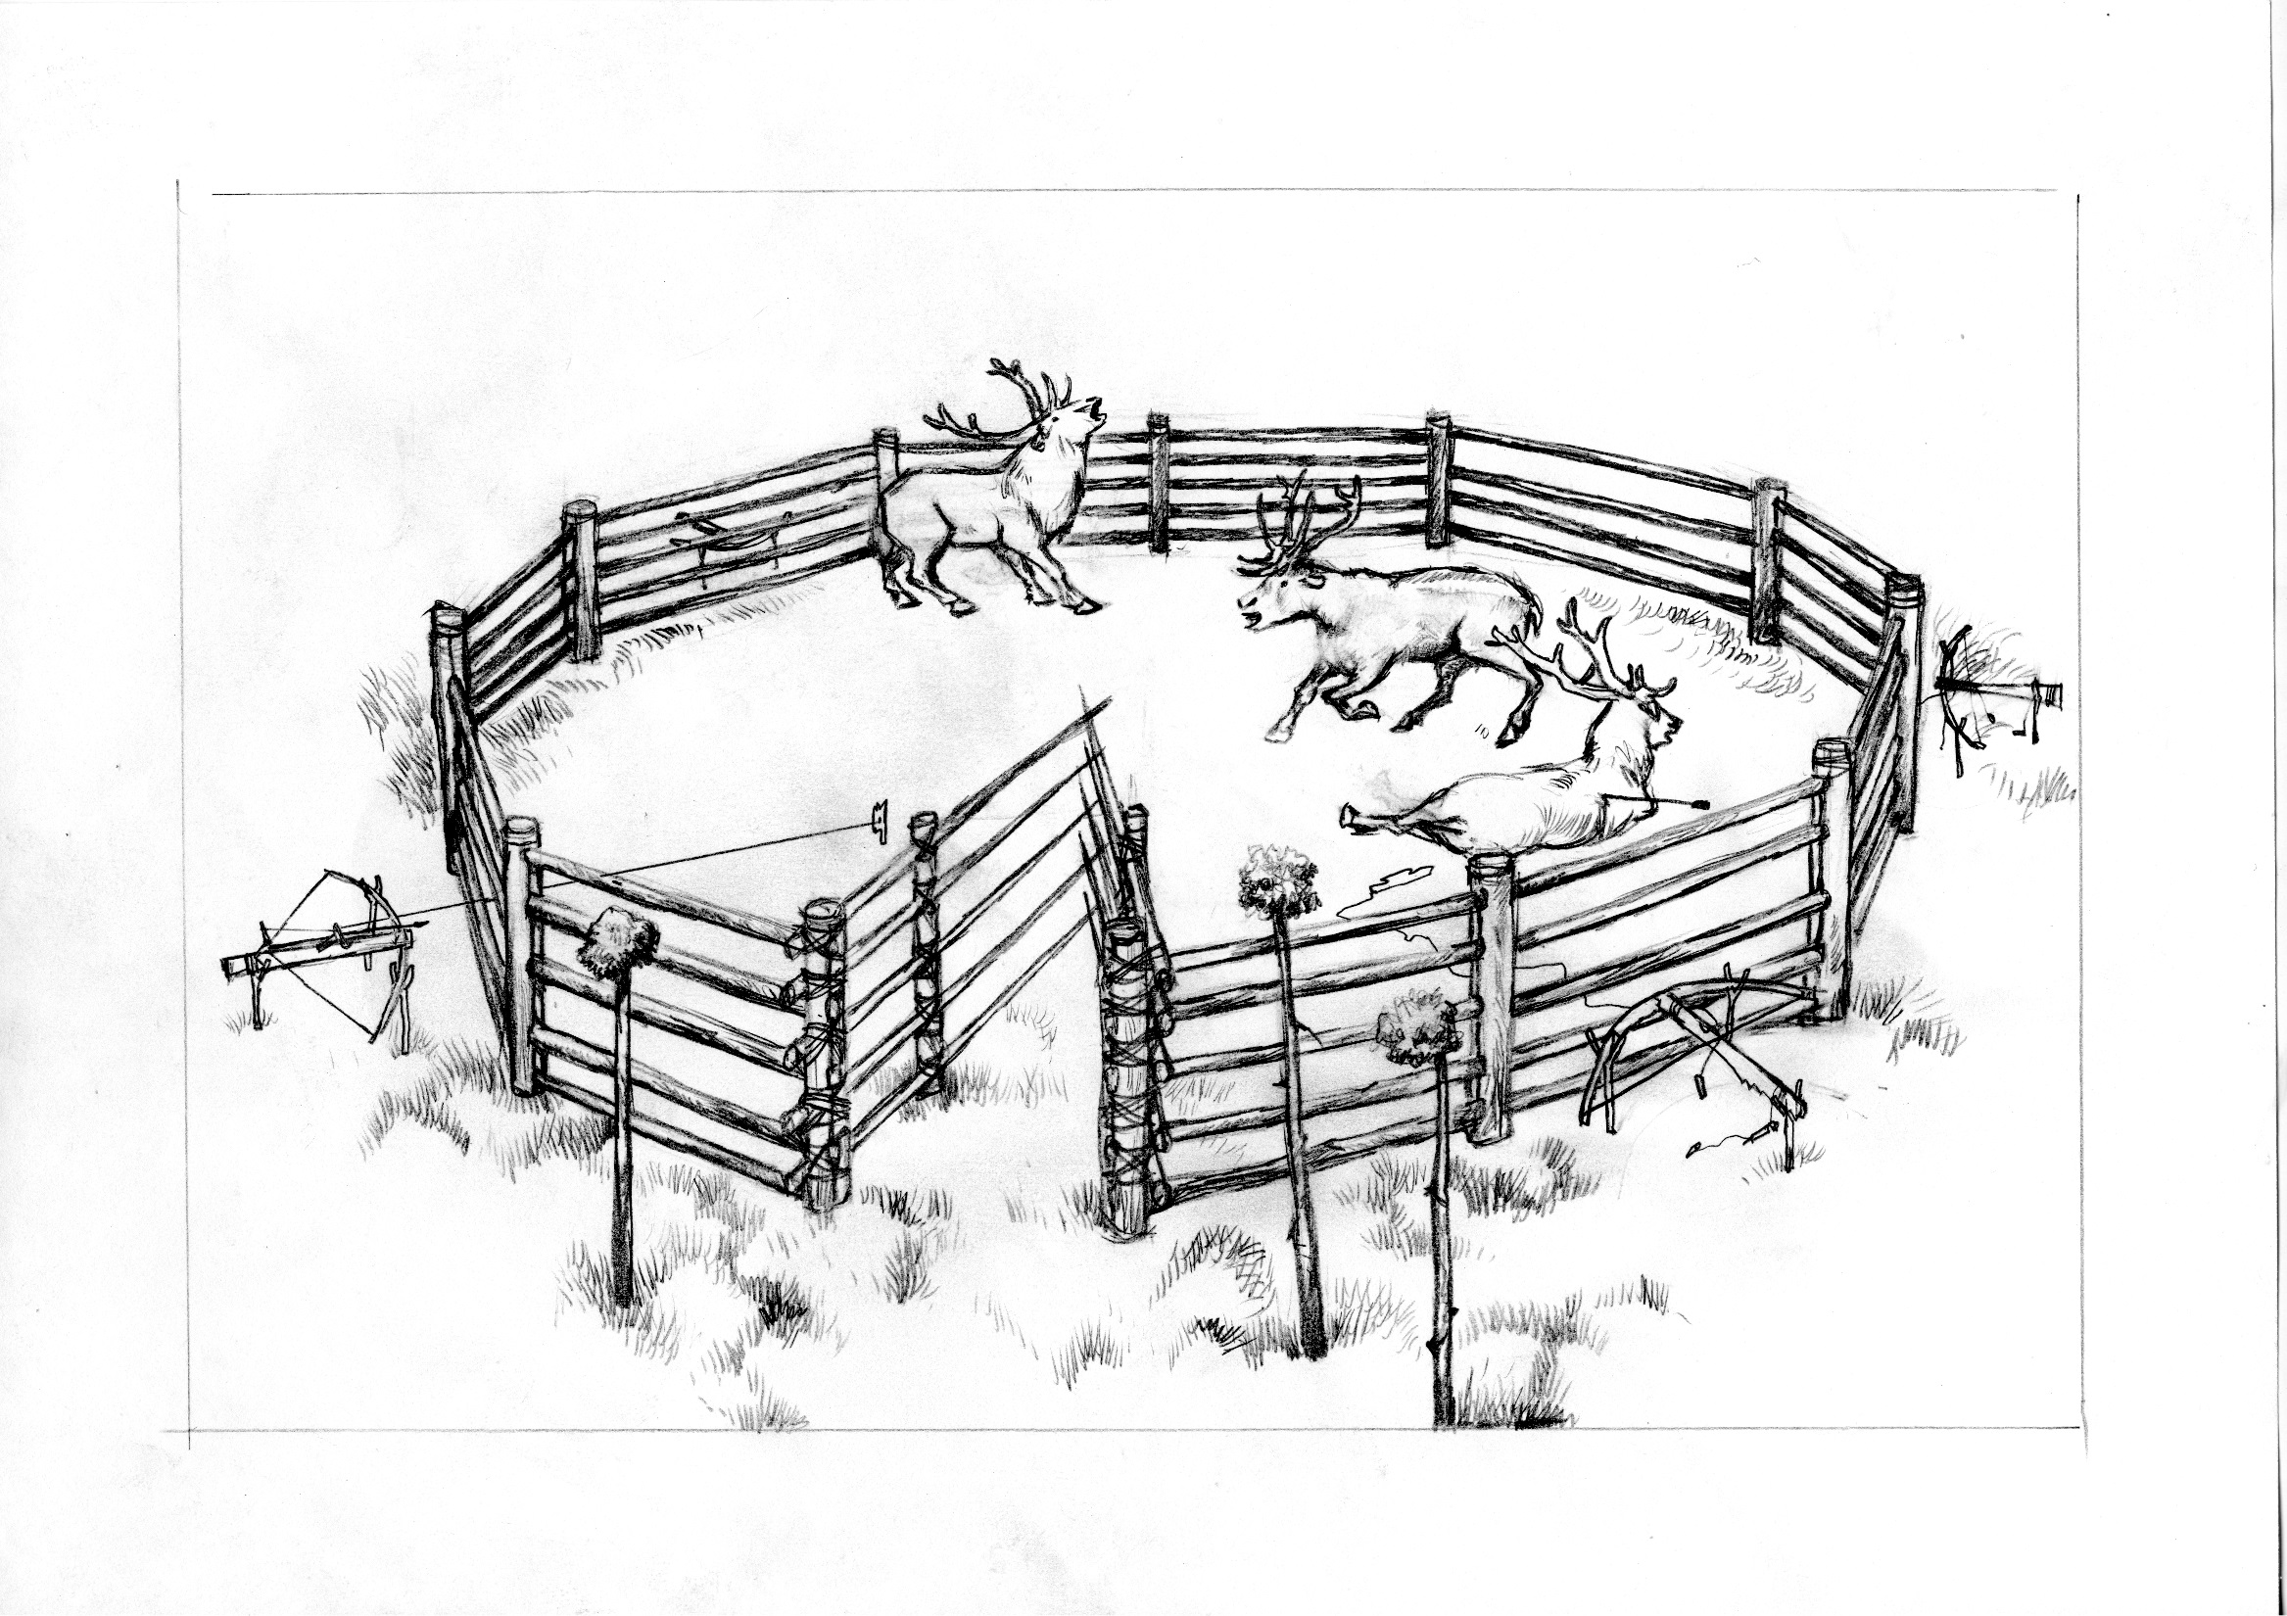
The corral hunting with crossbows on the reindeer natural migration routes, the drawings by Kuchterin A.

Slide 23
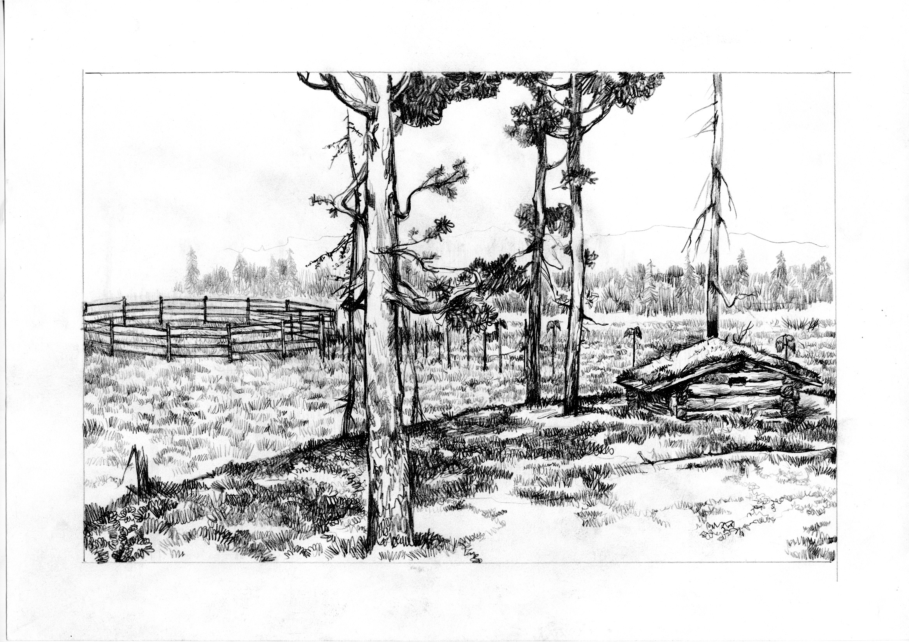
A hunter watching the reindeer to come from the hunter’s hut, the drawings by Kuchterin A.

Slide 24
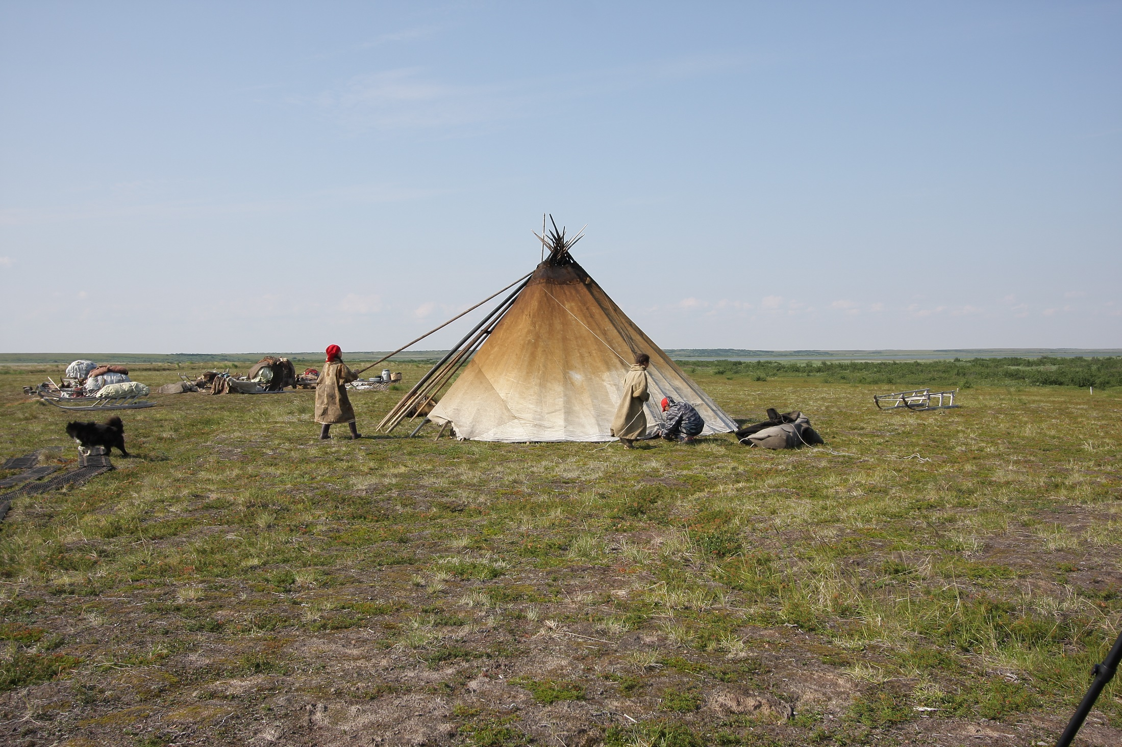
The Yamal Peninsula. The modern summer settlement of Nenets. Photo by Kardash O.

Slide 25
One more specific feature of the north of Western Siberia is the almost complete absence of stone for making stone tools. The finds of stone tools are rare, there are a few arrowheads from the settlements. In the burials there are no more than two or three of them.
There were bows and arrows, but stone arrows were not widespread for use, even bone arrowheads were rare, because to make a bone arrowhead in the Stone Age there should be a suitable stone tool.
So it is possible to conclude that the individual hunting was minimal, in the archaeological materials is not known a lot, collective hunting was more developed and effective.

Slide 26
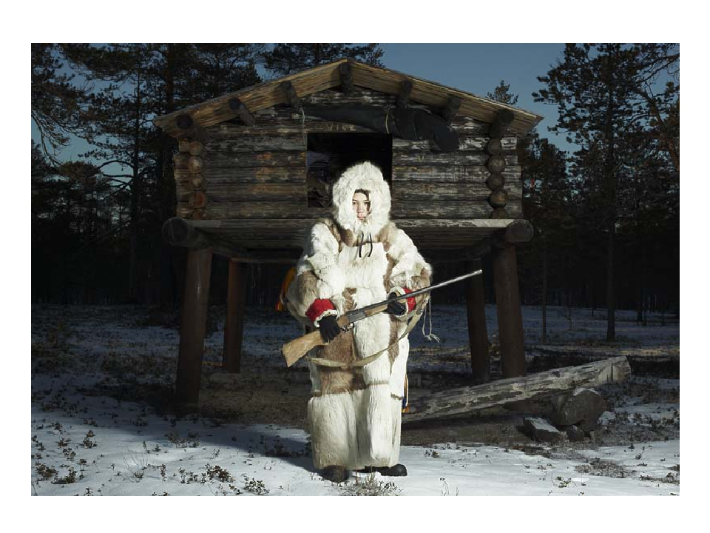
The modern Khanty individual hunting

Slide 27
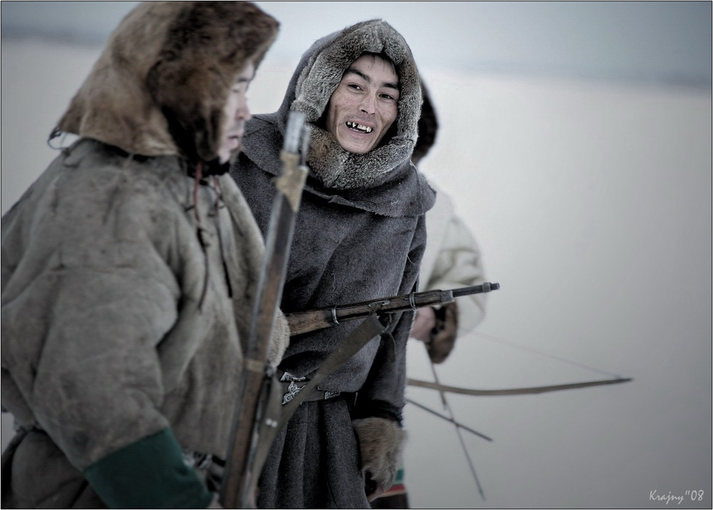
The modern Nenets individual hunting

Slide 28
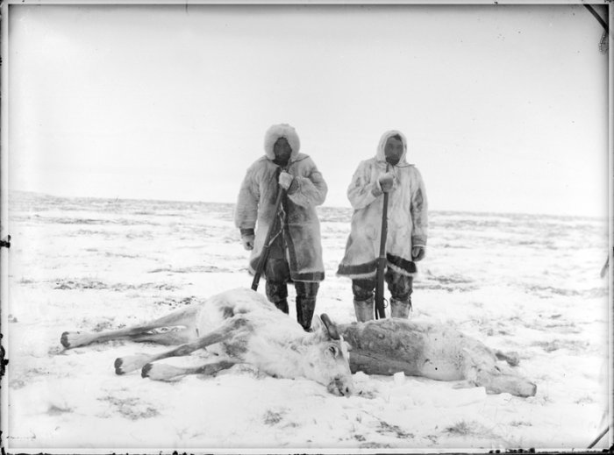
The individual hunt for wild deer with a shield was recorded in the northern Ket groups living in forest tundra. The hunter crawled to the animal at a distance of shot under a cover of light parka made of reindeer fur, and instead of ordinary shoes wore ones, entirely made out of reindeer leg skin of light tone in order to be not seen on white snow.
By Cherkasov A. The notes of a hunter of western Siberia

Slide 29
Territorial isolation was the reason for the preservation of the biocenosis throughout the entire Holocene. Northern reindeer appears in the Early Pleistocene, its modern species Rangifer tarandus becomes one of the predominant among the deer of the northern taiga and the Arctic. Resettlement of Asian tribes to this territory took place in the late Pleistocene-early Holocene from the south. There was an important adaptation task for the migrants, especially in the absence of flint, stone, suitable making individual hunting tools. Collective hunting apparently been known before, but in the North, in these special conditions, a new form of hunting was the result of adaptation, which, due to isolation of the territory, existed until almost the 20th century.

Slide 30
The regularity of wild reindeer herds migrations and the persistence of the routes for their seasonal migrations was a good opportunity for collective hunting methods. Hunters had to take into account the direction and time of the mass migrations of deer (in spring to the sea coast, in autumn - back), they had to thoroughly learn the ways of such migrations in order to choose the places most convenient for hunting. Until recently, the changes in the ways of seasonal migrations of wild reindeer radically violated the economic and rhythm of life of the tundra population, forcing him to move to other places, start wars, etc.

Slide 31
An indirect confirmation of the development of the social structure of hunters and gatherers of the North of Western Siberia can be the number of settlements and the number of dwellings functioning on them at the same time. Interesting is the correlation with the settlements of the Khanty of the 17th – 19th centuries, who mainly used individual hunting methods.
Separate settlements of the Mesolithic - early Neolithic usually had up to 12 dwellings, each of which belonged to the family, which allows us to determine the number of the neighborhood community in the range from 96 to 192 people.
In the Iron Age, the average number of settlements is the same, rarely reach up to 14 dwellings, so the maximum population is from 112 - 222 people.
After switching from the collective hunting to individual hunting, the population of settlements decreased:
After 12th-13th centuries - from 8-12 people up to a max. of 38-48 people.

Slide 32
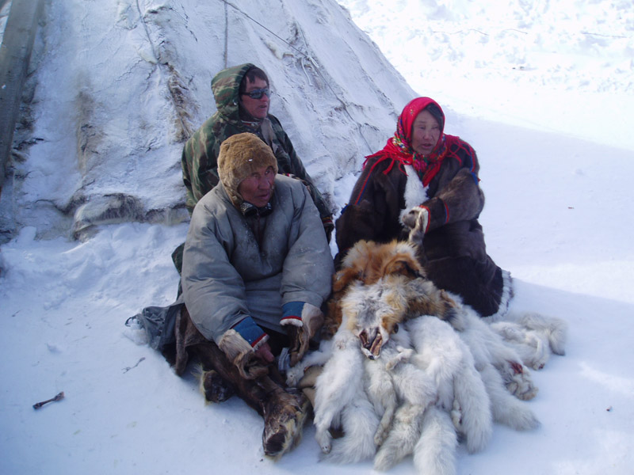
Modern fur-hunters of the Nenets. Photo by Kardash O.

Slide 33
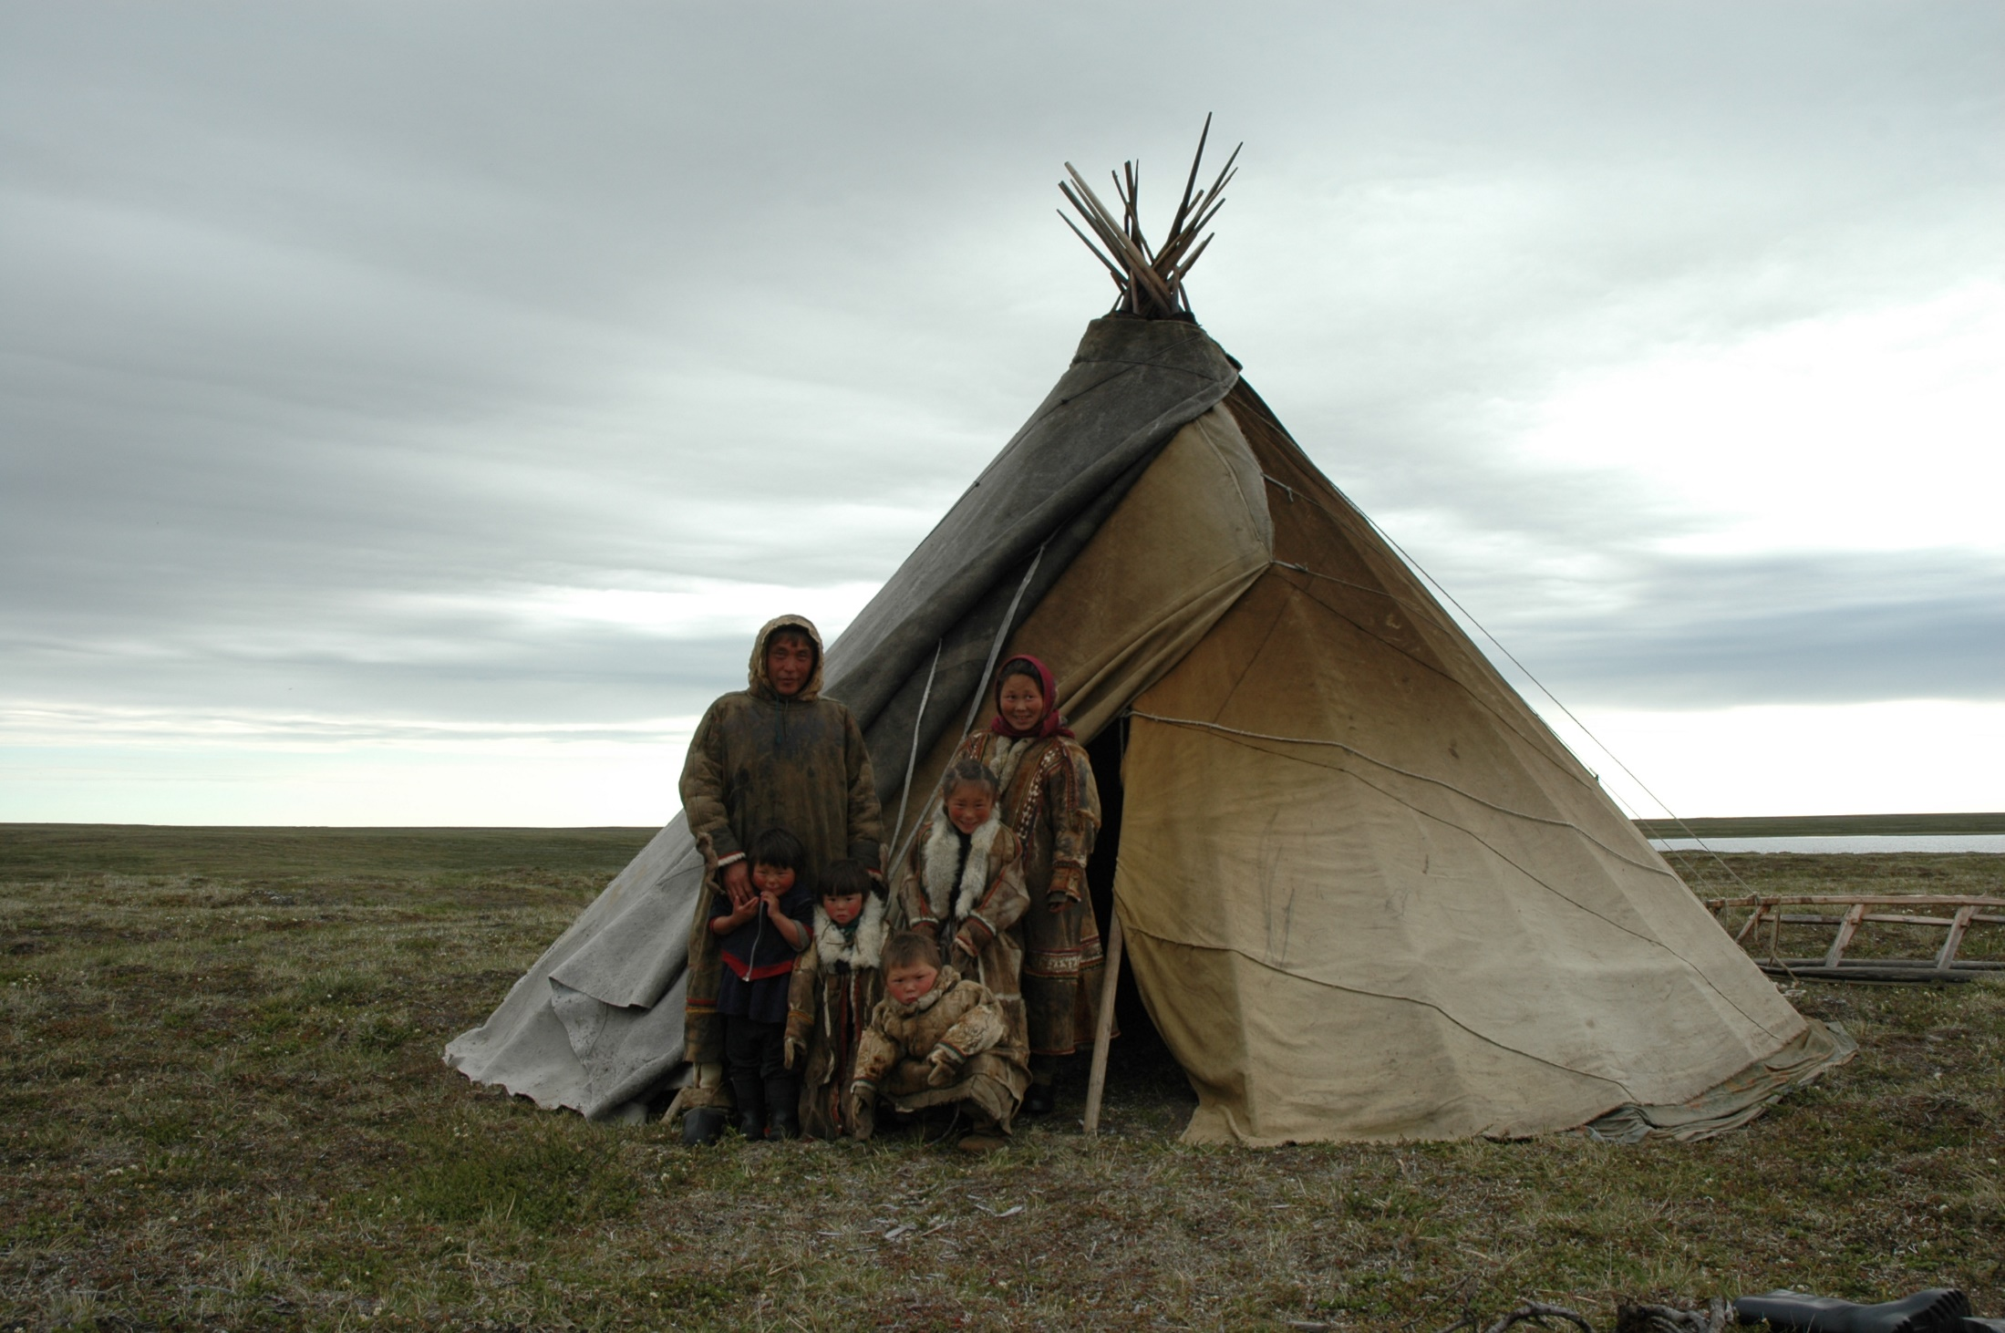
Thank you for the attention!

