Slide 1
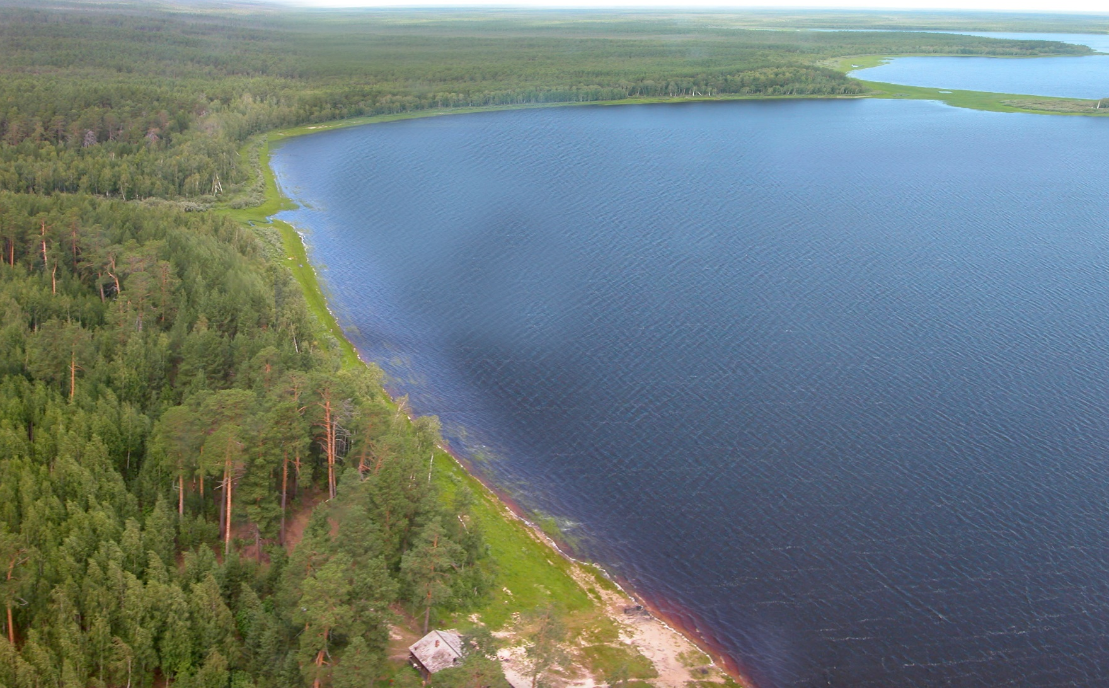
DEFENSIVE-RESIDENTIAL COMPLEXES OF THE ABORIGENOUS POPULATION OF NORTHERN ASIA the mid. 1st mill. BC – the mid. of the II mill. AD. The resettlement in the Far North of Euroasia (origins, development, decline)
Svetlana Lips
Oleg Kardash
Ekaterina Girchenko
Insitute of the Archaeology of the North
Nefteyugansk, Russian Federation
Surgut State University
Surgut, Russian Federation
Institute of Archaeology and ethnography SB RAS
Novosibirsk, Russian Federation

Slide 2
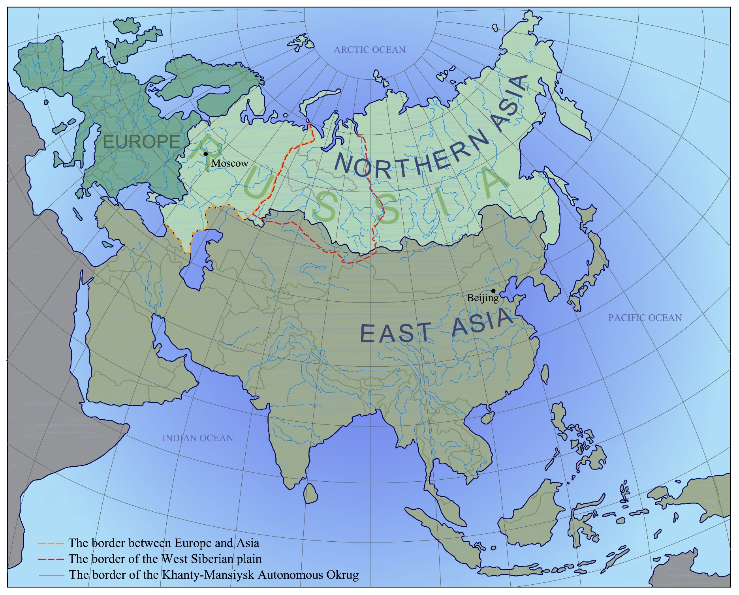
1. Реальный факт о [предмет викторины]:
[Вставьте неправильный ответ]
[Вставьте неправильный ответ]
[Вставьте неправильный ответ]
[Вставьте правильный ответ]
Fig. 1. Map of Eurasia. The territory of the West Siberian Plain

Slide 3
THE PHENOMENON OF THE RESETTLEMENT AND ADAPTATION OF THE MANKIND IN THE NORTH OF THE WESTERN SIBERIA
The Khanty-Mansi Autonomous Okrug-Yugra includes most of the taiga zone of Western Siberia. The territory of the Autonomous Okrug is 535,000 sq.km. Nowadays in the region there are more than 5 800 objects of archaeology allocated, including about 700 fortified settlements. Yugra excels neighboring regions with similar landscape and climatic conditions of Arctic, North-Eastern Europe, Eastern Siberia by total number of archaeological sites.
- In the taiga zone of North-Eastern Europe on the territory of the Komi Republic and the Perm Kray (the territory is 576,137 sq. km) only 2455 archaeological sites were recorded.
- North of Yugra in the Yamal-Nenets Autonomous Okrug in the zone of the northern taiga and tundra there are 550 archaeological sites recorded on the territory of 750,000 sq. km.
The taiga zone has no conditions for the agriculture development. From the Upper Paleolithic, hunter collectives settled there and the appropriation was the basic economy of the region until the 20th century.
At different chronological stages, there was a dynamics of the population of the taiga zone of Western Siberia and it has always remained high. We tried to study this question with the help of architectural analysis of fortified settlements.

Slide 4
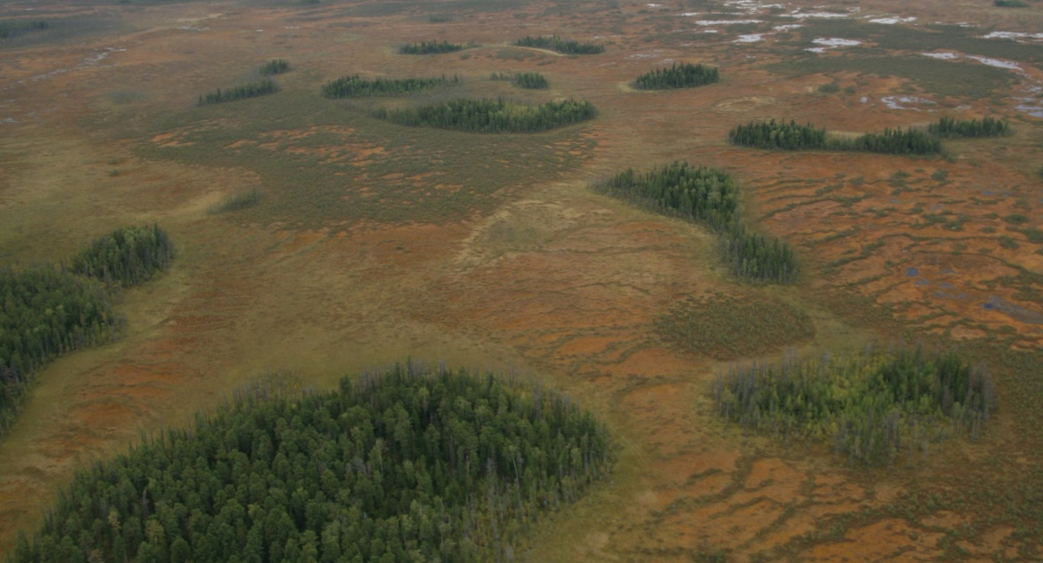
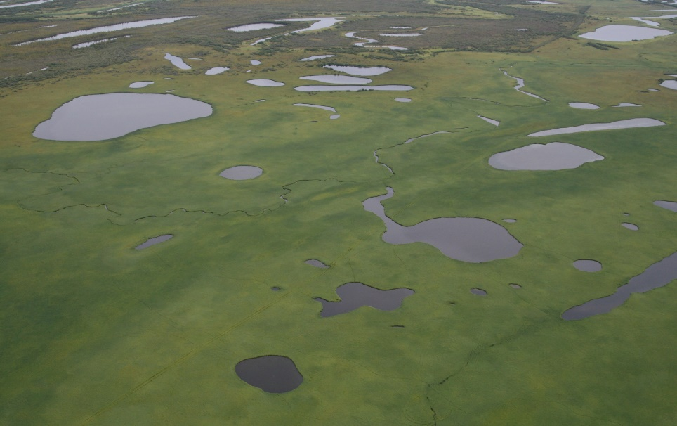
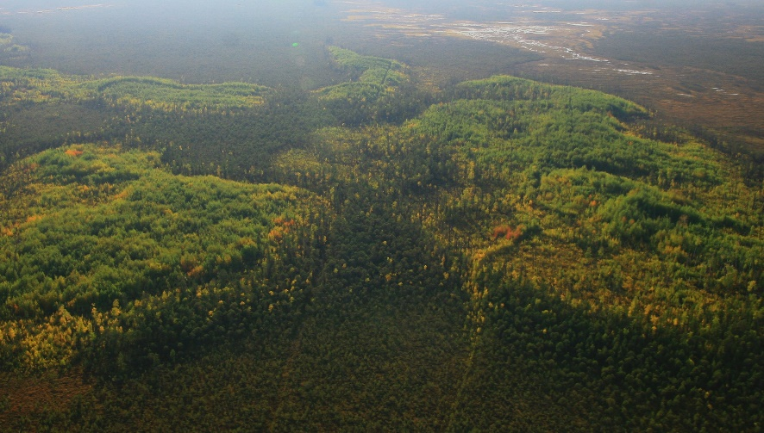
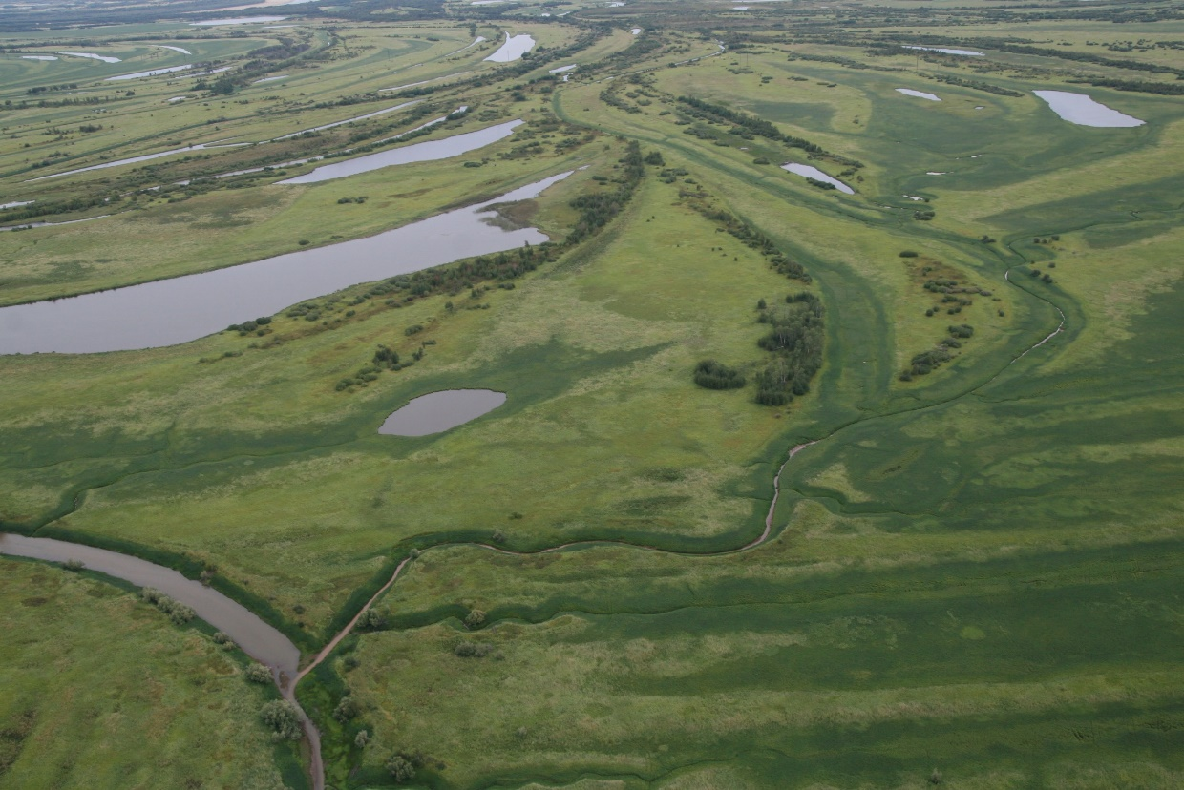
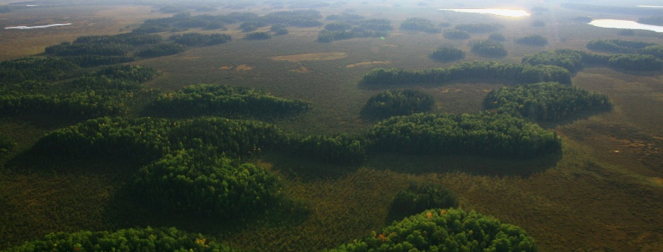
Fig. 3. North Asia. The landscape of the territory of the North of Western Siberia

Slide 5
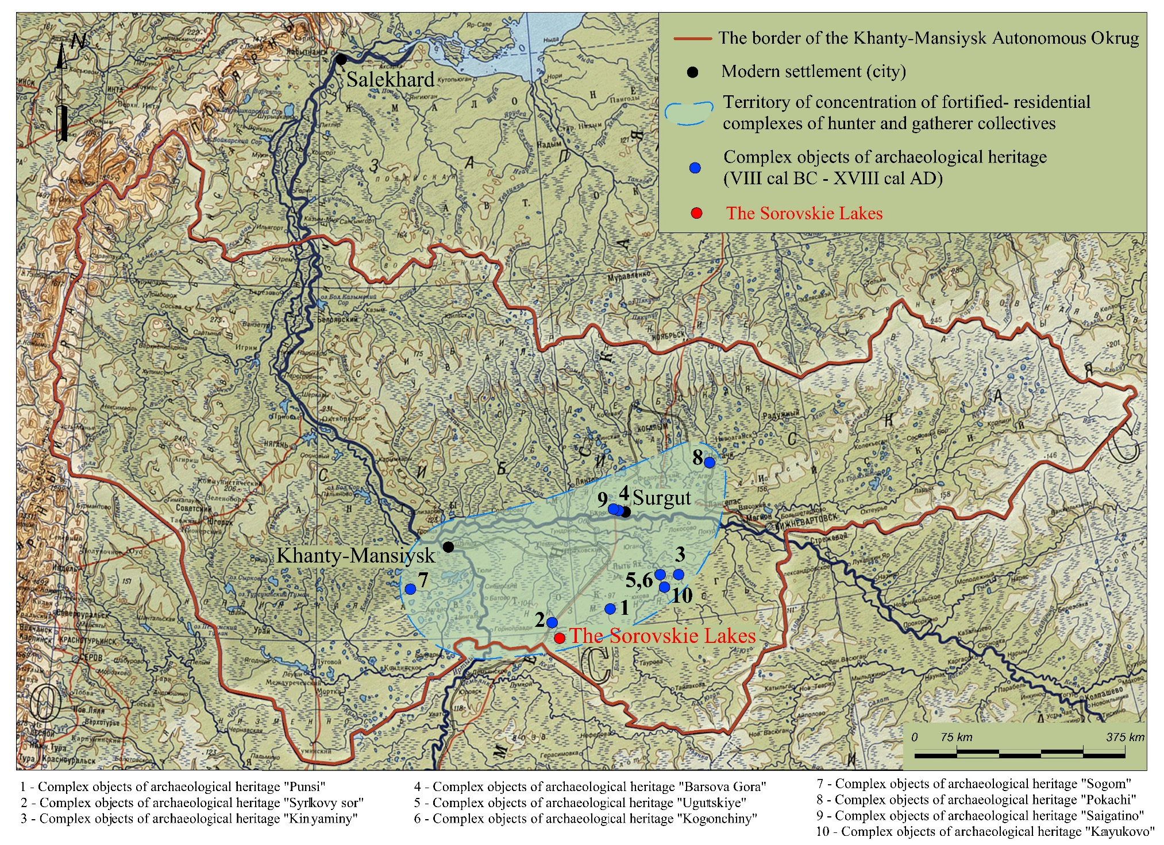
3. Где находится [предмет викторины]?
[Вставьте неправильный ответ]
[Вставьте правильный ответ]
[Вставьте неправильный ответ]
[Вставьте неправильный ответ]
Fig. 5. Khanty-Mansi Autonomous Okrug. The territory of concentration of defensive-residential complexes of the hunters and gatherers societies

Slide 6
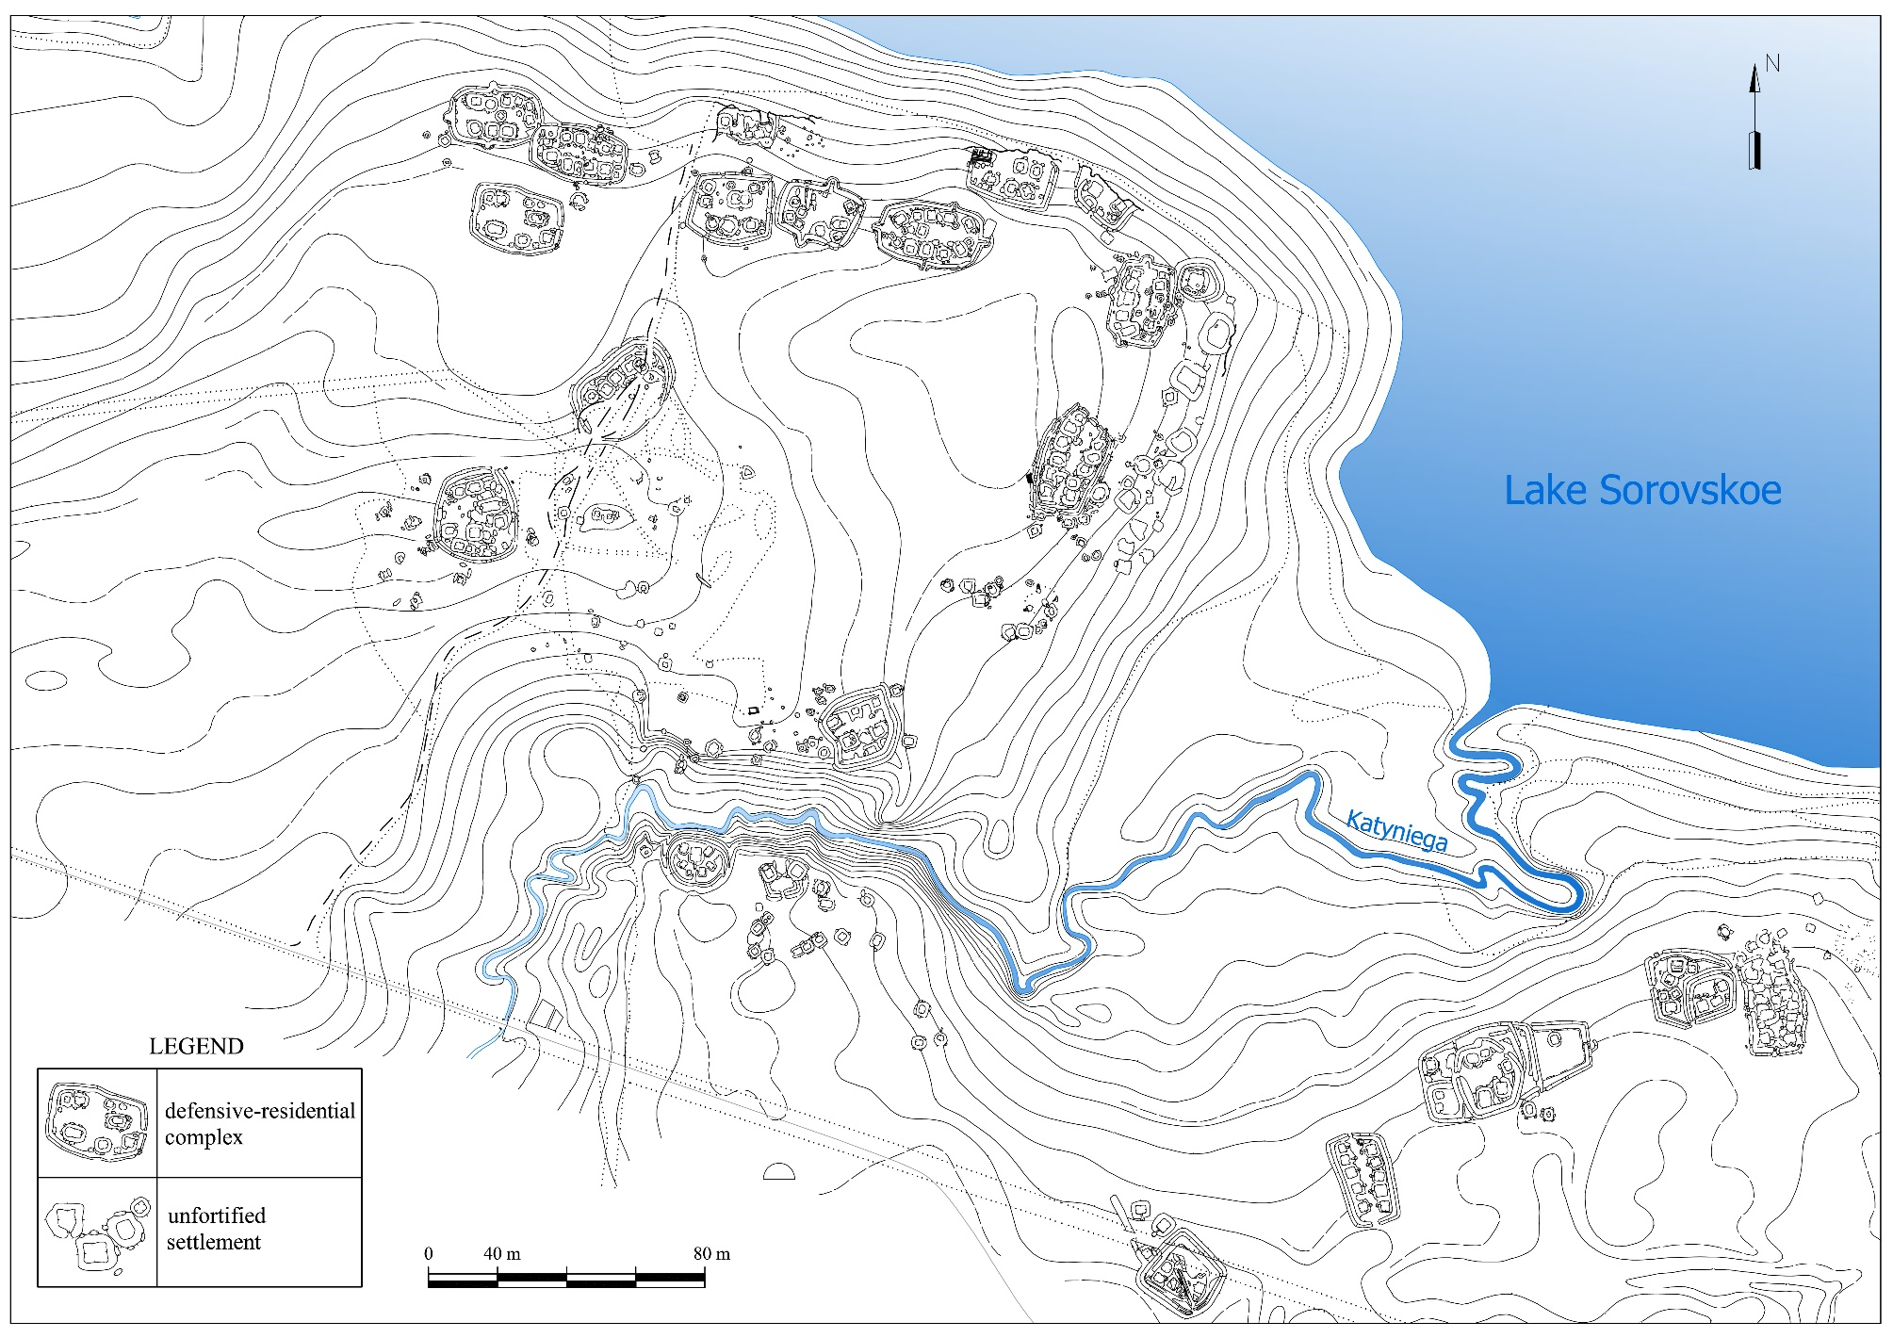
5. Как долго остается [предмет викторины] со своей матерью?
[Вставьте неправильный ответ]
[Вставьте правильный ответ]
[Вставьте неправильный ответ]
[Вставьте неправильный ответ]
Fig. 7. Archaeological complex of the Sorovkiye Lakes. The concentration of defensive-residential complexes on the south-western shore of Sorovskoe Lake

Slide 7
THE MAIN GOALS OF THE STUDY
As part of the investigations of the human resettlement and adaptation in the North of Western Siberia, we conducted a primary historical and architectural analysis of fortified settlements of the mid. Ist mill. BC – the mid. II mill. AD.
A unique feature of the region - the remains of archaeological sites are visually well seen. This makes it possible to study defensive-residential complexes without destroying them, using an instrumental survey to fixate remnants of buildings and to collect the samples of soil for dating.
A peculiarity of the cultures of the ancient aboriginal population of the North of Western Siberia is the construction of settlements on a new place that previously was not used for residential, economic and other reasons. Most of the settlements functioned in a narrow chronological range, so they are mainly single-layer archaeological sites.
RESEARCH OBJECTIVES:
- chronological differentiation of topographic plans of defensive-residential complexes;
- an initial architectural analysis of the composition and the planning structure of defensive-residential complexes;
- a comparative analysis of the defensive-residential complexes in the steppe zone of South-Eastern Europe and the taiga zone of the North of Western Siberia.

Slide 8
STATISTICS FOR DEFENSE-RESIDENTIAL COMPLEXES OF THE
TERRITORIES OF THE NORTH OF WESTERN SIBERIA
In Yugra most of the objects of archeology are concentrated in groups of 40-50 to 100-150 buildings. Such groups are called "archaeological complexes". The structure of archaeological complexes includes residential, economic, trade and religious objects.
А defensive-residential complex is a group of buildings on a specially planned territory surrounded by a defense system.
The Neolithic-Eneolithic Age (VII-III millennium BC) - reliably includes 2 objects
The Bronze Age (II – I millennium BC) - includes more than 2 buildings 0 objects
The Early Iron Age (VIII-VII centuries BC - III century AD) - about 300 objects
The Middle Ages (III - early XVth centuries AD) - about 350 objects
XV-XVIII centuries AD - about 50 objects
Most of the defensive-residential complexes on the territory of the North of Western Siberia refer to the VIII - XIII centuries AD

Slide 9
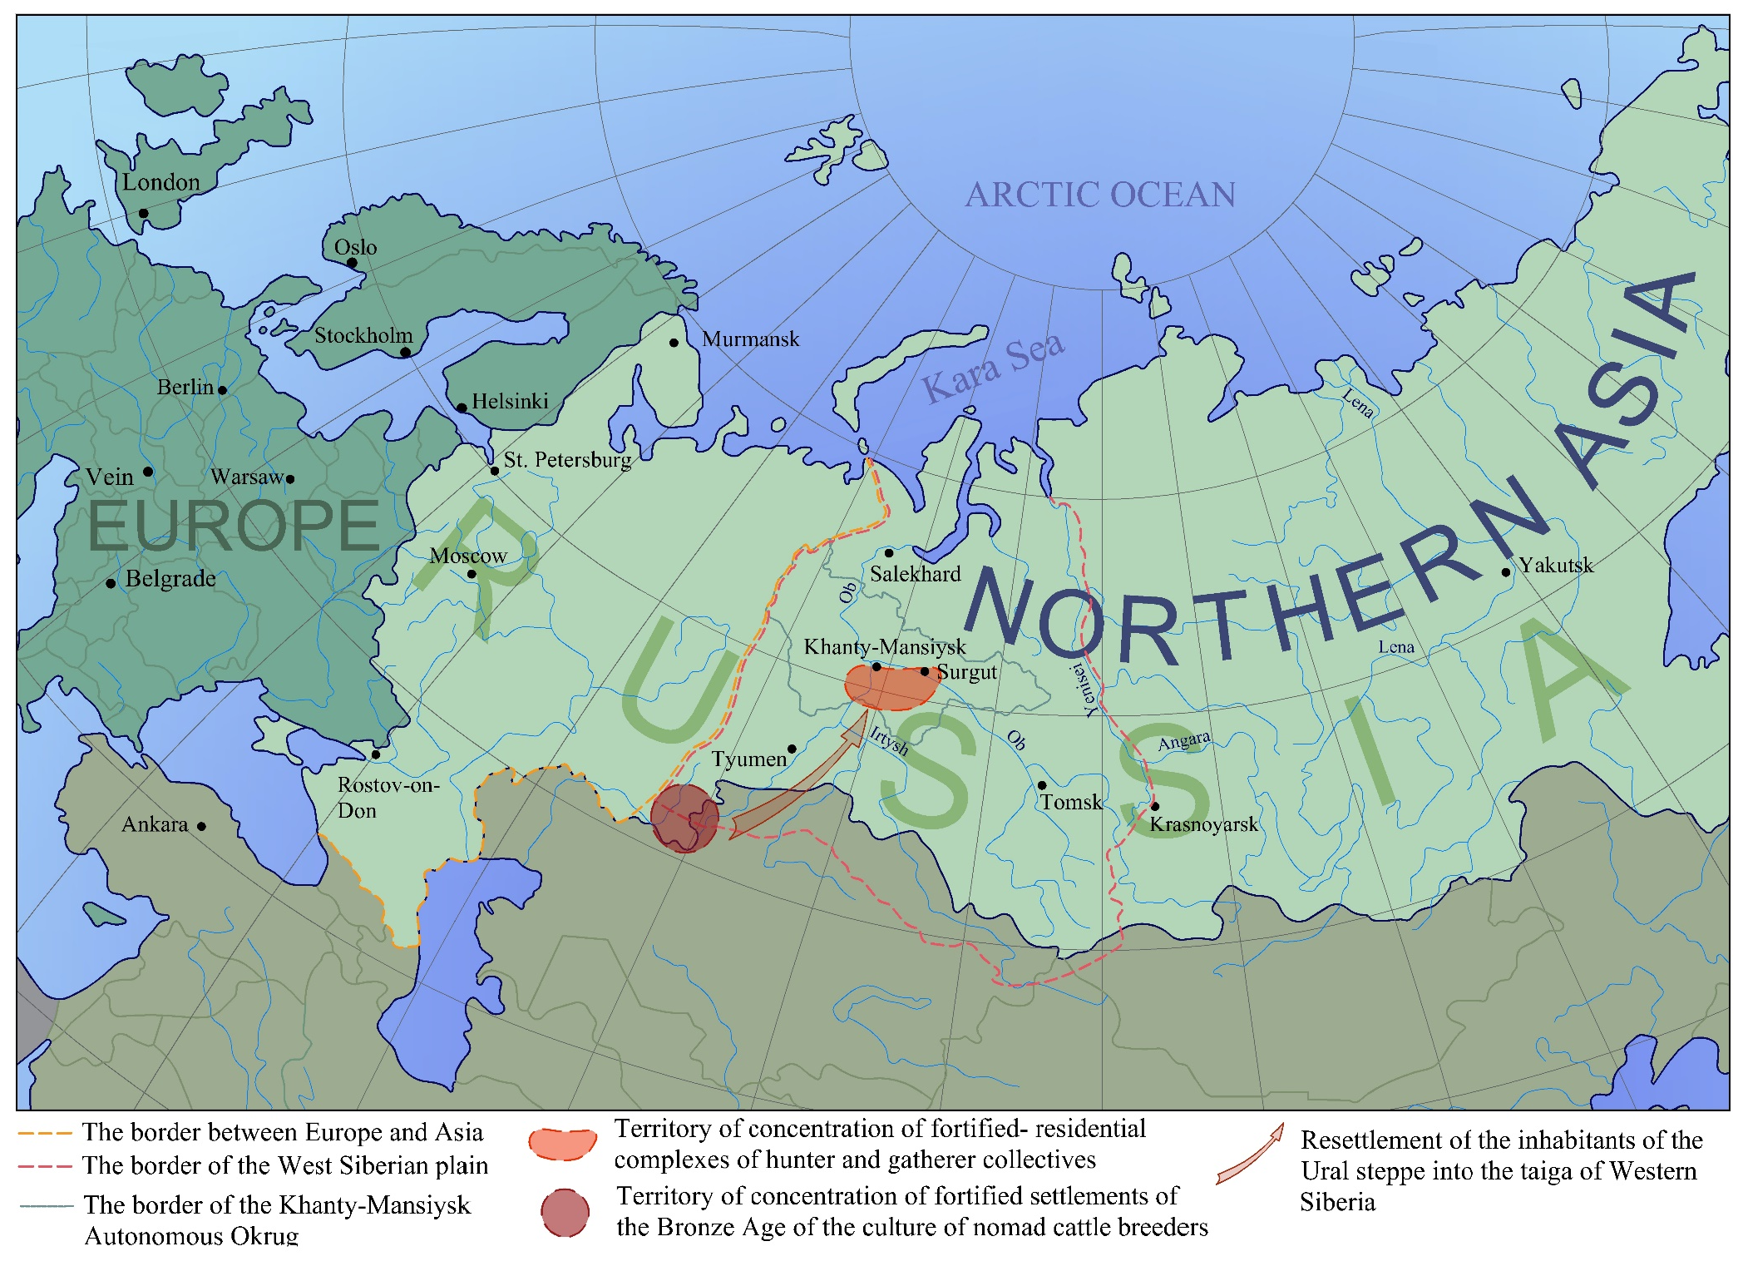
2. [Предмет викторины] относится к категории:
[Вставьте неправильный ответ]
[Вставьте неправильный ответ]
[Вставьте неправильный ответ]
[Вставьте правильный ответ]
Fig. 2. Map of Eurasia. The territory of Northern Asia. The area of research
.

Slide 10
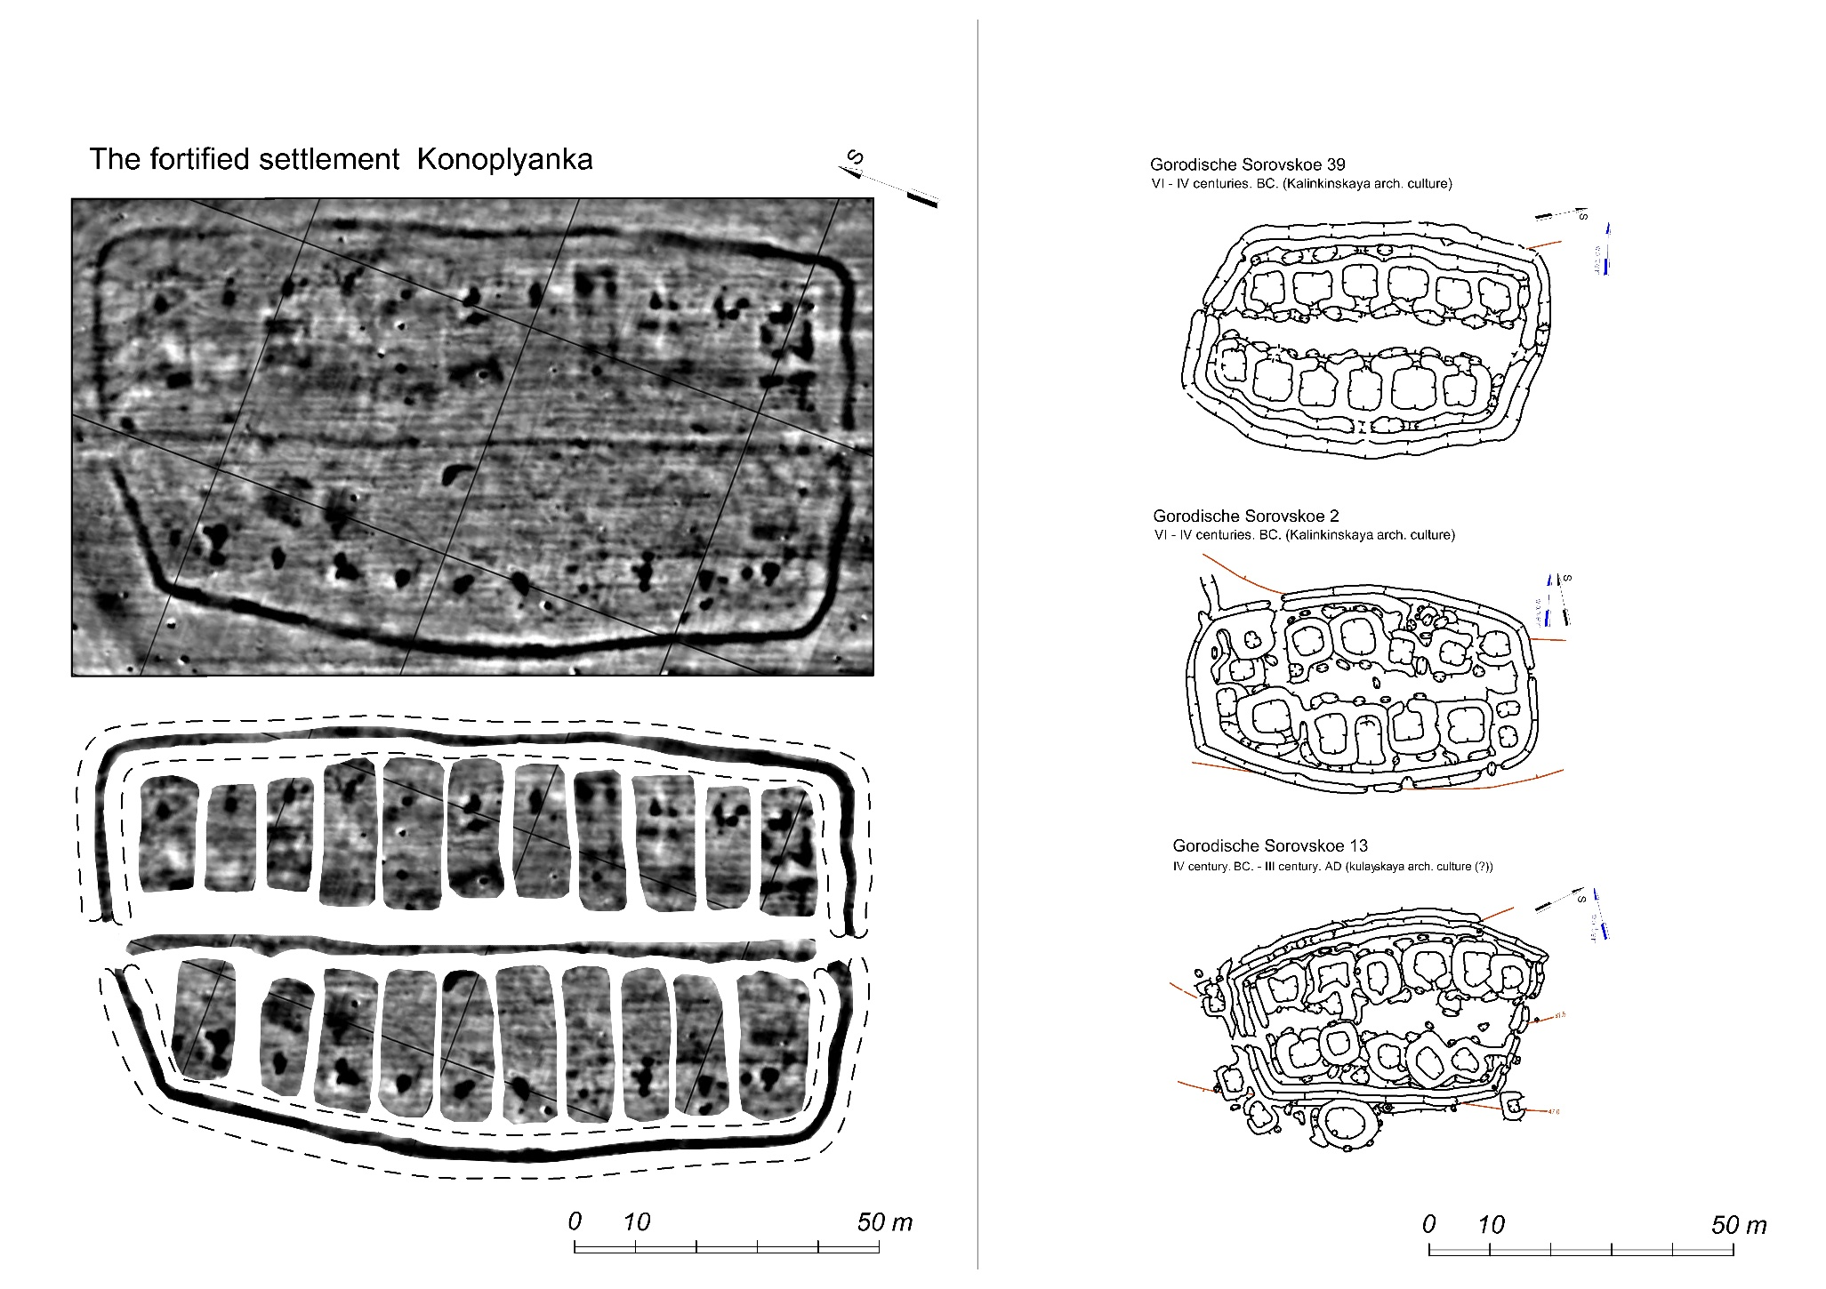
Укрепленное поселение
общества кочевников-животноводов
Укрепленные поселения
общества охотников и собирателей
Отеты прилагаются
Fig. 20. A comparative analysis of fortified settlements of the nomadic farmer society of the XXX-XVII - centuries BC and the hunters-gatherers of the VI - IV centuries BC - III century AD

Slide 11
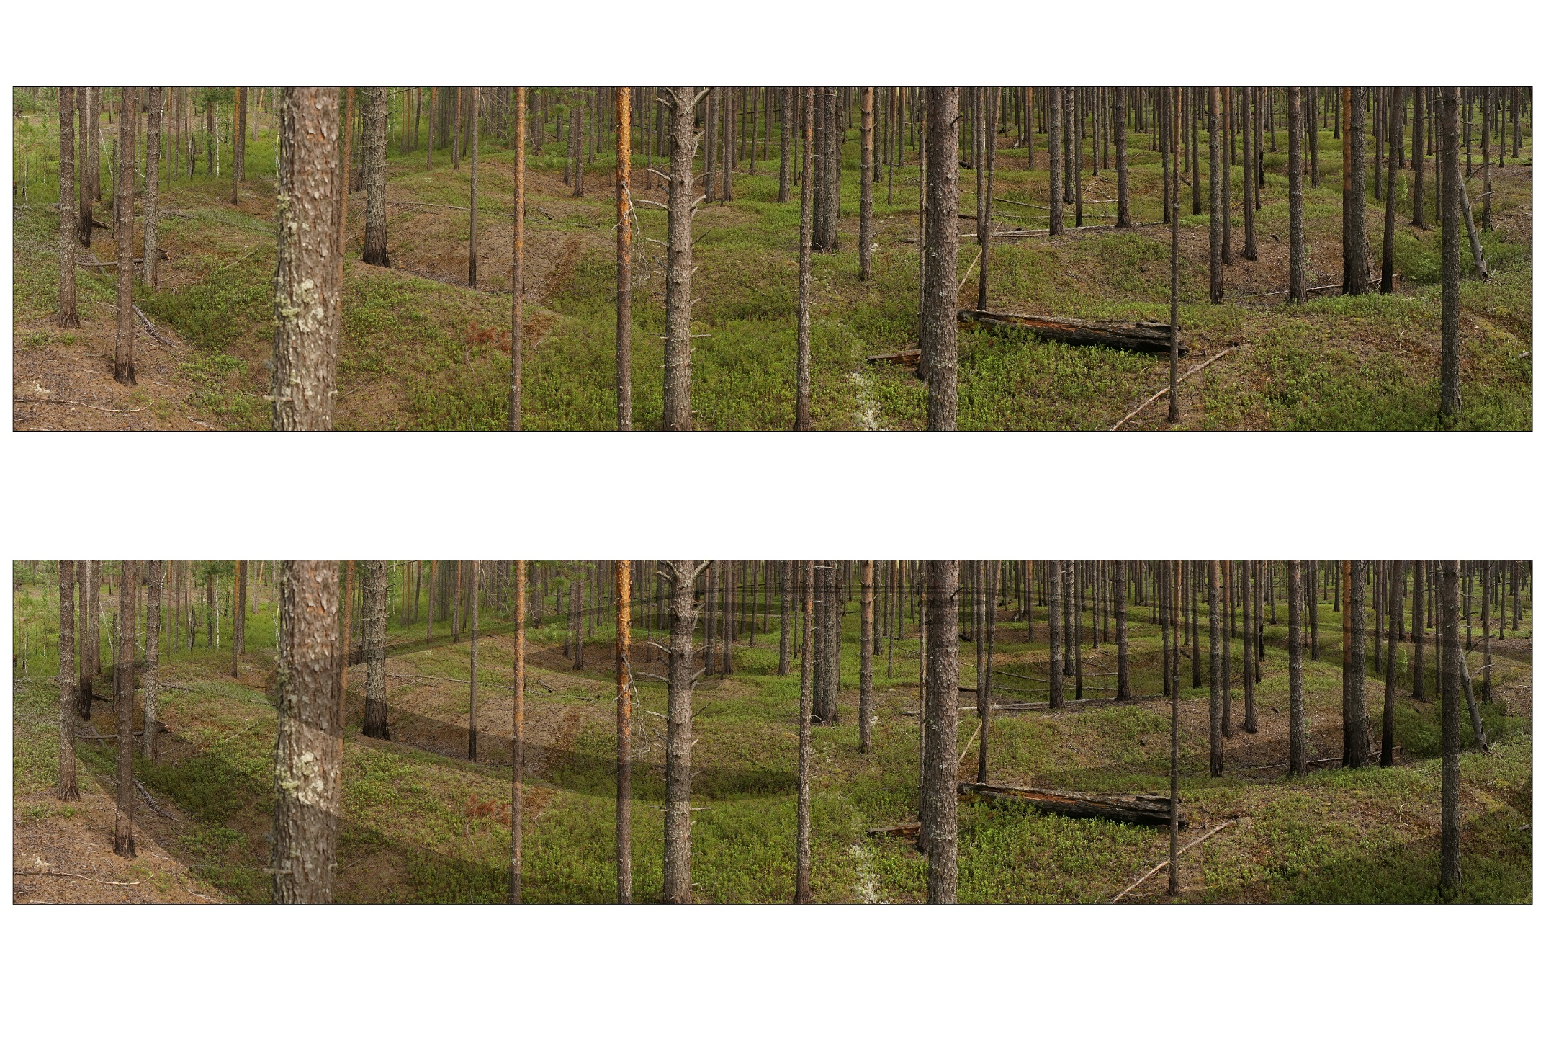
Sorovskoe 25. View from the north-west. Defensive-residential complex of the society of hunters and gatherers of the IX-X centuries AD General view. Photo by Lips S.A.
Sorovskoe 25. View from the north-west. Defensive-residential complex of the society of hunters and gatherers of the IX-X centuries AD. Photo outline.
Fig. 8. The remains of defensive-residential complexes are visually well seen

Slide 12
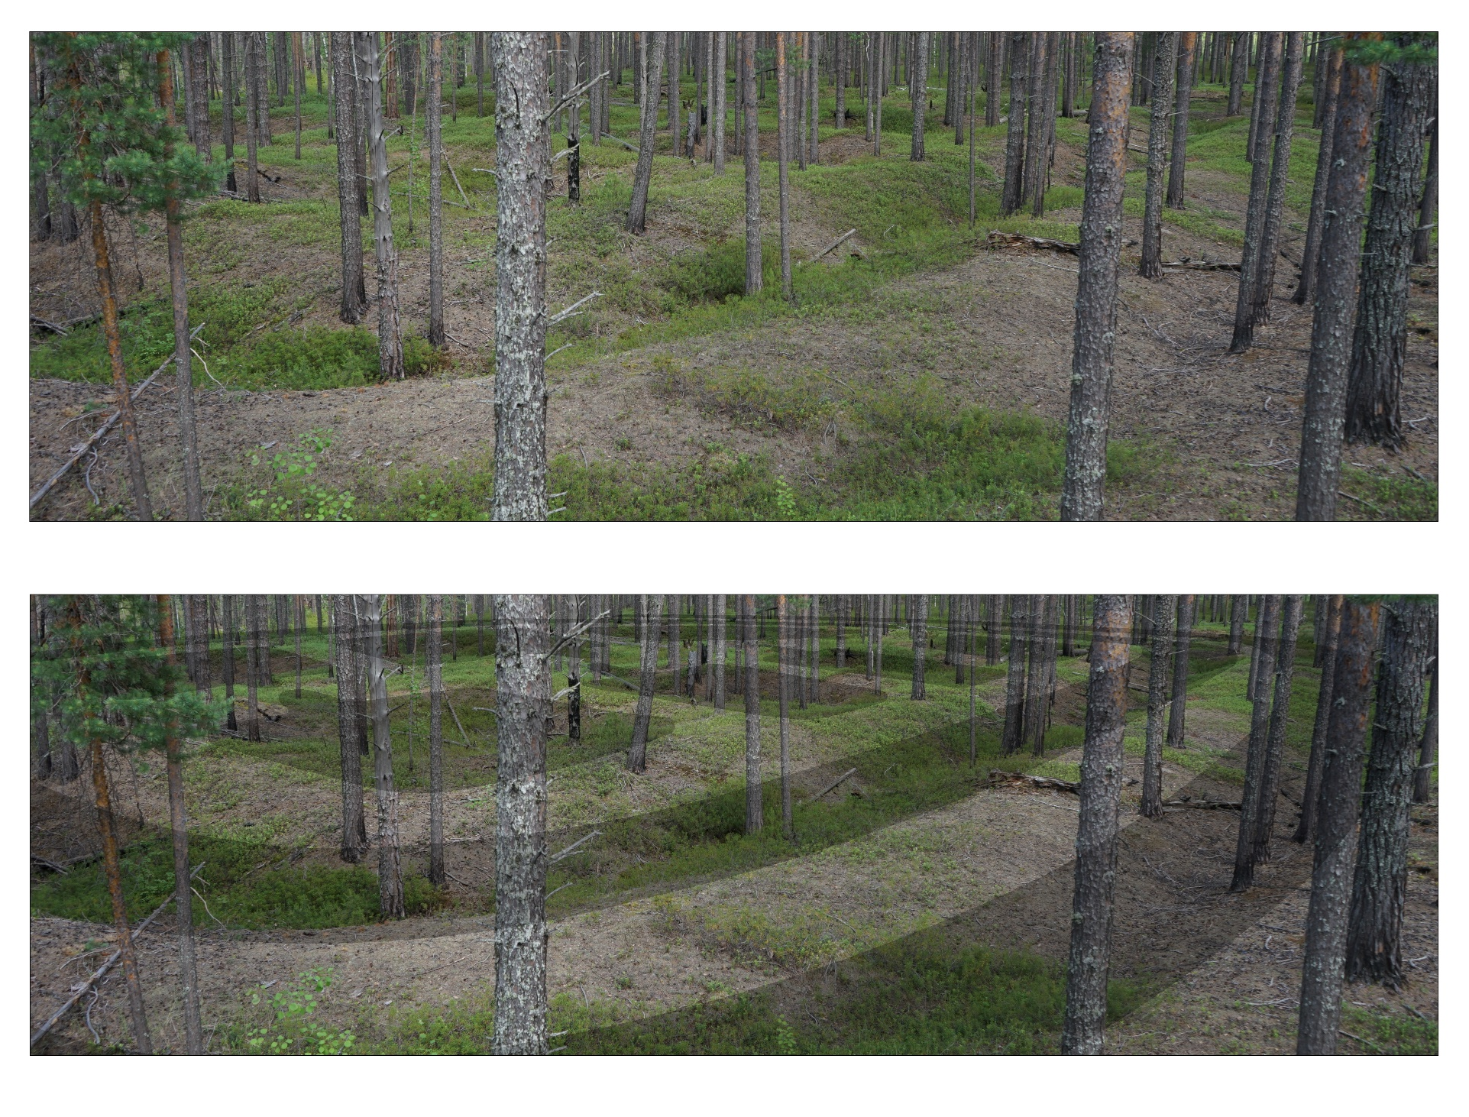
Sorovskoe 25. View from the west. Defensive-residential complex of the hunters and gatherers society of the IX-X centuries AD. Defensive system. Photo by Lips S.A.
Sorovskoe 25. View from the west. Defensive-residential complex of the hunters and gatherers society of the IX-X centuries AD. Defensive system. Photo outline.
Fig.10. The remains of defensive-residential complexes are visually well fixed in the relief.

Slide 13
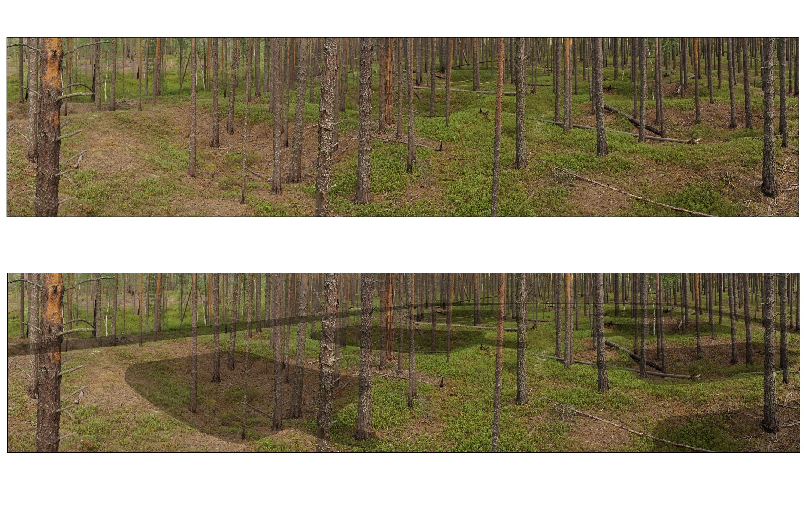
Sorovskoe 25. View from the west. Defensive-residential complex of the hunters and gatherers society of the IX-X centuries AD. Residential area. Photo by Lips S.A.
Sorovskoe 25. View from the west. Defensive-residential complex of the hunters and gatherers society of the IX-X centuries AD. Residential area. Photo outline.
Fig. 9. The remains of defensive-residential complexes are visually well fixed in the relief.

Slide 14
ANALYSIS OF DEFENSIVE-RESIDENTIAL COMPLEXES OF SOROVSKIYE LAKES
On the territory of the archeological complex "Sorovkiye Lakes" there are:
22 defensive-residential complexes of the Early Iron Age
16 defensive-residential complexes of the Middle Ages
The fortification system of defensive-residential complexes at different chronological stages remains unchanged, there are – defensive walls and moats (ditches), but varies in massiveness - during the VII - XII centuries AD an increase in the massiveness of the defensive system is recorded. The system of fortification of 3 defensive residential complexes of the Middle Ages, located on capes, is supplemented by steep slopes.
The number of dwellings of defensive-residential complexes is also changing:
The maximum number of dwellings of the early Iron Age is 13;
The maximum number of medieval dwellings is 8.
By the III-IV centuries AD the number of dwellings of the clan community is decreasing, and the massiveness of the defensive system is growing. According to the analysis of the planning structure of the defensive-residential complexes of the Sorovskiye Lakes, social differentiation of society is not recorded. There are no pronounced differences in the size and location of dwellings on the residential site.
In the XII-XIII centuries AD defensive-residential complexes of the Sorovskiye Lakes disappear. 75% of defensive-residential complexes of the Sorovskiye Lakes have a rectangular planning system with the rows of buildings along the main longitudinal axes (streets).

Slide 15
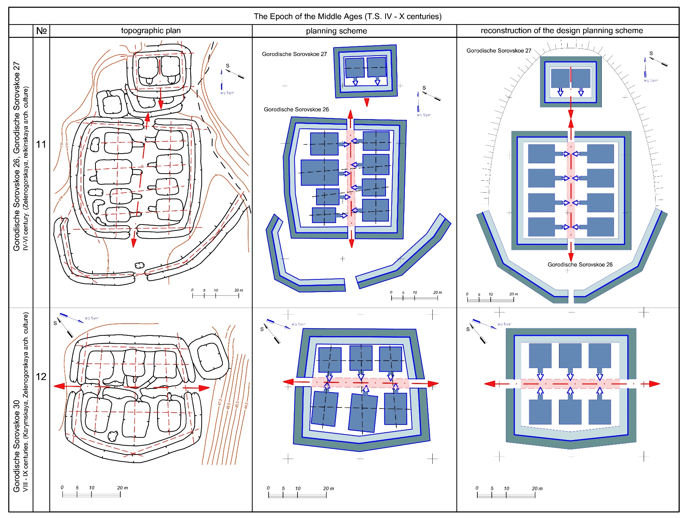
Fig. 17. Graphical analysis of the planning structure of defensive-residential complexes of the IV – X cent. AD

Slide 16
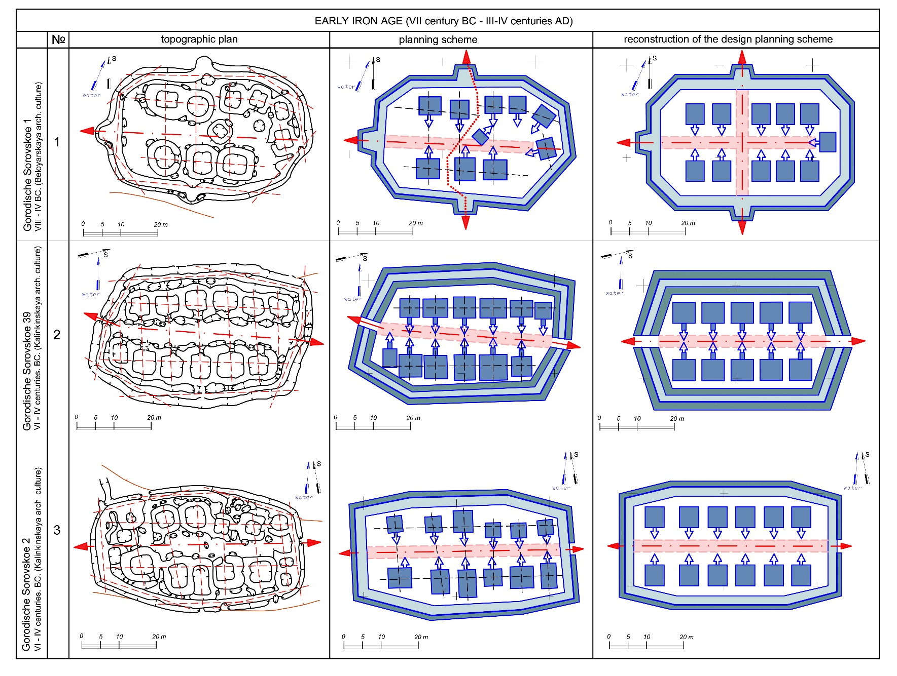
Fig. 11. Graphical analysis of the planning structure of defensive-residential complexes of the VIIth cent. BC. - III-IV cent. AD

Slide 17
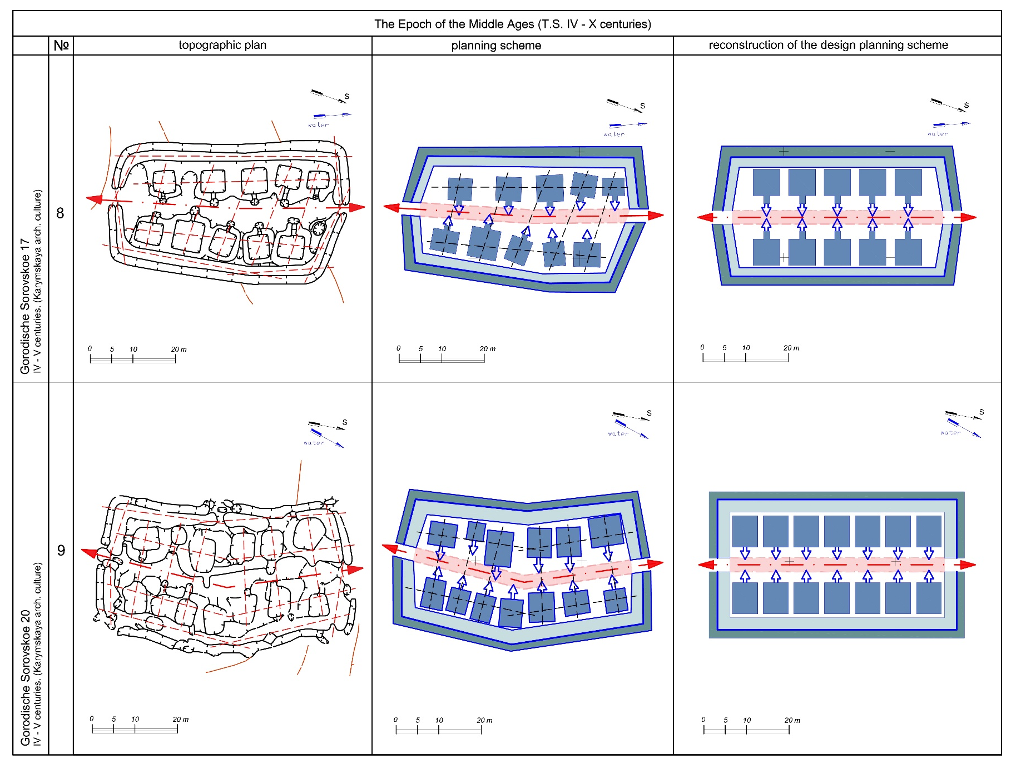
Fig. 15. Graphical analysis of the planning structure of defensive-residential complexes of the IV – X cent. AD

Slide 18
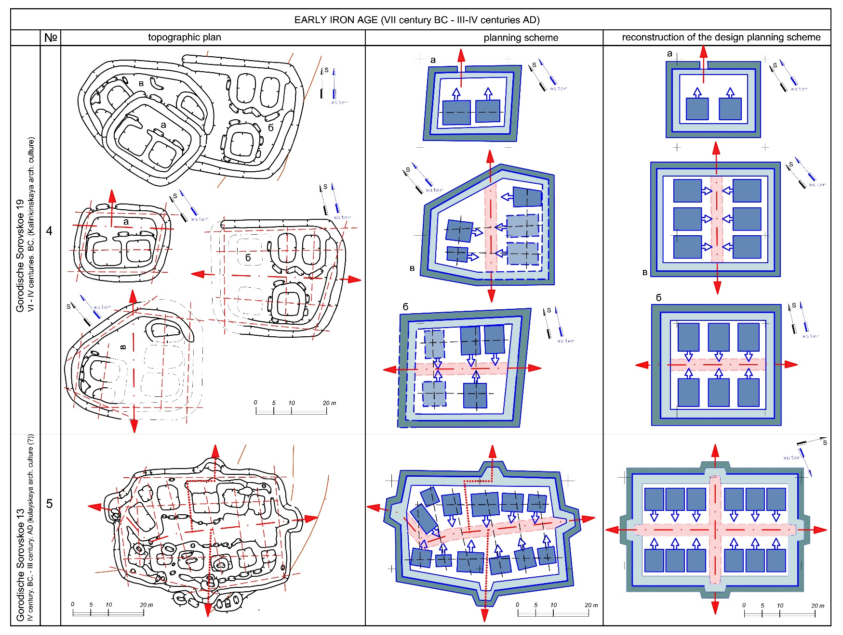
Fig.13. Graphical analysis of the planning structure of defensive-residential complexes of the 7th cent. BC. - III-IV cent. AD

Slide 19
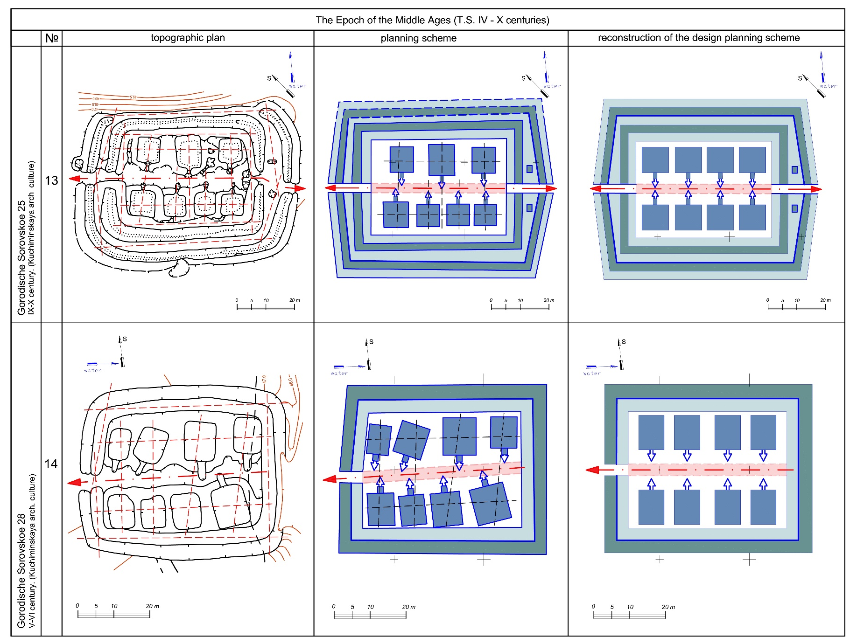
Fig. 18. Graphical analysis of the planning structure of defensive-residential complexes of the IV – X cent. AD

Slide 20
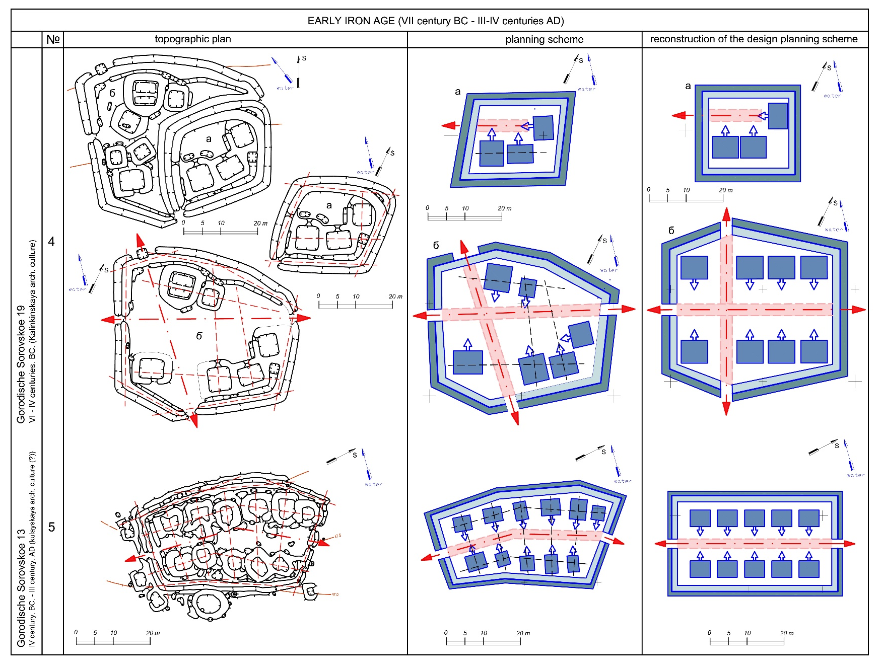
Fig. 12. Graphical analysis of the planning structure of defensive-residential complexes of the VIIth cent. BC. - III-IV cent. AD

Slide 21
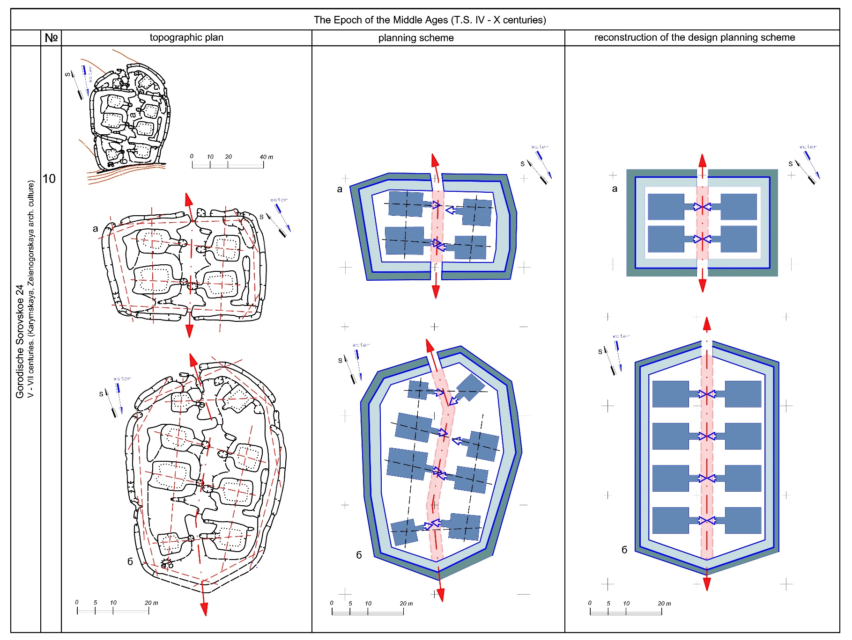
Fig. 16. Graphical analysis of the planning structure of defensive-residential complexes of the IV – X cent. AD

Slide 22
THE ORIGINS OF ARCHITECTURAL TRADITION
Fortified settlements with architecture similar to the defensive-residential complexes of the North of Western Siberia existed in the Bronze Age (XXX-XVII centuries BC) in the steppe zone of the Southern Urals. The distance between them is more than 1000 km.
COMMON FEATURES:
Rectangular planning structure of the complex of buildings
The buildings are arranged in a row (2-3) along the streets symmetrically with the opposite ones
The defensive system of fortified settlements is formed along the complex of residential buildings and consists of walls (ramparts) and ditches
DIFFERENCES:
The dimensions of the fortified settlements of the South Urals reach 180 x 200 m; the size of the defensive-residential complexes of the North of Western Siberia is no more than 50 x 100 m.
The number of residential buildings in the fortified settlements of the South Urals is 20 - 40, with dimensions from 10 x 5 to 20 x 10 m;
The number of residential buildings in defensive-residential complexes of the North of Western Siberia is no more than 30, with dimensions from 4 x 4 to 10 x 15 m.

Slide 23
CONCLUSIONS
75% of the defensive-residential complexes of the Sorovskiye Lakes belong to a rectangular planning system with the rows of buildings along the main longitudinal axes (streets). They are similar to the rectangular fortified settlements of the Southern Ural.
The principles for the planning of fortified settlements of the VIII-VII centuries BC - XII century AD territory of the North of Western Siberia and fortified settlements of the Bronze Age in the steppe zone of the Southern Ural are similar.
The architectural tradition was brought to the territory of the North of Western Siberia by farmers of the South Ural steppes at the end of the Bronze Age.
The tendency to reduce the size of defensive-residential complexes on the territory of the North of Western Siberia is caused with climatic conditions.
The tendency to reduce the number of family-clan communities in the North of Western Siberia is connected with the transformation of the economy system.
The planning structure and architecture of defensive-residential complexes is one of the signs of a gradual transformation of the culture of farmer-pastoralists into a culture of hunter-gatherers.

Slide 24
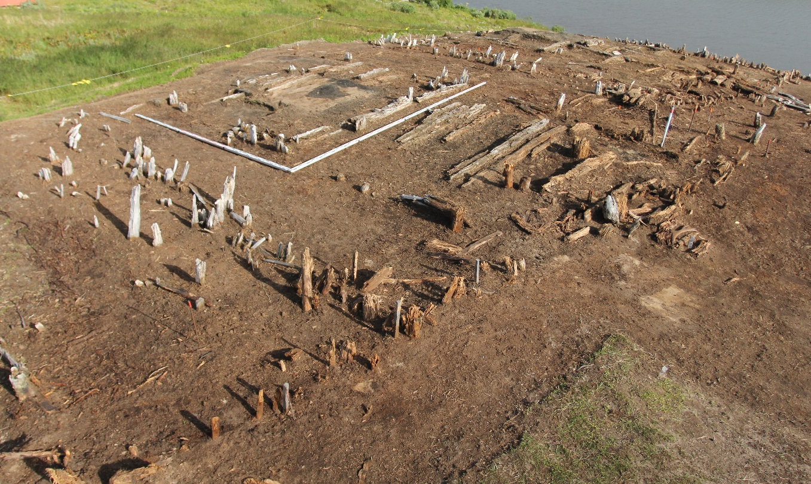
Оборонительно-жилой комплекс Бухта Находка
In the far north of Asia, on the territory of the tundra zone of the middle Yamal, there is a defensive-residential complex of the Nakhodka Bay (XI-XIV centuries). The cultural layer of the site is frozen. There are well preserved wooden remains. Having studied the construction of the site, we get a unique opportunity to recreate the architecture of the defensive-residential complexes of the North of Western Siberia with worse preservation.

Slide 25
The architectural tradition of the defensive-residential complexes existed until the XIII - XV centuries and was typical up to the tundra zone of the middle Yamal. There are archaeological sites with a frozen cultural layer and good preservation of constructions. Their investigation helps to restore architectural traditions.
The study of the traditions of the construction of defensive-residential complexes allows us to understand aspects of the social structure and the economy of the ancient society, using methods of engineering in historical and architectural studies without the archaeological excavations.

Slide 26
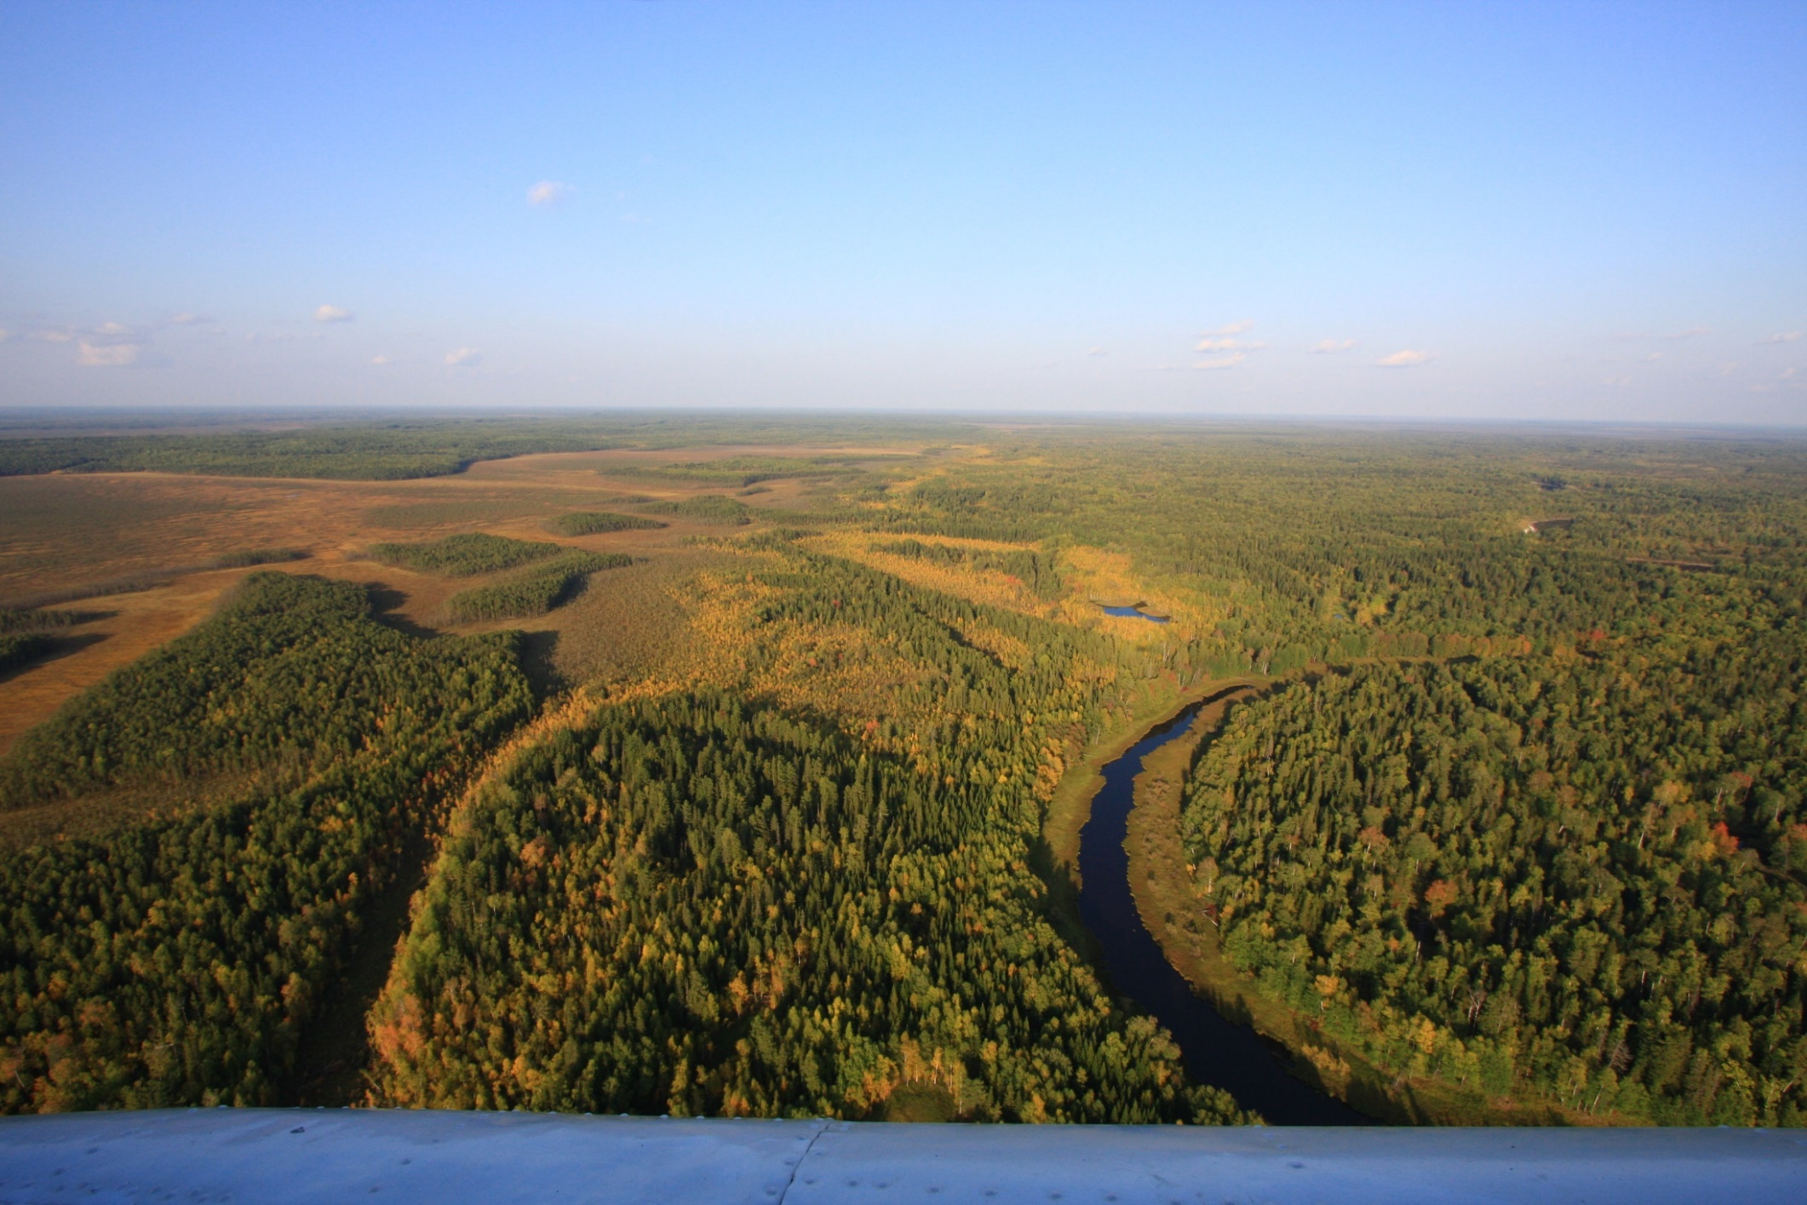
Thank you for the attention

