Slide 1
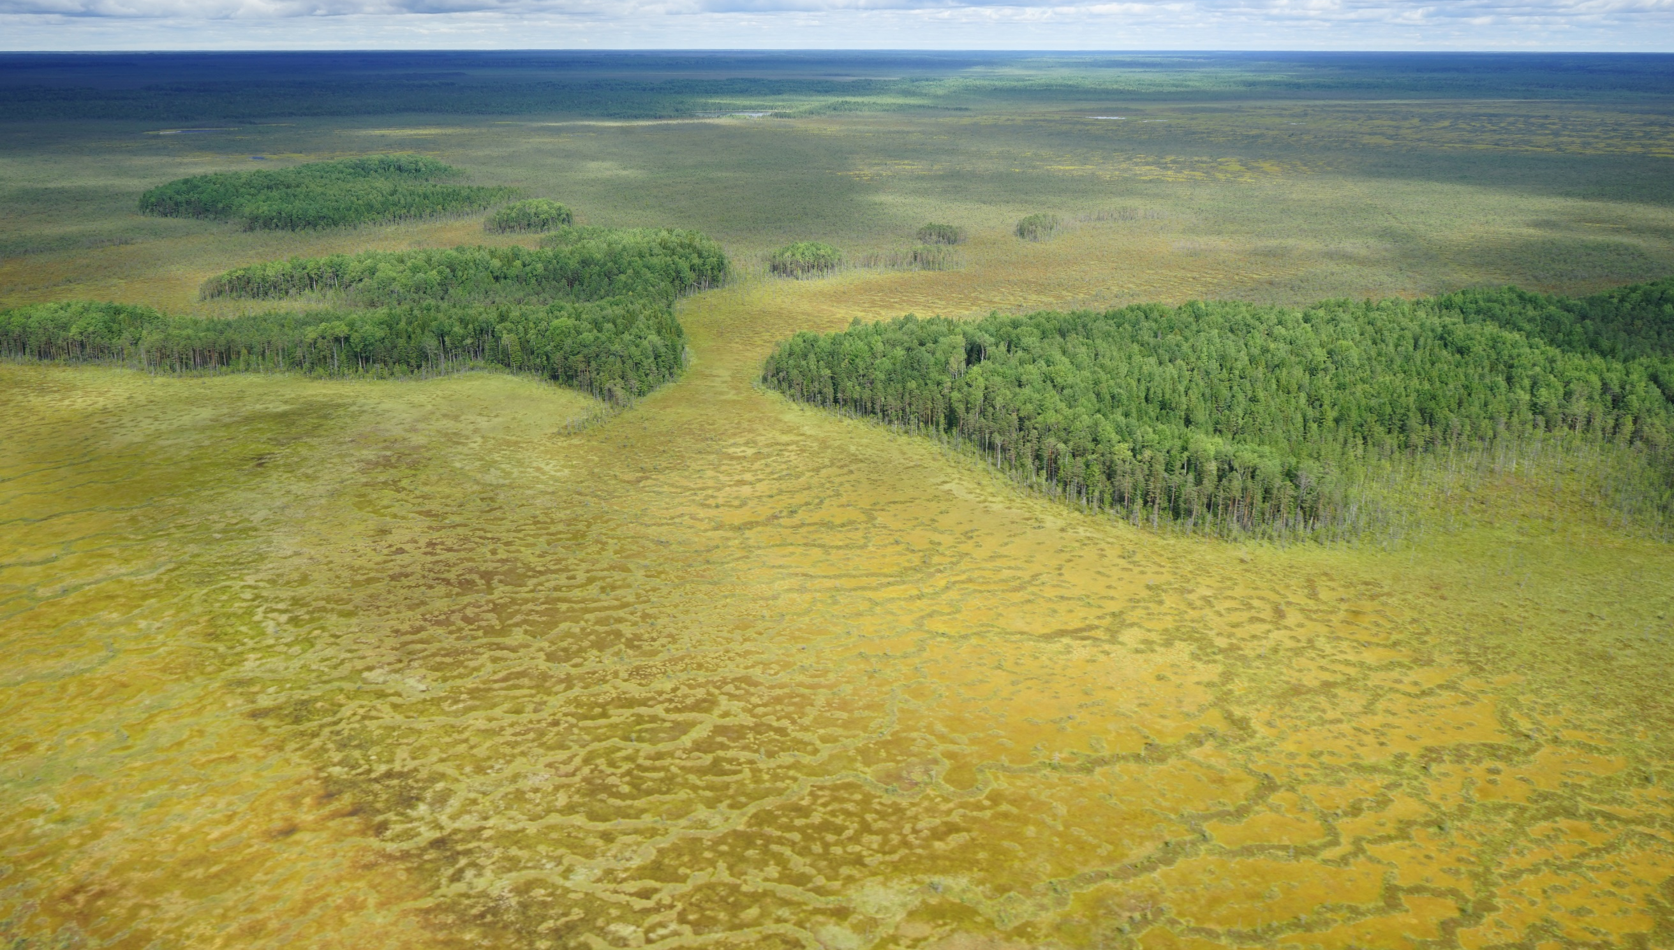
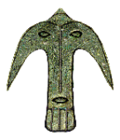
Complex architectural structures of the early Neolithic of the North Siberia (based on materials from the ancient settlement Kayukovo 2)
Oleg Kardash, George Vizgalov, Henny Piezonka
Nefteyugansk city, Russia, Kiel city, Germany
SURGUT STATE UNIVERSITY YUGRA. LABORATORY FOR ARCHAEOLOGY AND ETHNOGRAPHY
INSTITUT FÜR UR- UND FRÜHGESCHICHTE CHRISTIAN-ALBRECHTS-UNIVERSITÄT ZU KIEL
OPERATOR FUND OF THE PRESIDENTIAL GRANTS FOR THE DEVELOPMENT OF CIVIL SOCIETY
«SCIENTIFIC PRODUCTION ASSOCIATION «NORTHERN ARCHAEOLOGY-1» LTD
ANO «INSTITUTE FOR ARCHAEOLOGY OF THE NORTH»

Slide 2
HUMAN DIFFUSION ON THE TERRITORY OF THE NORTH OF THE WESTERN SIBERIA, ARCHAEOLOGICAL DATA
Since the Neolithic Age at the turn of VII century BC hundreds of settlements were appearing in the North of the West Siberian Plain, the number of these settlements increased later and not decreased till the Middle Ages.
The most part of the West Siberian Plain taiga zone, the land between 58° и 65° north latitude, is an administrative division of Khanty-Mansiisk autonomous district, Yugra. Its territory is 535 000 sq.m. Up to the present day about 6000 archaeological sites were discovered at this region. They were settlements, households, hunting facilities, places of worship, dated since the Late Paleolithic Age
In the territory of Yugra there are more archaeological sites that on the neighbour districts which have similar landscape and climate conditions. For example:
in the Komi Republic and Perm district there is a taiga zone of the North-East part of Europe, its total area of 576000 sq., where archaeological sites have been discovering for more than 100 years, there are 2455 archaeological sites;
in the Yamal-Nenets Autonomous District there is the zone of north taiga and tundra of the Far North of the Western Siberia, its area is 750000 sq. and there are 550 sites.
The north taiga zones of the Western Siberia were densely populated in ancient times, especially the earlier periods; it is a unique trait of the region. However, this phenomenon is not investigated.

Slide 3
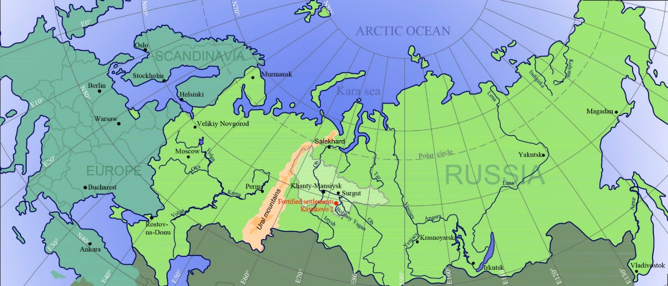
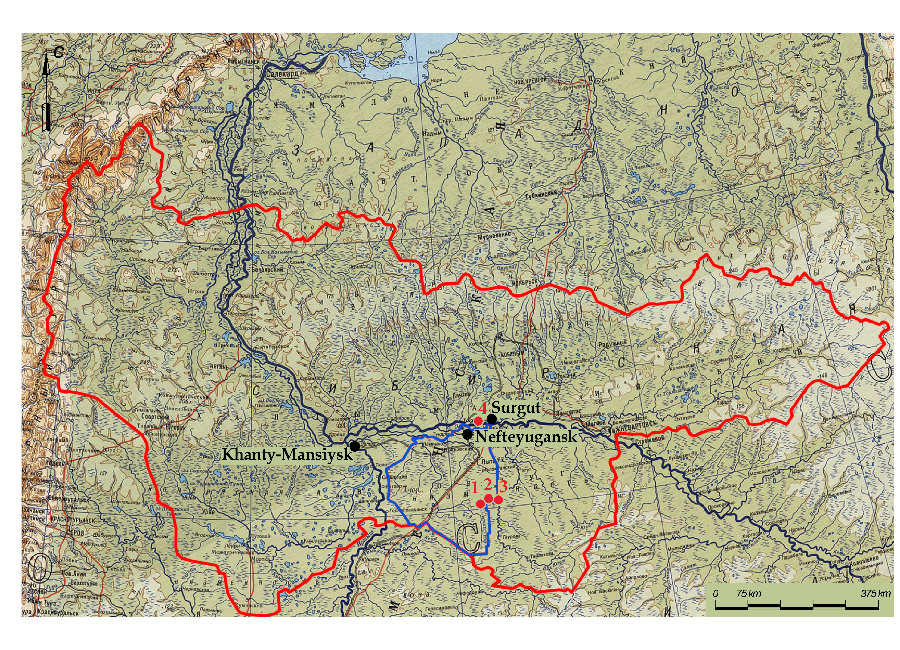
Условные обозначения:
Khanty-Mansiysk Autonomous Okrug – Ugra;
Nefteyugansk district;
Modern inhabitat locality;
Archaeological sites;
Fig. 003. Kayukovsky archaeological culture, the end of VII - the middle of VI millennia BC. Fortified settlement :
1 – Kayukovo 1;
2 – Kayukovo 2;
3 – Kachnisap 2;
4 – Barsova gora II / 9

Slide 4
THE KAYUKOVSKY ARCHAEOLOGICAL CULTURE OF THE EARLY NEOLITHIC PERIOD
On the Yugra territory there were supposedly from 100 to 200 settlements within the Early Neolithic period from 7 millennium BC till 6 millennium BC. 4 out of all the sites are conclusively the sites of Kayukovsky culture.
Kayukovo 2 is a primary site, Kayukovsky culture was recognized on the basis of this site excavation.
The culture is characterized with:
- settlements consist of 5-6 regularly planned houses; among the studied sites there are three settlement complexes, Kayukovo 2, Kachnisap 2 and Barsova Gora II/9 with circular plan structure, one settlemet, Kayukovo 1, with linear or street structure (in two rows) plan structure;
- Pottery vessels have unusual shape; flat bottom; various ornamental composition, including sign-symbols, completely covering the pottery surface, including bottom;
- Stone grinded implements of peculiar form: adzes with longitudinal channel and knives in the shape of sickle.
Fig. 004. Kayukovsky archaeological culture, the end of VII - the middle of VI millennia BC. Fortified settlement Barsova gora II / 9. The materials of excavations by Chemyakin Y.P. 1988-89. Initially was dated the late Bronze Age, the end of the II millennium BC.

Slide 5
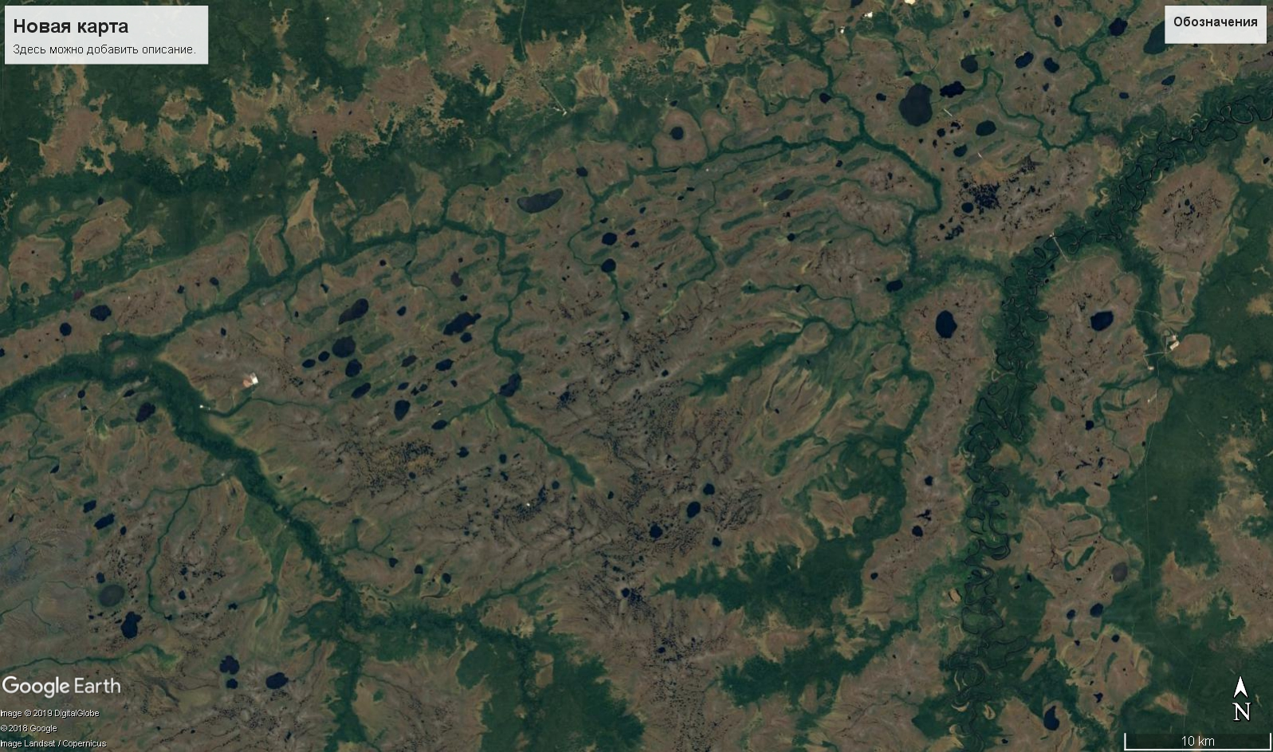
the are of the Bolshoye Kayukovo lake (Punsy)
Fortified settlement Kayukovo 2
The Bolshoy Yugan river
The Bolshoy Salym river
Fig. 005. Fortified settlement Kayukovo 2. Te first third of the VI millennium BC. The area of the watershed of the Bolshoy Salym river and the Bolshoy Yugan river. The planimetric map of the archaeological site near the Bolshoye Kayukovo lake (Punsy).

Slide 6
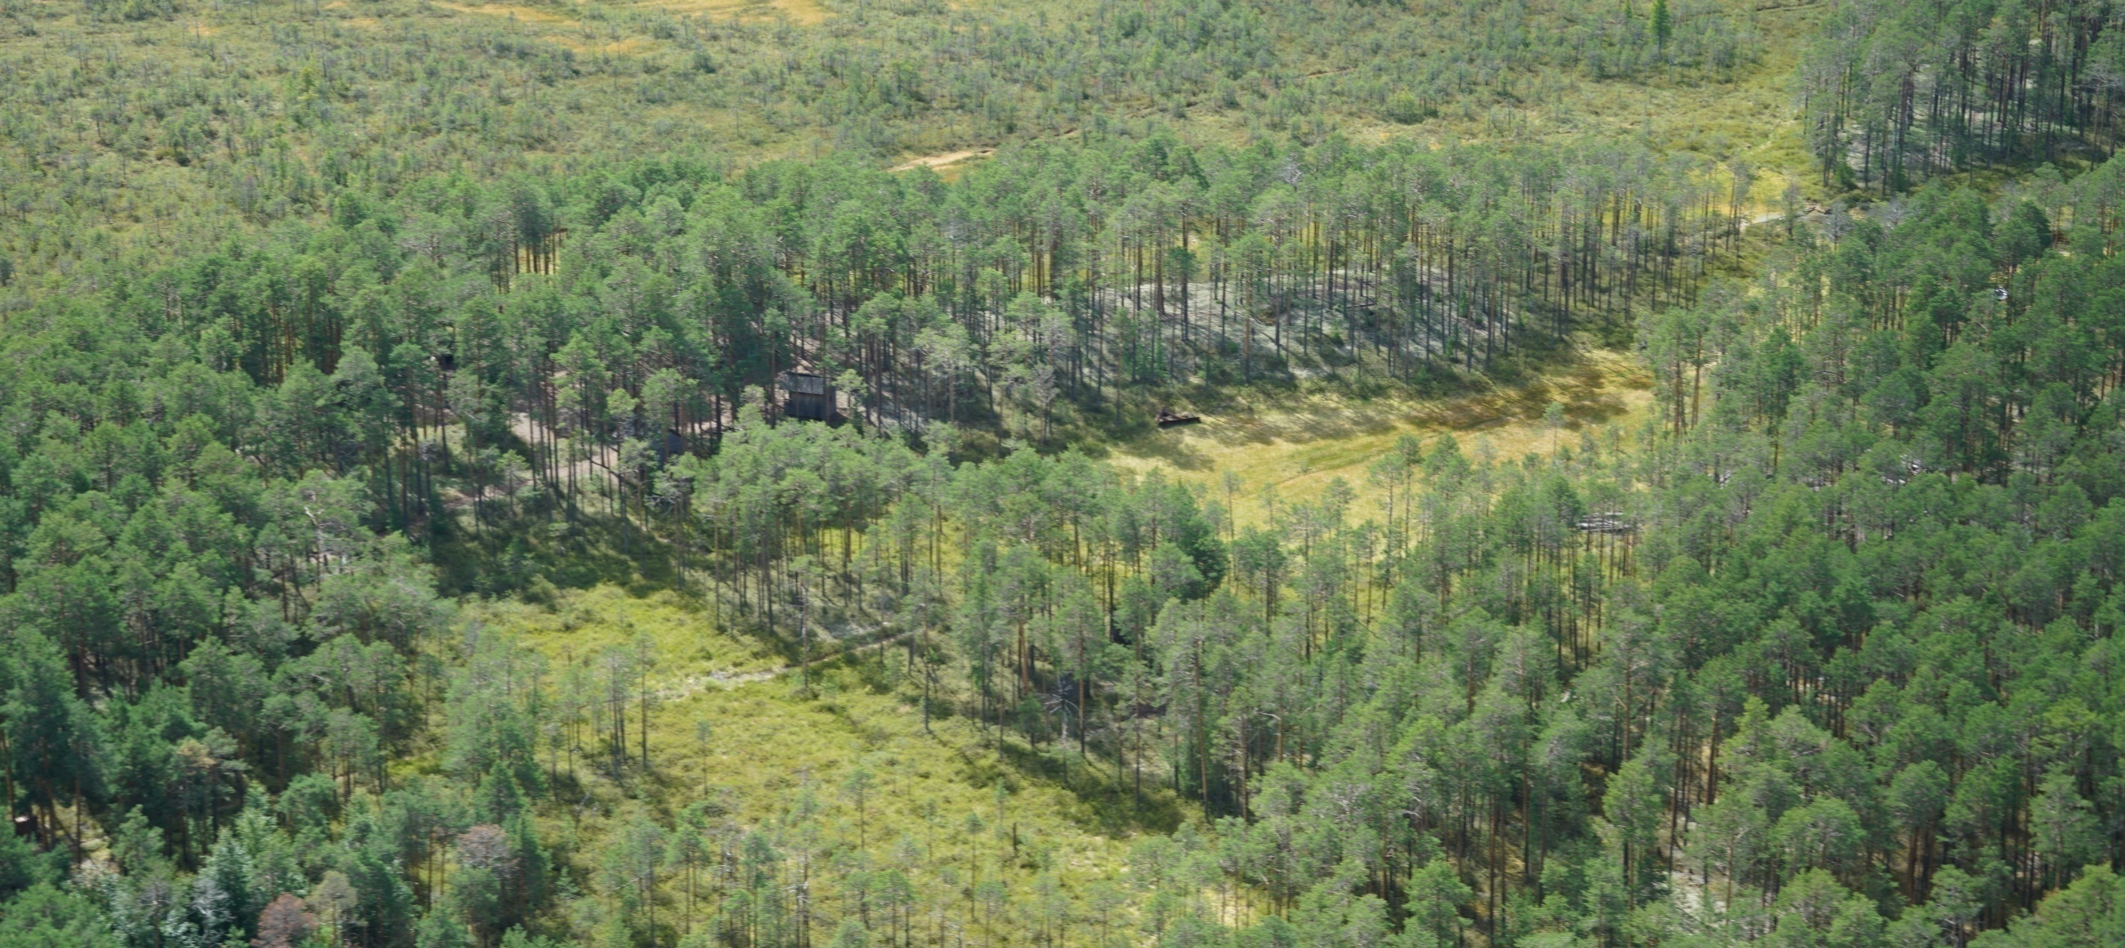
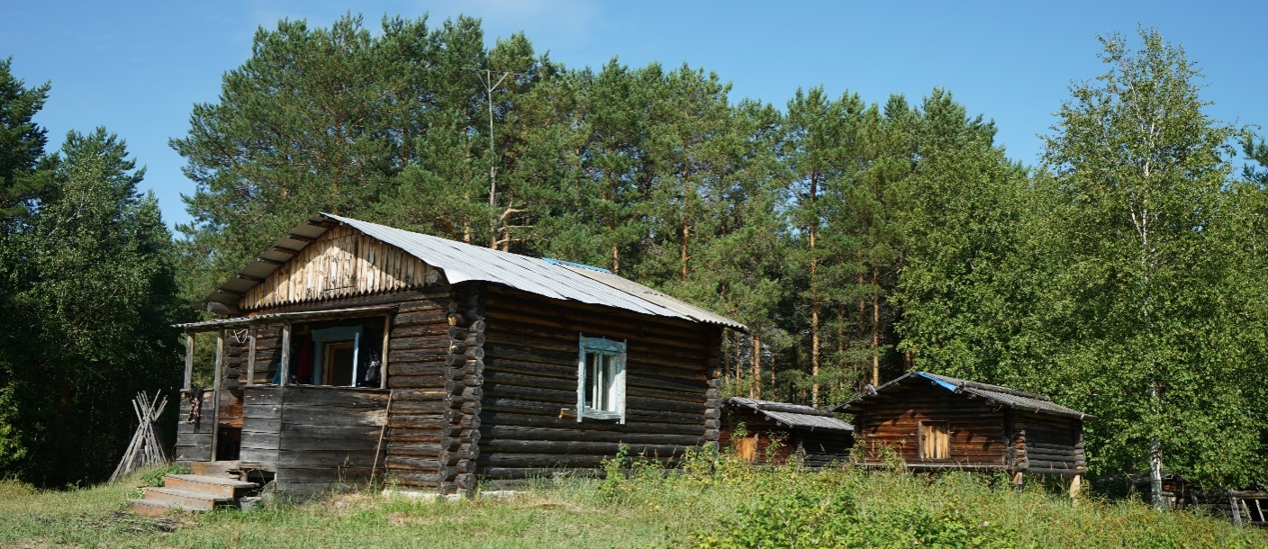
А
Fig. 006. Fortified settlement Kayukovo 2. The first third of the VI mil. BC. А – the archaeological site Kayukovo 1 and Kayukovo 2, general view. Б – Punsy yurtas, near the Bolshoye Kayukovo lake– dwellings and household buildings.
Б

Slide 7
THE SITE KAYUKOVO 2
The defensive and settlement complex Kayukovo 2 is situated near the Bolshoye Kayukovo lake in the watershed of the Bolshoy Salym river and the Bolshoy Yugan river (the left tributaries of the Ob’ river), in the Nefte-Yugansk region of the Khanty-Mansiisk autonomous district, Yugra. The site is situated on the edge of the large sand island, surrounded with raised bogs.
The site was discovered in 1991 and was initially investigated by the survey work group of Vizgalov G.P. In 2000-2002 the archaeological excavations were directed by Kardash O.V. In the summer of 2018 the excavation was continued by the international expedition organized by autonomous non-profit organization Institute of the archaeology of the North, Scientific Production Association ‘The Northern Archaeology’ in partnership with the Institute of History and Archaeology of the Ural branch of the Russian Academy of Science, under the charge of Chairkina N.M. and Institut für Ur- und Frühgeschichte Christian-Albrechts-Universität zu Kiel under the charge of Prof. Dr. Henny Piezonka.
The linear dimensions of the site with the surrounding area are 35x35 m, the area of the site is about 1100-1200 sq.m. The explored with excavation area is 270 sq. m.
Two habitation structures, one non-residential structure, connected with the outer wall/corridor were studied. The area out of the settlement complex was studied as well, there the household constructions were discovered.
The site research was difficult because of the high level of ground waters, the lower part of the cultural layer were permeated with it. It was a result of swamp formation in the bodies of water during millennia.

Slide 8
THE CHRONOLOGY OF THE FORTIFIED SETTLEMENT KAYUKOVO 2
The functioning time of Kayukovo 2 was determined with the radiocarbon dating method. The earliest data were obtained from the sample of the deepest part of the layers. Two of them, which were cross-dated in the laboratory of SB RAS) in Novosibirsk and the Institute for the History of Material Culture of RAS in Saint-Petersburg :
The functioning time of Kayukovo 2 :
The first third VI mil. BC.
The cultural layer morphology and absence of evidence of rebuilding indicate, that the wooden-earthen habitation structure existed for a short period of time, not more than 100 years, it defines the site as a single-layer structure.
# | The year | Sampling location | laboratory of SB RAS) in Novosibirsk |  |  | Laboratory IHMC RAS in Saint-Petersburg
 |  |  | Lab number of the sample | Radiocarbon date | absolute calibrated dates BC | Lab number of the sample | Radiocarbon date | absolute calibrated dates BC
1 | 2000 | Excavation area 1. Building3, the foundation, sq. Л/18; 63.40-63.50 | SOAN-4800 | 6810+55 | 6020-5375 BC end VII – mid VI BC | Le-6206 | 6810+40 | 5739-5635 BC 1st half. VI mil. BC
2 | 2001 | Excavation area 2. Moat (corridor), filling, sq. Д/20; 63.55-63.65 | SOAN-4801 | 6795+65 | 6005-5370 BC end VII – mid VI BC | Le-6207 | 6580+35 | 5611-5479 BC mid. VI mil. BC

Slide 9
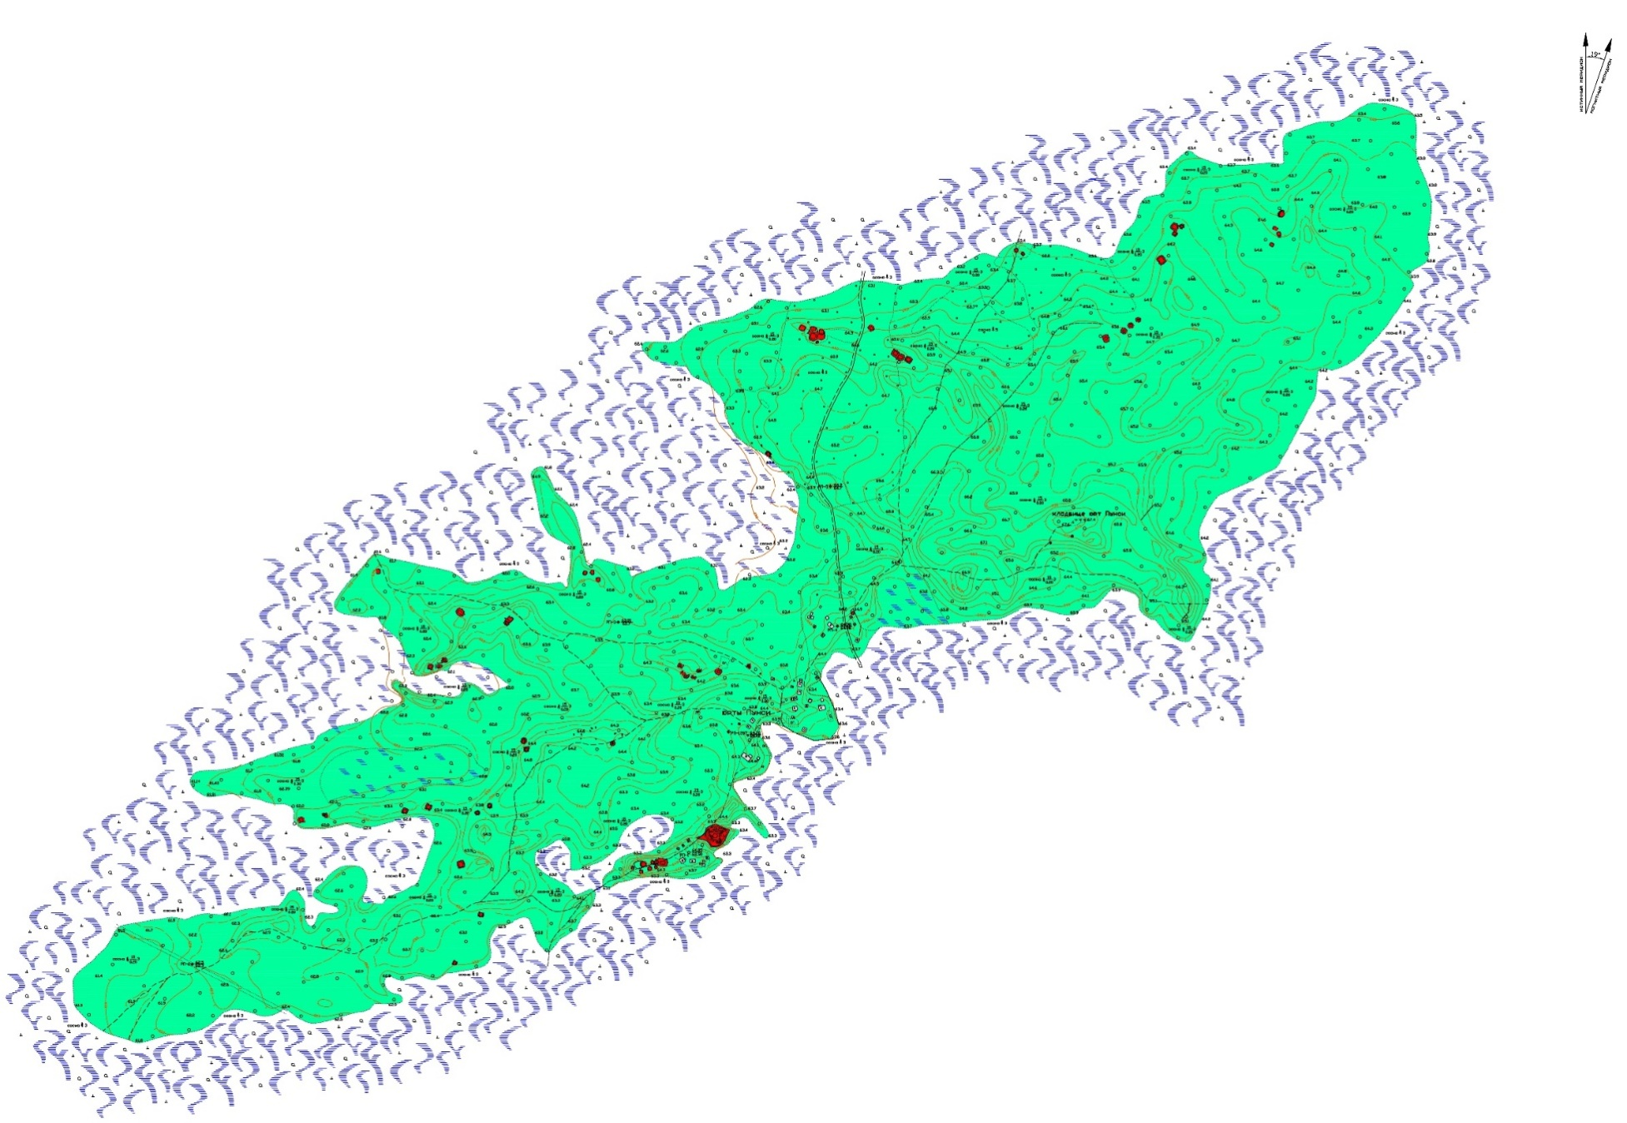
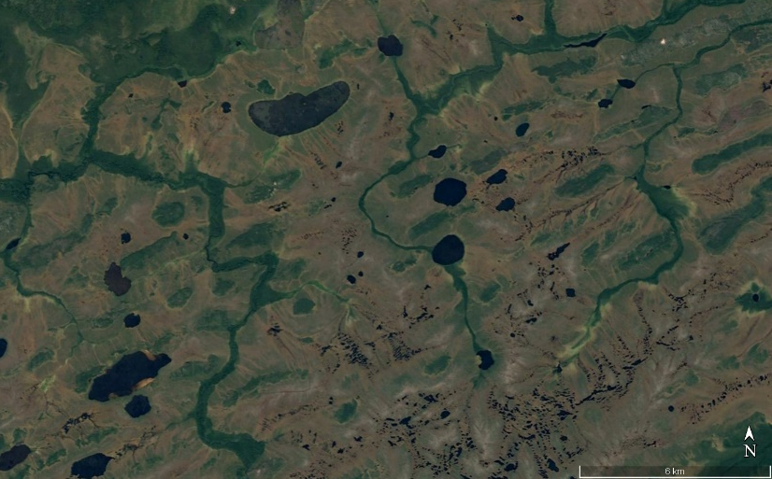
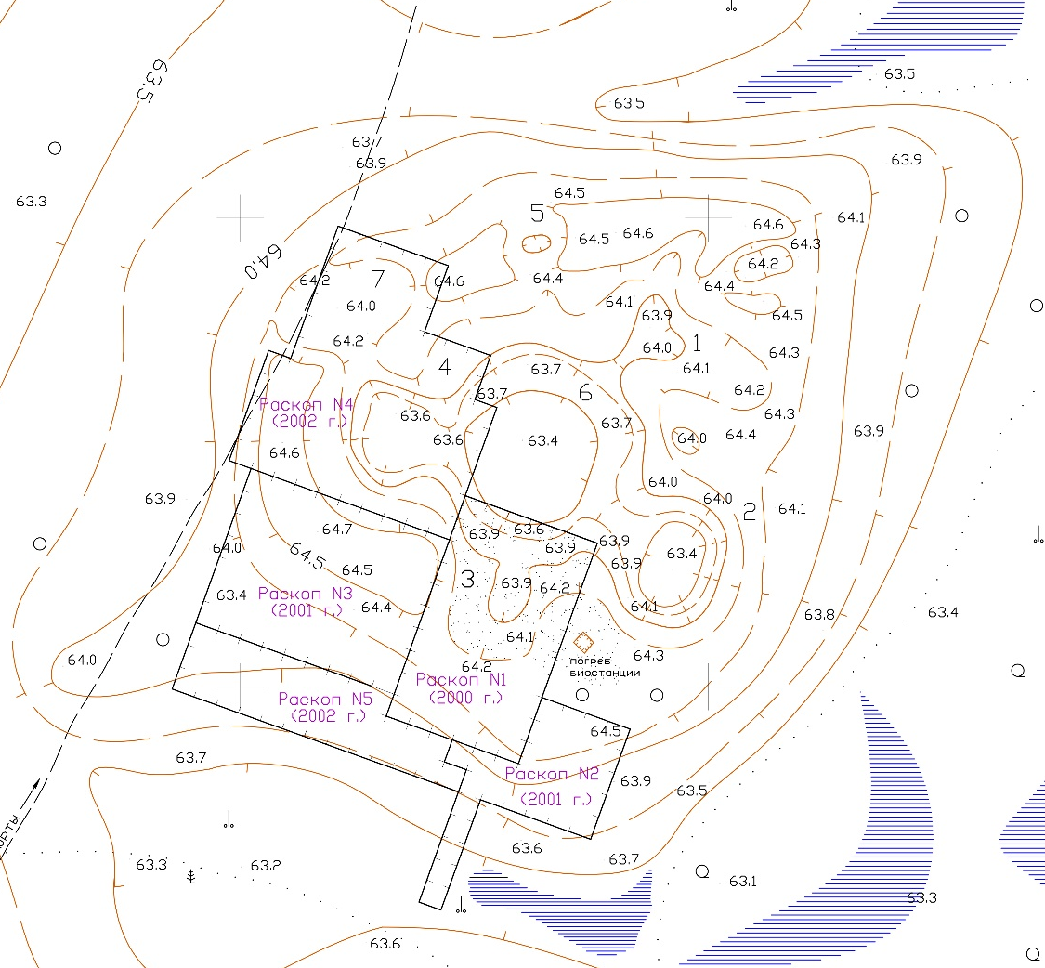
Fig. 009. Fortified settlement Kayukovo 2. The first third of the VI millennium BC. The planimetric map of the archaeological site

Slide 10
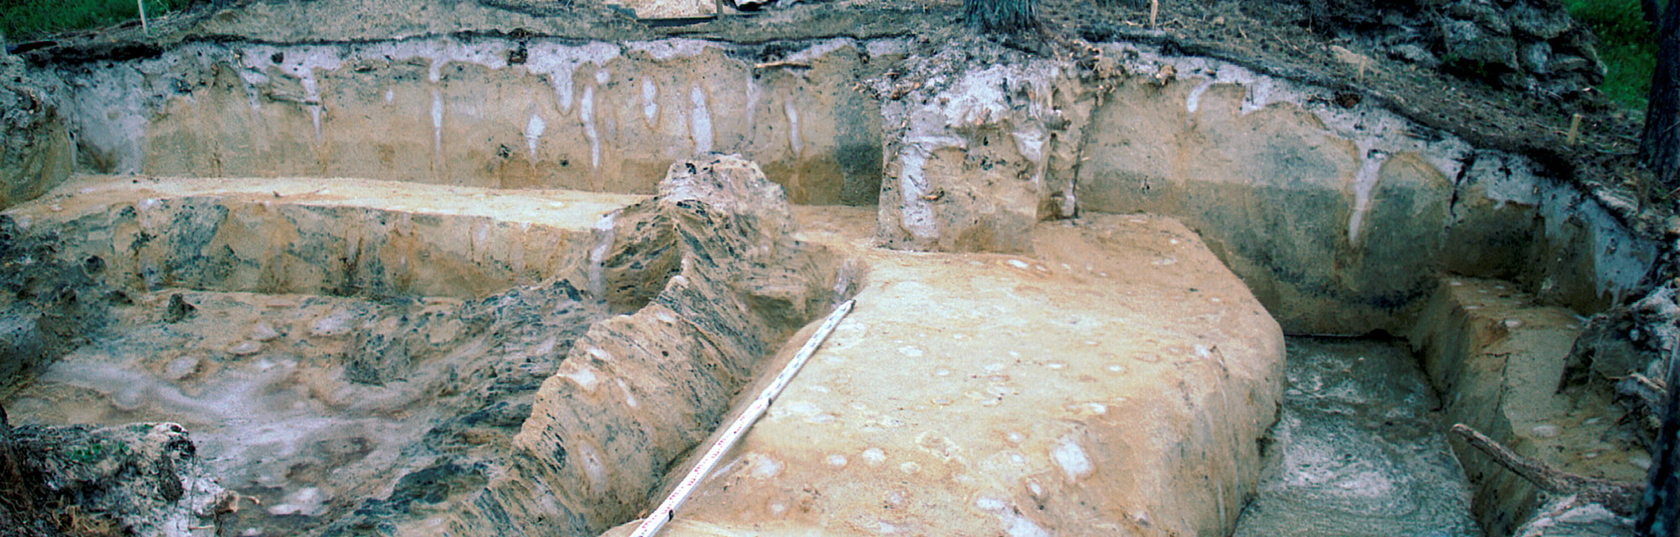
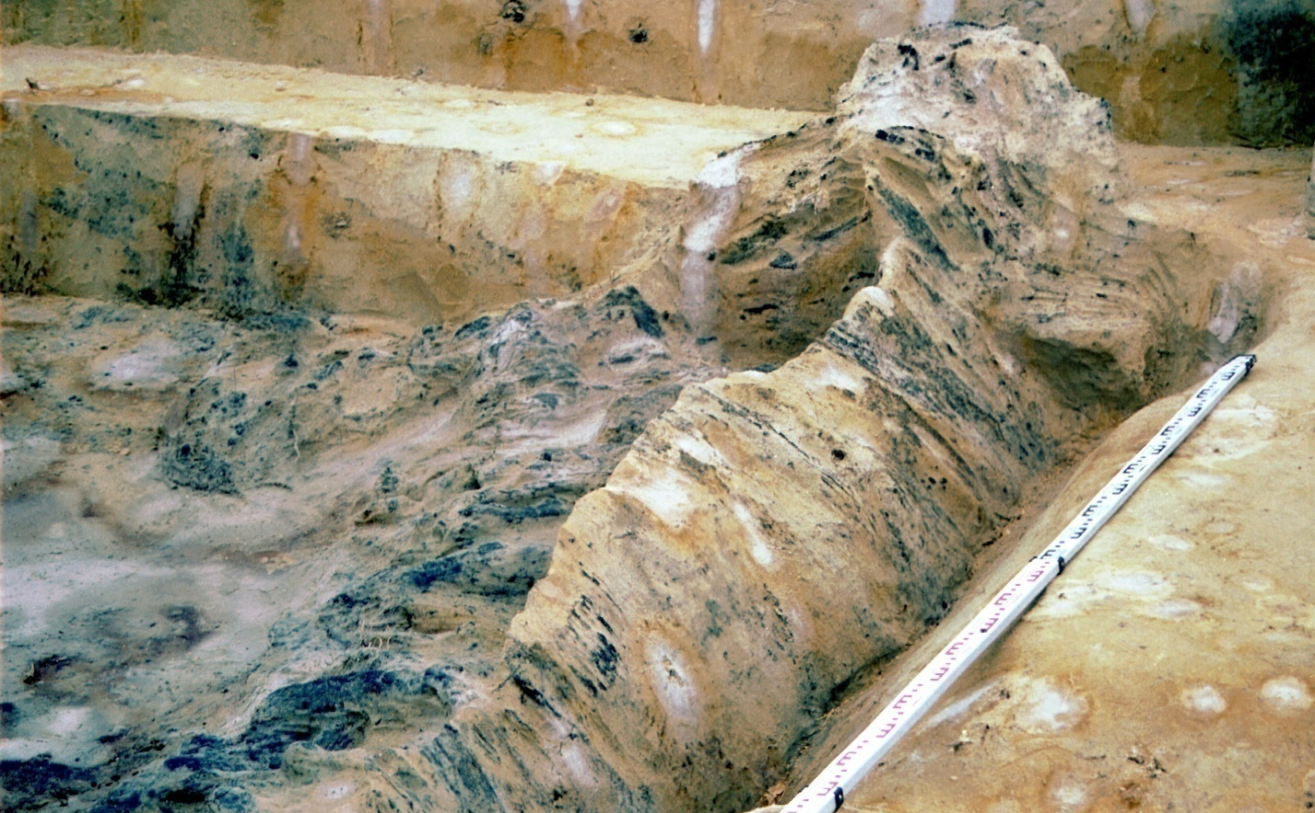
А
В
Fig. 010. Fortified settlement Kayukovo 2. The first third of VI mil. BC. The habitation structure #3 (south-western): А – proportion the structure and the ditch – the construction of the outer wall/corridor-maze.
В – the remains of the burnt wall construction – irremovable frame of the south-western wall of the structure.

Slide 11
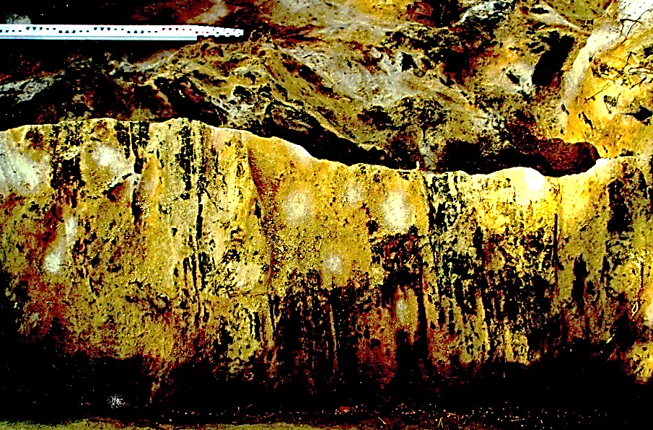
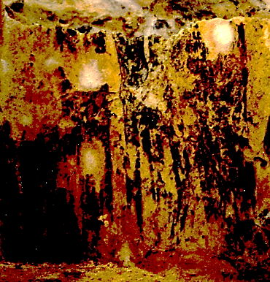
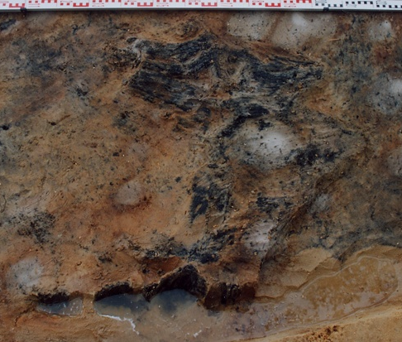
5
1
2
3
4
Fig. 011. Fortified settlement Kayukovo 2. The first third of VI mil. BC. The construction of the frame of the inner structure walls: 1, 2 – the remains of burnt logs (timber) of the frame of the south-western wall # 3; 2, 3 – the remains of burnt logs (timber) of the frame of the south-western wall # 4; 5 – the variant of the graphical reconstruction of the frame of the walls of the settlement complex.

Slide 12
Fig. 012. Fortified settlement Kayukovo 2. The first third of VI mil. BC. The habitation structure # 4 (north-western): the remains of the burnt constructions on the foundation of the south-western wall. The picture was made in 2018.

Slide 13
THE ARCHITECTURE OF THE DEFENSIVE AND SETTLEMENT COMPLEX KAYUKOVO 2
The remains of settlement complex Kayukovo 2 looked like cruciform structure with the diameter about 25 m. of five constructions in the form of hollows (pits): a big central pit connected via the corridors with the four others. The central construction is square in plan view, its size is 6x6 meters, its facades were oriented toward north-west and south-east directions respectively (its corners were close to the axis north-south and west-east).
On the western part the “entrance” to the inner space of the building was discovered, it was marked with the paired fireplaces and pits. The excavated constructions were supposedly the semi-subterranean dwellings; there is a foundation pit about 1 or 2 meters deep, earthen walls and central hearth. The earthen walls were supported with the irremovable frame, made of vertical thin logs.
The habitation structure in the form of ditch 1,0-1,5 meters deep and width was found, it circled almost completely the most part of the settlement complex along the outer perimeter. In the structure there are the remains of the wooden frame that can be the framework of the outer wall or the roofed tunnel from the north-western structure 4 to the western complex entrance.
The important fact is that all the structures, including the outer wall-tunnel, were deliberately burnt. The action of deliberate burning is confirmed with simultaneous fire outbreak and simultaneous flame extinction because of construction demolishing.

Slide 14
Fig. 014. Fortified settlement Kayukovo 2. The first third of VI mil. BC. The nonresidential construction #7 (entrance space), connected via the corridor with the habitation structure # 4 and the corridor-tunnel, circling the settlement complex.

Slide 15
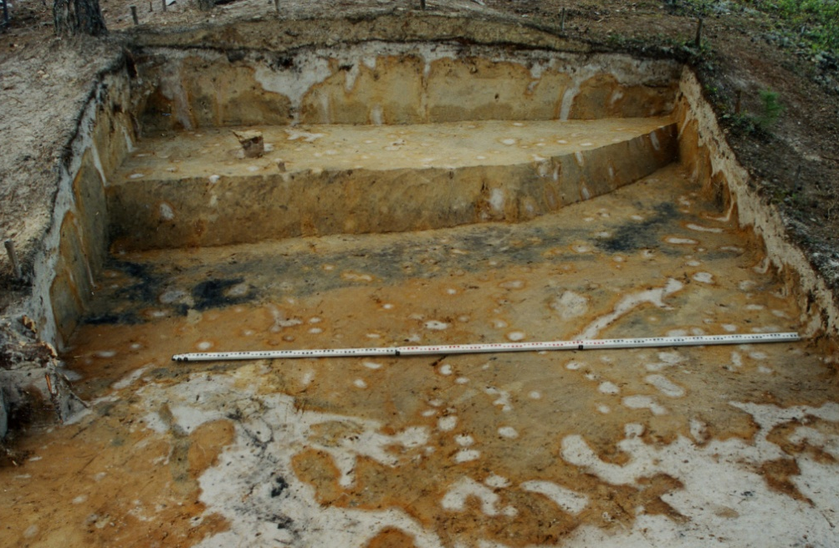
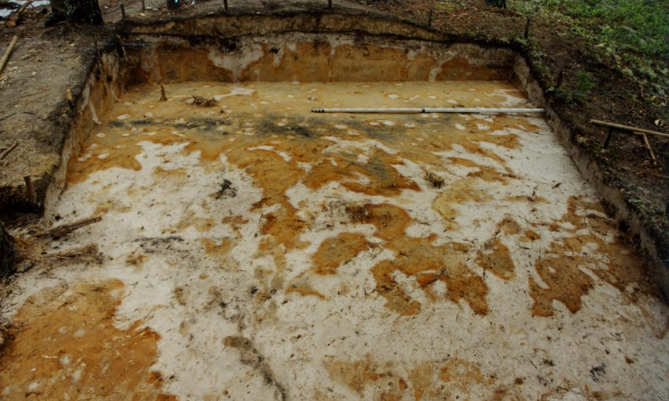
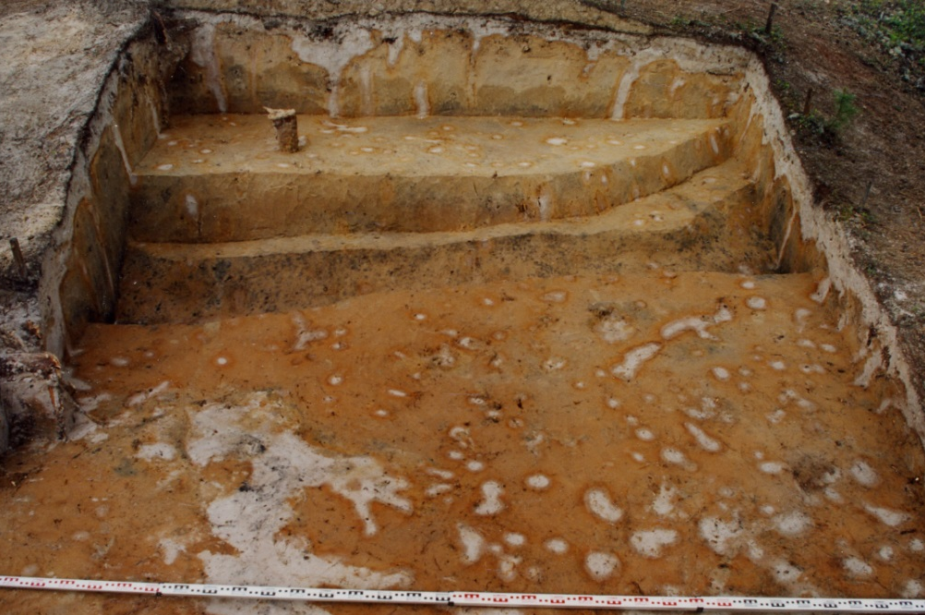
1
4
5
2
6
7
3
Fig. 015. Fortified settlement Kayukovo 2. The first third of VI mil. BC. The southern surrounding area of the settlement complex. The remains of the constructions of the outer wall/corridor-tunnel: 1-3 – the stages of the work in the culture layer; 4-5 – the foundation of the wall construction in the shape of ditch; 6-7 – black, saturated with coal filling is taken out according to its outlines.

Slide 16
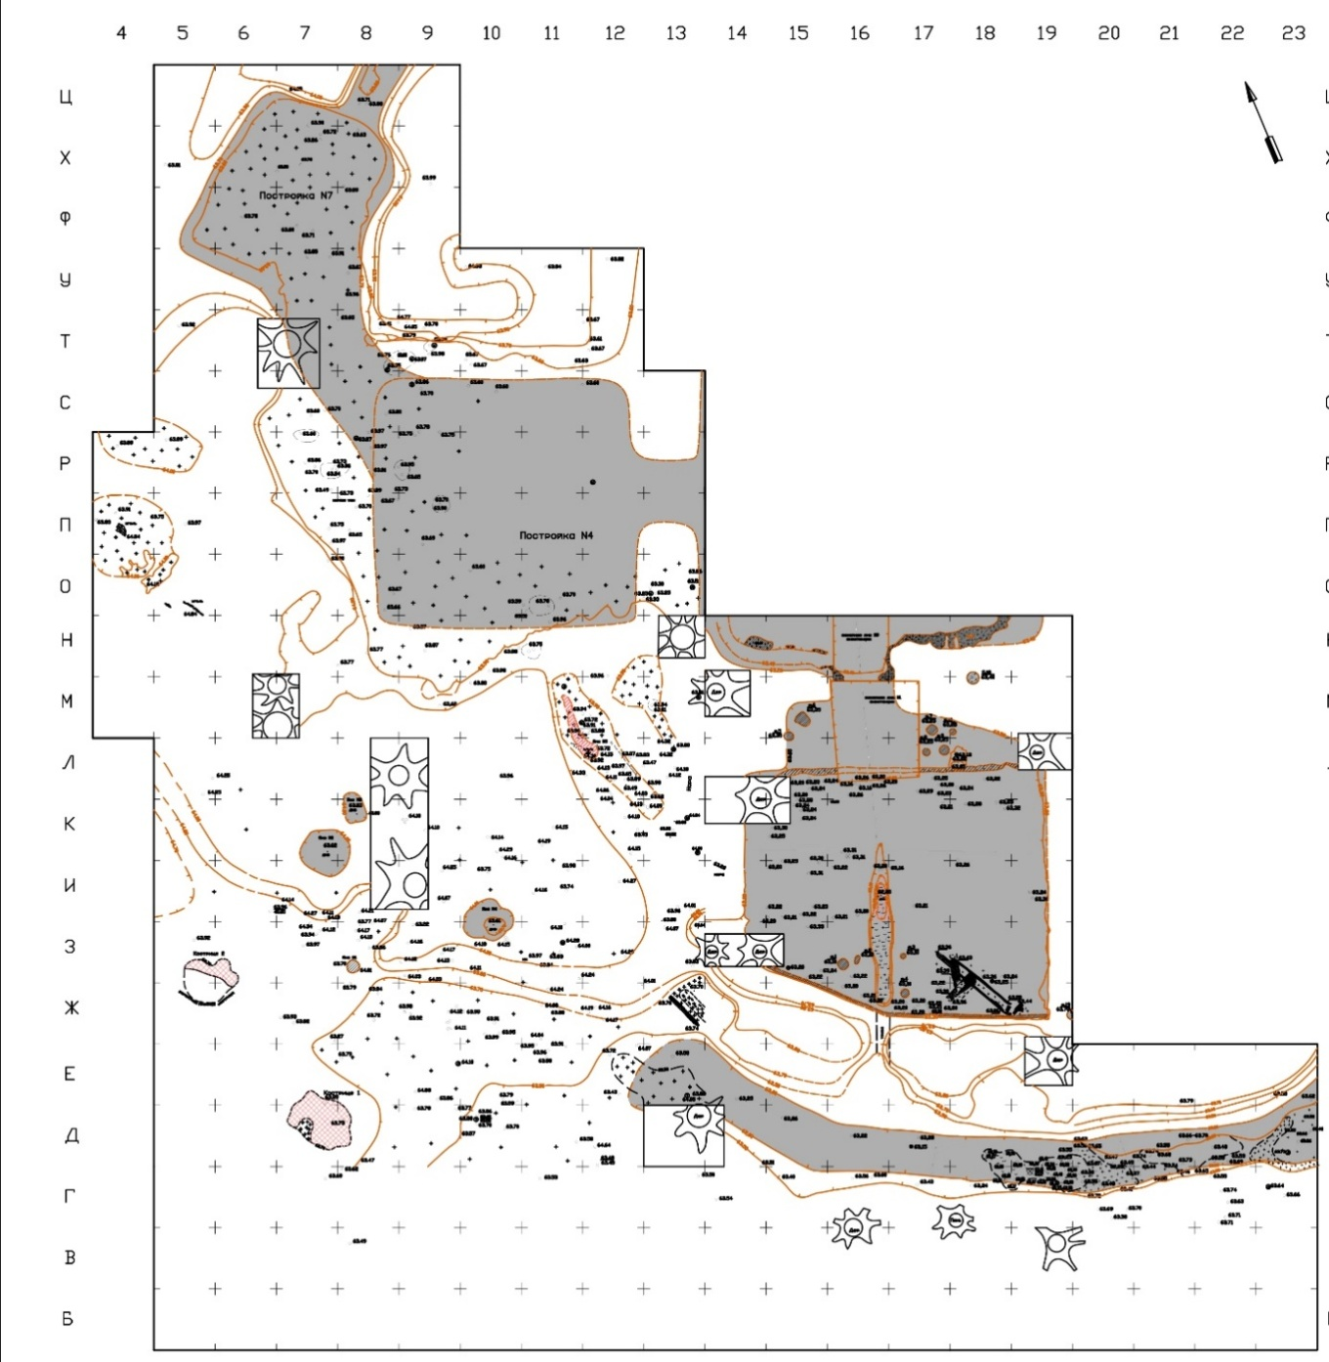
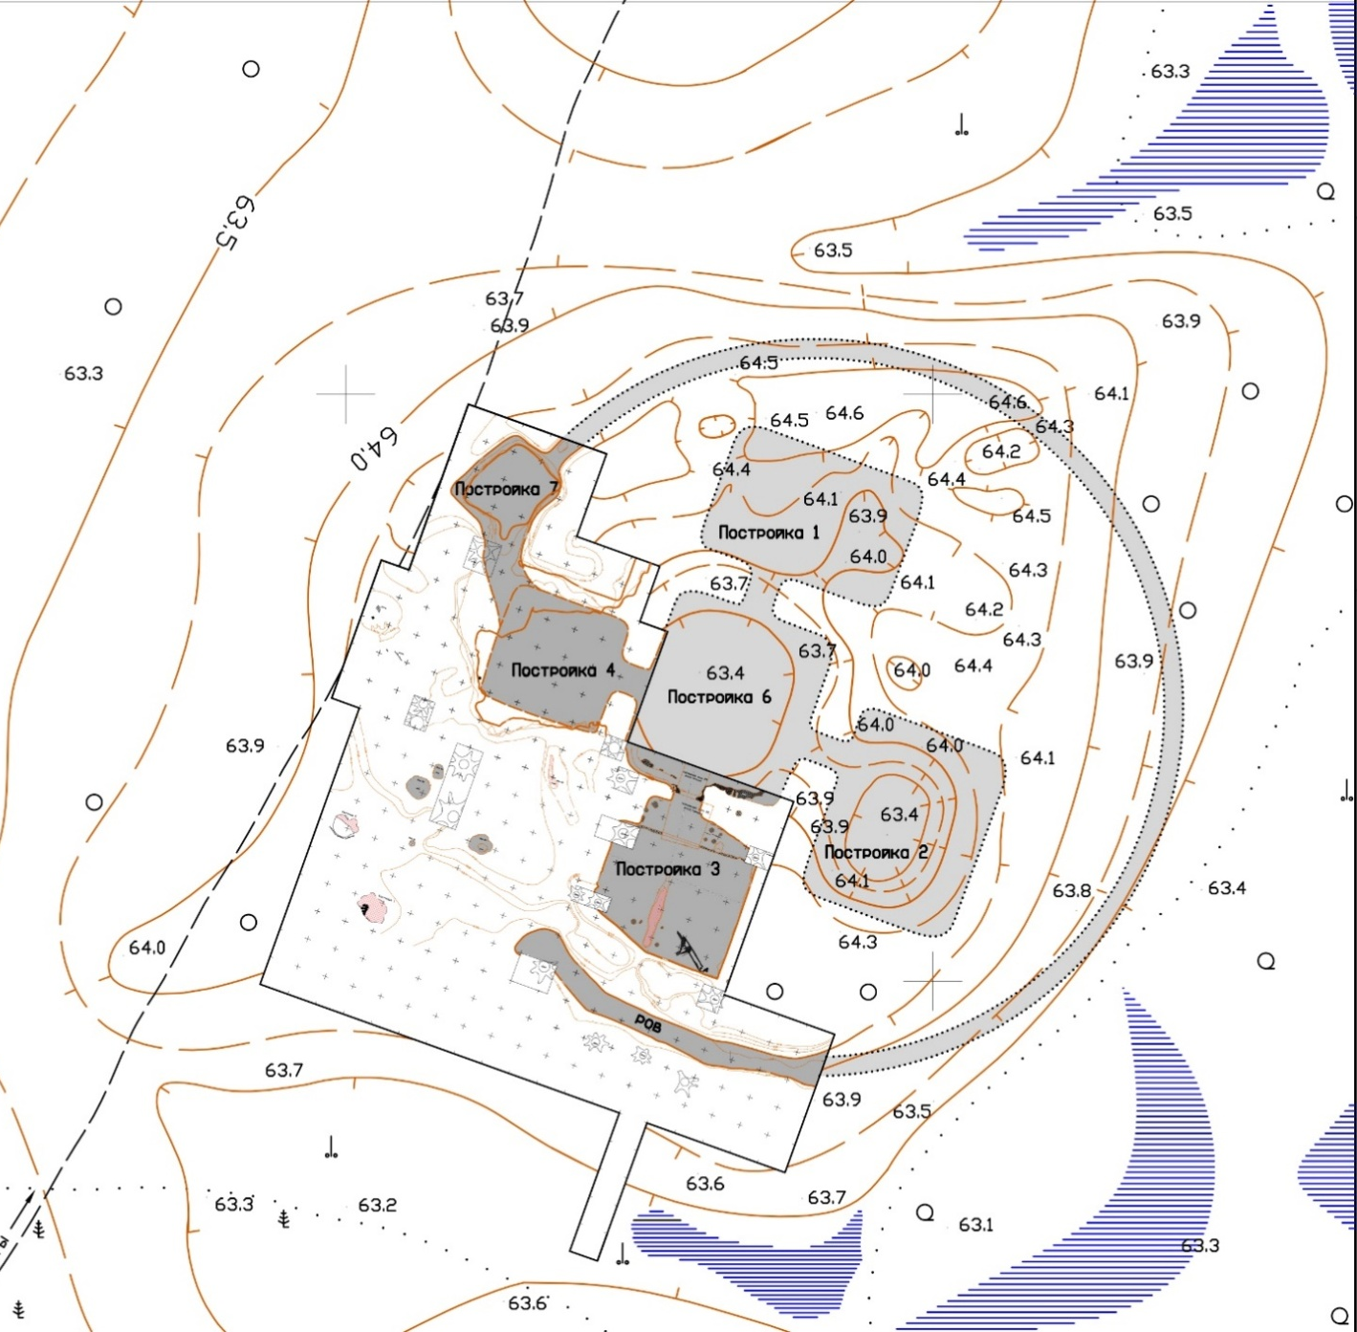
А
В
Fig. 016. Fortified settlement Kayukovo 2. The first third VI mil. BC. А – master plan of the excavation areas of 2000-2002, 2018 years; В – A variant of reconstruction of plan structure of the fortified settlement Kayukovo 2, made on the basis of the master plans of the excavation areas combined with the master topographic plan of the site.

Slide 17
THE ARTEFACT COMPLEX OF THE FORTIFIED SETTLEMENT KAYUKOVO 2
In the artefact collection there are fragments of 80-90 pottery vessels. All vessels are similar to each others, the most common are the sphero-conical vessels with wide open mouth, thick walls and flat cylindrical bottom. There are very few vessels with rounded and pointed bottom.
The outer surface of the vessels is completely covered with ornament. Most of the vessels have undulating edge, made with finger pressing. Below it the upper part is decorated with the belt of large foveolar imprints. The ornaments, mostly linear, consist of the parallel row, they were made by stick impression with shift “shifted stick”. Comb stamp was used rarely, usually as a dividing as well. Variety of ornamental compositions is an important characteristic. There are vertical, horizontal, diagonal and scaly ornamental compositions and their variation. All of the flat bottoms are ornamented with symbolic pictures – labrys or solar cross, which were widely used in the Neolithic period – the Bronze Age of Western Asia, Mediterranean region and Black Sea region. At least part of the vessels was coloured with ochre.
Sculpted statuettes should be mentioned as a part of ceramic items. Four statuettes were found: 3 fragments of bird, supposedly goose, statuettes and one, probably, human statuettes. The shape of the head and the edge are similar with female statuettes of Tripol culture (V-VI mil. BC) of the South-Eastern Asia.
There are little of stone artefacts, not more than 50 items. They are grinded implements and abrasives. Adzes with longitudinal channel and knives in the shape of sickle are typical and were not found in the other Neolithic sites in the region. The tools were made of the rocks, which cannot be found in the Western Siberia, but were common in the Southern Urals and Kazakhstan.

Slide 18
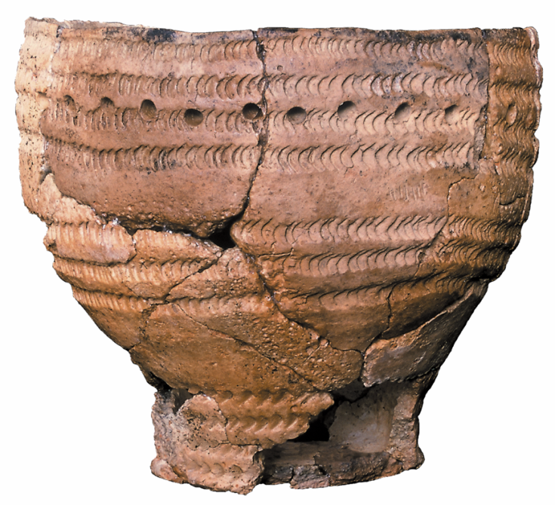
1
2
3
Fig. 018. Fortified settlement Kayukovo 2. The first third VI mil. BC. Pottery vessels: artefacts and graphical reconstructions: 1 – vessel #1 (was found in the foundation of wall construction); 2 - ; 3 – vessel #3 from the construction #4 and ditch.

Slide 19
1
3
2
Fig. 019. Fortified settlement Kayukovo 2. The first third VI mil. BC. Pottery vessels: artefacts and graphical reconstructions from the construction #4: 1 – vessel #15; 2 – vessel #16; 3 – vessel #17.

Slide 20
Fig. 020. Fortified settlement Kayukovo 2. The first third VI mil. BC. Pottery vessels: artefacts and graphical reconstructions.

Slide 21
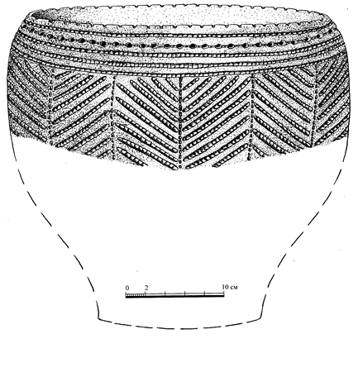
2
3
1
Fig. 021. Fortified settlement Kayukovo 2. The first third VI mil. BC. Pottery vessels: artefacts and graphical reconstructions : 1 – vessel #13 (the western periphery); 2 – vessel #12 (the western periphery); 3 – vessel #2 (the construction #3).

Slide 22
3
2
1
4
5
6
Fig. 022. Fortified settlement Kayukovo 2. The first third VI mil. BC. 1 – the pottery vessels from the moat (corridor-maze); 2 – a fragment of the bottom of the vessel with the solar sign; 3 – fragments of the ochre-coloured pottery vessel; 4,5 –

Slide 23
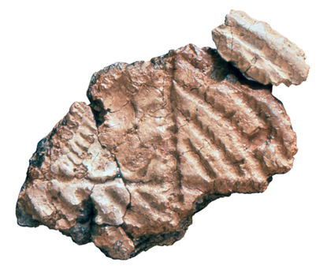
Fig. 023. Fortified settlement Kayukovo 2. The first third VI mil. BC. Solar ornaments at the flat bottoms of the vessel: 1 – labrys-like ornament, 2 – the ornament of solar cross (solar wheel)

Slide 24
Fig. 024. Fortified settlement Kayukovo 2. The first third VI mil. BC: sign-symbolic ornaments at the bottoms of vessels.

Slide 25
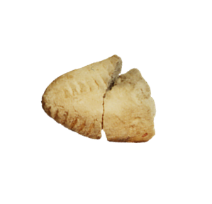
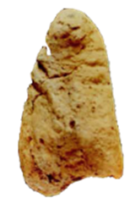
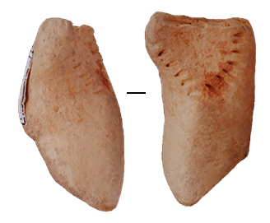
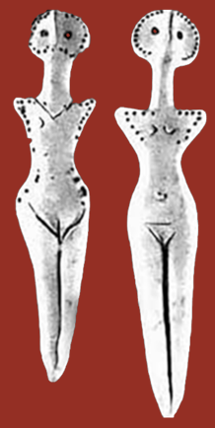
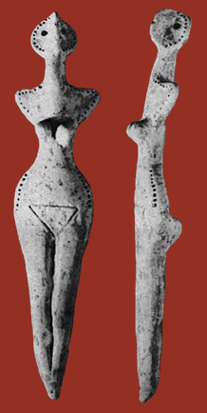
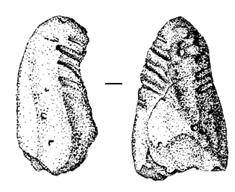
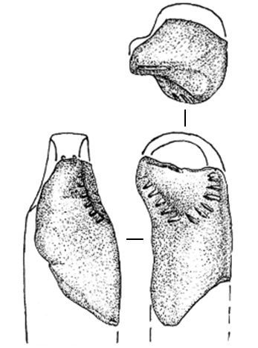
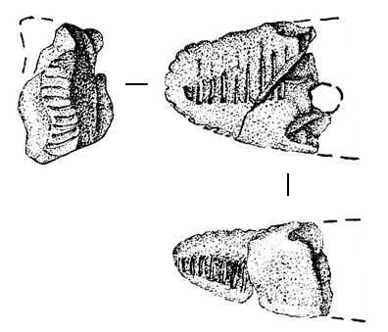
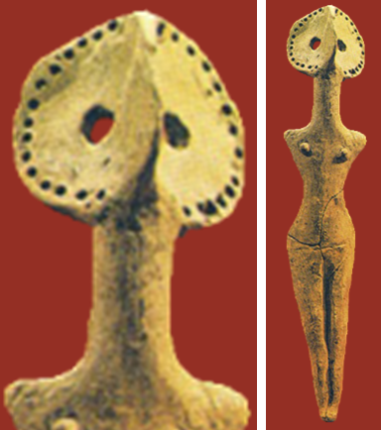
3
2
1
4
Fig. 025. Fortified settlement Kayukovo 2. The first third VI mil. BC. Sacral ceramic statuettes: 1 – bird statuette (goose?), fragment of the back part; 2 – bird statuette (goose?), the fragment of head; 3 – human statuette (?), fragment; 4 – female statuette of Tripol culture of V – mid. IV mil. BC.

Slide 26
4
1
3
2
5
Fig. 0261. Fortified settlement Kayukovo 2. The first third VI mil. BC. 1 – vessel #15 with vertical ornament; 2 – the reconstruction of the ornamental composition of the vesselа #15; 3 – vessel of the Eneolithic Age with the ornamental composition analogous with the vessel #15 (Western Asia, Istanbul, the Archaeological museum); 4 – fragment of vessel, the bottom with labrys-like image; 5 – bottom of vessel from the Western Asia with the analogous labrys-like image.

Slide 27
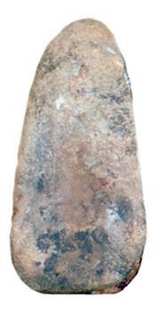
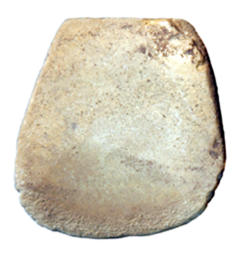
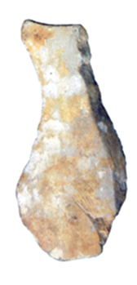
1
2
3
4
5
1
1а
4
5а
4а
2
2а
Fig. 027. Fortified settlement Kayukovo 2. The first third VI mil. BC. Stone implements: 1 – 3 – adzes with longitudinal channel; 4 – 5 – knives in the shape of sickle.

Slide 28
CONCLUSION ON HUMAN DIFFUSION ON THE TERRITORY OF THE NORTH OF THE WESTERN SIBERIA
Settlement complex Kayukovo 2 unique characteristics , which are not typical for the Neolithic sites in Yugra:
Sophisticated architectural and plan organization of the settlement, unusual for the North of the Western Siberia. These defensive settlement complexes mark, probably, the societies with more complicated social structure than simple groups of ancient hunters and gathers.
2. The architecture of Kayukovo 2 is analogous may be comparable with the constructions of ancient preagricultural societies of Western Asia, (Gebekli Tepe in the southern-eastern Turkey), there are two common characteristics:
architectural organisation of the space of the structures inside the circle
spiral bypass corridor along the outer diameter
3. Pottery vessels with flat bottom ornamented with sign-symbolic composition: labrys, solar cross, as well as ochre colouring, shape of sacral statuettes, all that are parallel to archaeological materials from the early periods of the Central Eurasia.
4. Stone implements of unique shape: adzes with longitudinal channel and knives in the shape of sickle, made of the rocks, originated from the Southern Urals and Kazakhstan
The listed above hallmarks suggest that population of Kayukovo 2 originated or was connected to the some archaeological cultures of the Western Asia and the South-Eastern Europe.

Slide 29
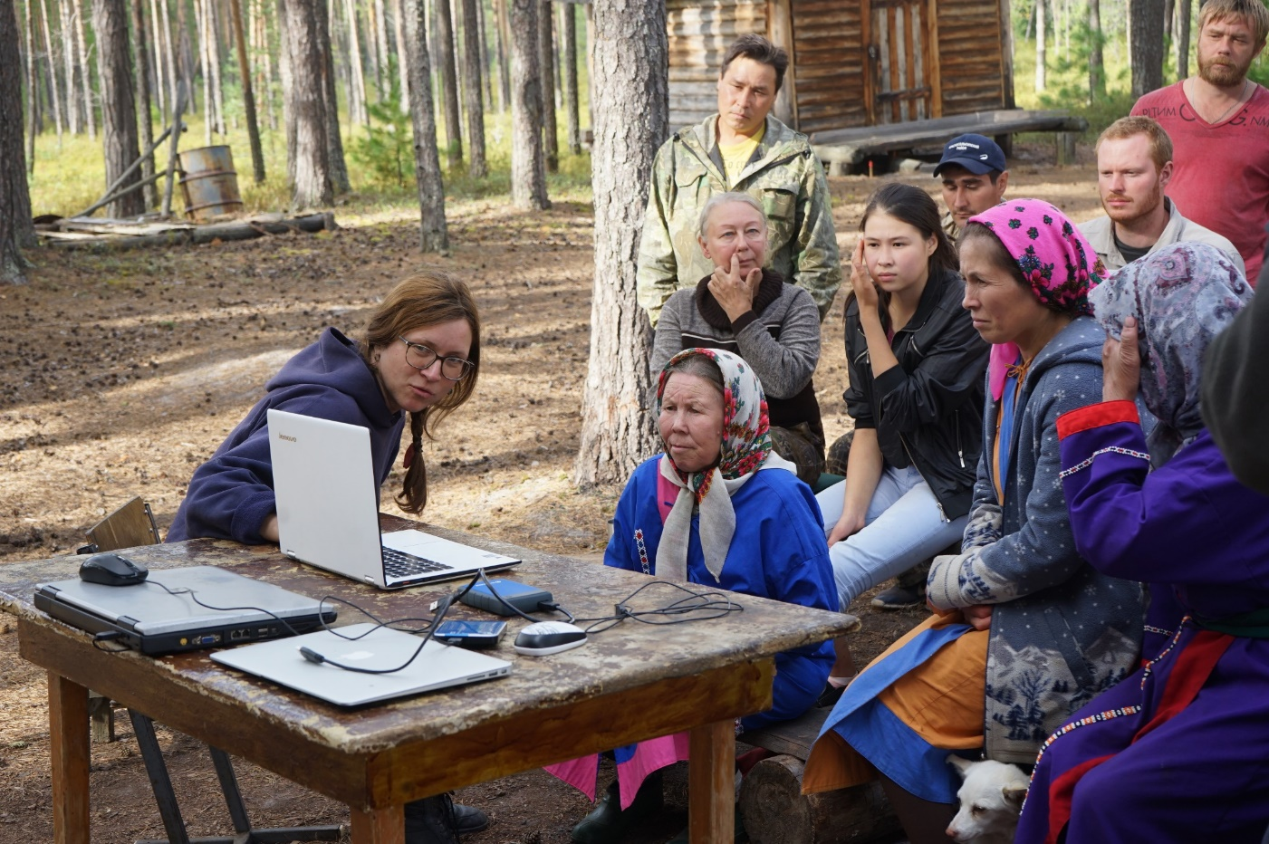
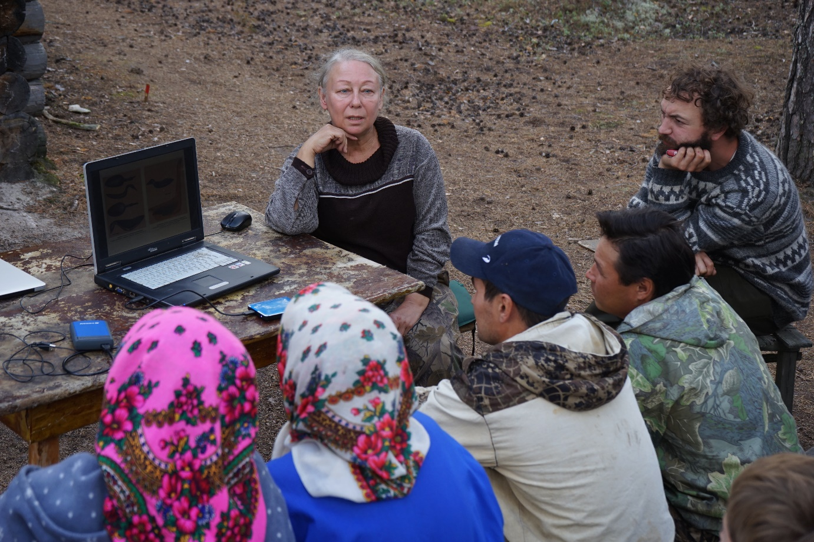
А
Б
Fig. 029. Fortified settlement Kayukovo 2. Diring the work of the international expedition Punsy-2018 the workshop was held for the participant and inhabitants of Punsy yurtas (Kayukov families). А – The report of the professor of Kiel University Dr. Henny Piezonka. Б – The report of vice-director of the Institute of History and Archaeology of the Ural branch of RAS Dr. Chairkina N.M.

Slide 30
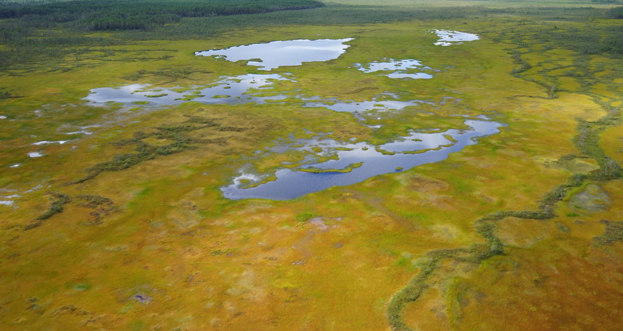
Oleg Kardash – e-mail: kov_ugansk@mail.ru
George Vizgalov – e-mail: vizgalovgp@mail.ru
Henny Piezonka – e-mail: hpiezonka@ufg.uni-kiel.de
THANKS FOR ATTENTION!
Complex architectural structures of the early Neolithic of the North Siberia
(based on materials from the ancient settlement Kayukovo 2)

